Slide 1
LEQ: What are the characteristics of African Kingdoms?

Slide 2
Bell Ringer
Evaluate Hammurabi’s law codes. Why are they historically significant?

Slide 3
Egypt
Geography
Nile River
Sahara Desert
South of Egypt- Red Sea

Slide 4
Egypt
Government
Theocracy –ruled by religious figures
Pharaoh- king/god

Slide 5
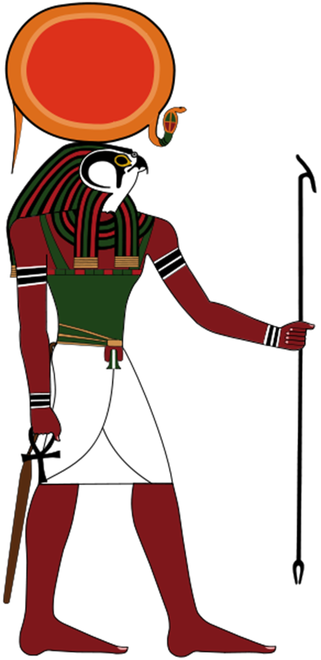
Egypt
Belief System
Polytheistic
Did believe in after life

Slide 6
Egypt
Economy:
Trade
Farms

Slide 7
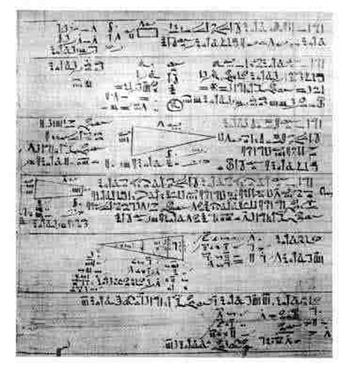
Egypt
Accomplishments:
Writing- Hieroglyphics
Math
Medicine

Slide 8
Egypt’s Decline
Persian’s conquer and kill last pharaoh

Slide 9
Now Let’s See It!
https://www.youtube.com/watch?v=KdtgX9ORiW4 (3:08)

Slide 10
Aksum
Geography
Along the Red Sea
Access to Indian Ocean
Highlands

Slide 12
Aksum
Government:
Strong centralized government
Focus on military

Slide 13
Aksum
Belief System:
Due to trade routes, Aksum will become Christian

Slide 14
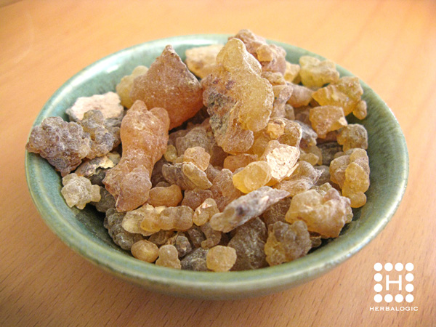
Aksum
Economy
Trade
Ivory, frankincense, gold and slaves

Slide 15
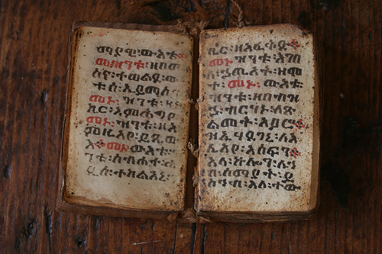
Aksum
Accomplishments:
Diverse culture
Minted coins
Written language- Ge’ez and Swahili

Slide 16
Aksum
Decline
Muslim invaders conquered ports

Slide 17
Now Let’s See It!
https://www.youtube.com/watch?v=S3G5ZklLkm0

Slide 18
Ghana (later become Mali)
Geography:
Land locked by the Sahara Desert

Slide 19
Ghana
Government:
Centralized government
Military

Slide 20
Ghana
Belief System:
Muslim… Islam is introduced by traders

Slide 21
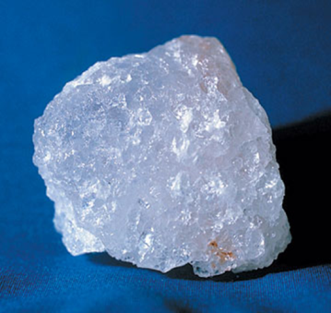
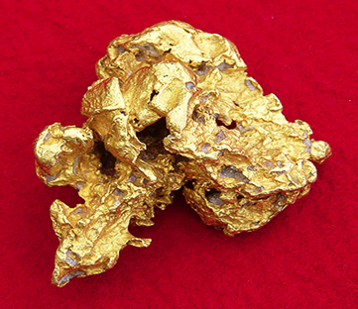
Ghana
Economy:
Caravan trading
Would trade their gold for salt and then trade salt with the South

Slide 22
Ghana
Accomplishments:
Timbuktu: large center for learning and literacy

Slide 23
Ghana
Decline:
Try to expand north, empire weakens and people rebel
Mali arose

Slide 24
Writing Assignment- Journal Entry (at least 5 sentences)
Pick one African Kingdom.
Imagine you are a citizen of that African Kingdom.
What is your life like?
What is your job?
Do you enjoy your home?
Be creative! Use your knowledge!

