Slide 1
LEQ: Why are humans civilized?

Slide 2
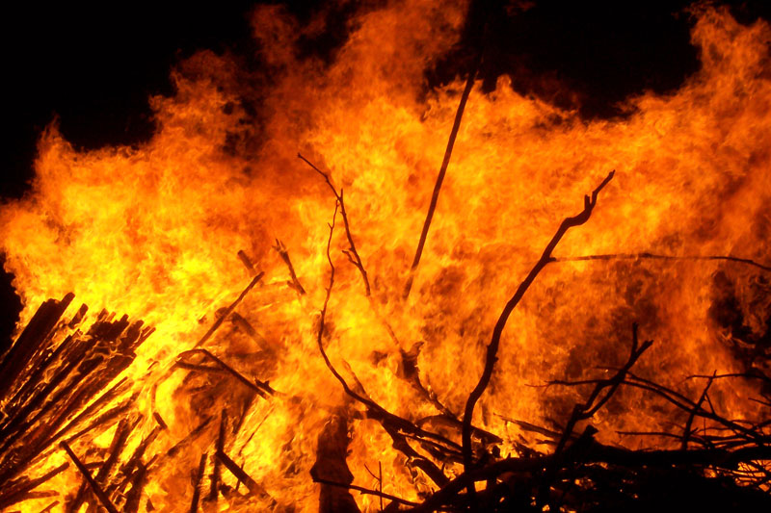
Bell Ringer
Explain why fire was an important technological development for humans?

Slide 4
The Stone Age
Hunter-gathers: hunted animals and gather wild plants to survive

Slide 5
New Stone Age (Neolithic Era)

Slide 6
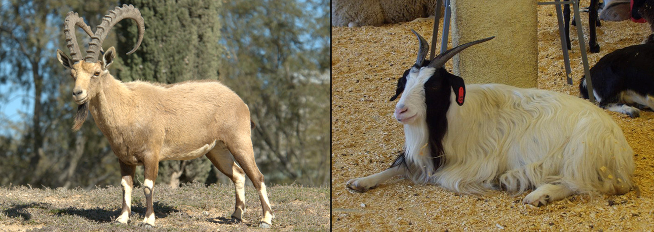
Neolithic Revolution (Agricultural Revolution)
People began to farm and domesticate animals

Slide 7
Results
Increase population
Reliable food supply
Settlements

Slide 8
Now Let’s See It
https://www.youtube.com/watch?v=bhzQFIZuNFY (3:17)

Slide 9
Changes (continued)
Pastoralists: people who ranged over wide areas and kept herds of livestock

Slide 10
Changes (continued)
Disease spread
Crop failures led to famine
War

Slide 11
Changes (continued)
Bronze Age
Starting to use metal for tool

Slide 12
Now Let’s Review
Paleolithic
Neolithic

Slide 13
Foundations of Civilization

Slide 14
From Villages to Cities
Irrigation helped produce a surplus
Surplus helped create a division of labor & traditional economy
Trade increased
Notes:
Traditional economy- economic decisions based on custom, tradition or ritual

Slide 15
First Civilizations
Civilization: complex and organized society
Arose in fertile river valleys

Slide 17
Change in Civilization
Environment
War
Movement
Ideas

Slide 18
Change in Civilization
Cultural Diffusion: the spread of ideas, beliefs, skills, customs and technology from one culture to another

Slide 19
Review
Why did humans move from villages to cities?
What are the 7 characteristics of civilization?
Where did the first civilizations arise?

Slide 20
Map Activity

Slide 21
At the bottom of your notes construct your summary of todays’ lesson.
What did you learn?
What are today‘s key concepts?
Remember, your summary just be an extensive answer to today’s lesson essential question.
4-5 sentences

Slide 22
Bell Ringer
Analyze one impact of the agricultural revolution.
Remember analyze means to examine critically, so as to bring out the essential elements or give the essence of.

Slide 23
LEQ: How did Mesopotamia contribute to the advancement of civilizations?

Slide 24
First Known Civilization: Mesopotamia
Refer to your map from… what two rivers flow through Mesopotamia?
Now record the names of these two rivers in the section of notes for today

Slide 25
Geography
Fertile Crescent: Between Mediterranean Sea and Persian Gulf. Rich soil from silt
Notes:
The modern-day countries with significant territory within the Fertile Crescent are Iraq, Kuwait, Syria, Lebanon, Jordan, Israel, Palestine, Cyprus, and Egypt, besides the southeastern fringe of Turkey and the western fringes of Iran.

Slide 26
Problems
Little rain
Sudden floods
Hot dry summers

Slide 27
Solutions
Dams and dikes
Allocate resources
Assign jobs

Slide 28
Sumer (region in Mesopotamia)
First civilization
City State: political unit with own gov’t
Ziggurat: Temple; polytheism
Notes:
Within Sumer there was 7 city states

Slide 29
Sumer
Culture
Cuneiform: first writing system; wedge symbols on clay
Epic of Gilgamesh
Notes:
Sumerians developed math system, invented the wheel, plow and learned how to use bronze

Slide 30
Accomplishments of Sumer
During the video, record at least 2 accomplishments of the Sumerians.
https://www.youtube.com/watch?v=u-n84sDBEB4 (2:49)

Slide 31
Empires in Mesopotamia
Warfare weakened Sumer’s city states
Invading peoples conquered the region

Slide 32
Now Let’s Review- tree map

Slide 33
Babylonian Empire
Amorites

Slide 34
Hammurabi
King of Babylon- 1792 BCE
Created Babylonian Empire

Slide 35
Hammurabi
Accomplishments:
Buildings
Tax-collection
Increased trade
Cultural diffusion

Slide 36
Hammurabi
Hammurabi’s Code: code of laws… was written down for all to see

Slide 37
Now Let’s See It
https://www.youtube.com/watch?v=eXvM_0rFO-w

Slide 38
Review (tree map)

Slide 39
Primary Source Analysis: Hammurabi’s Code

Slide 41
Construct Your Summary
What did you learn today?
What connections did you make today?
What are some of the major themes we discussed today?
4-5 sentences

