Slide 1
APWH Compare and Contrast Essay
Ms. Allen

Slide 2
On the test day…
Typically this is the last essay in the FQR booklet
Strongly recommend that you write the DBQ first and then the CC
Notes:
Write them in any order but you have to identify them in your writing booklet. DBQ, if you know the rules and the strategies then you can tackle that np, and plus you need time to analyze the docs.

Slide 3
Time
Should take about 30 minutes to write
Take some time to outline some information… maybe do a Venn-Diagram
A graphic organizer will help you with your thesis statement
Notes:
Create some organization. See the strong simliarity, or strong difference so you can identify the degrees.

Slide 4
Know the Content
Comparative essays are TYPICALLY about two societies reactions to a common theme (like 20th century Decolonization or 19th century nationalism movements)
Remember! Comparing involves the discussion of similarities and differences. Don’t‘ create an essay that only discusses one and not the other.
Notes:
Big picture and golden nuggets of information. About two socities reacting to common theme.

Slide 5
Prompt from 2002
Analyze and compare the differing responses of China and Japan to western penetration in the nineteenth century.

Slide 6
Prompt from 2005
Compare and contrast the political and economic effects of Mongol rule on TWO of the following regions:
China
Middle East
Russia

Slide 7
Prompt from 2012
Compare demographic and environmental effects of the Columbian Exchange on the Americas with the Columbian Exchange’s demographic and environmental effects on ONE of the following regions between 1492 and 1750.
Africa
Asia
Europe

Slide 8
What do you notice about the prompts?
Notes:
More difficult, more wordy, change and continuity over time. Expect a difficult prompt.

Slide 9
Thesis Statement
Road map to your argument
Be specific
Example: Buddhism and Christianity were similar in the way their message was spread as well as those who began to follow these religions. However, the tenants that the followers adhered to were different.
Do not rewrite the prompt and say that is your thesis.
Non-example: There were lots of similarities and differences between Buddhism and Christianity.
Notes:
Without a road map your essay will not go anywhere. Give me some direction.

Slide 10
Writing the Paragraphs
Don’t give a book report
That is:
Introduction
Paragraph about first item (Example: Silk Road Trade)
Paragraph about second item (Example: Trans-Sahara Trade)
Conclusion
Notes:
Giving facts about each of them without comparing, its just a book report, got to link them together. Make linking statements.. “A and B are simliar because”

Slide 11
Direct Comparison/Contrast
Required
This means that you, the writer, must take the time to go in depth about the reason(s) for the similiarity/difference. What was the impact (positive or negative) of the similarity/difference on society, politics, religion, or the economy.
This shows a high level of analysis.

Slide 12
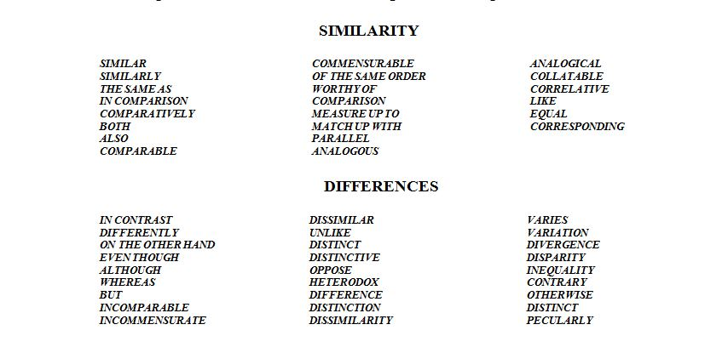
Good Transition Words
Notes:
So that you don’t over use different and similar. Linking words. Even t

Slide 13
Let’s Look at Student Samples

