Slide 1
"The Dynasties Song"
This "dynasties song," sung to the tune of "Frère Jacques,"
can help students remember the major Chinese dynasties in chronological order.
Shang, Zhou, Qin, Han
Shang, Zhou, Qin, Han
Sui, Tang, Song
Sui, Tang, Song
Yuan, Ming, Qing, Republic
Yuan, Ming, Qing, Republic
Mao Zedong
Mao Zedong

Slide 2
Interactive Map
http://archive.artsmia.org/art-of-asia/history/chin-dynasty-map.cfm.html

Slide 3
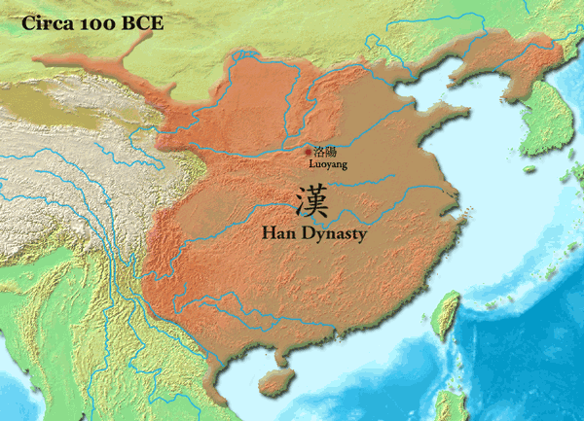
Introduction…
After the Han, we have China devolve into 3 separate kingdoms … and then into a mass of regional kingdoms

Slide 4
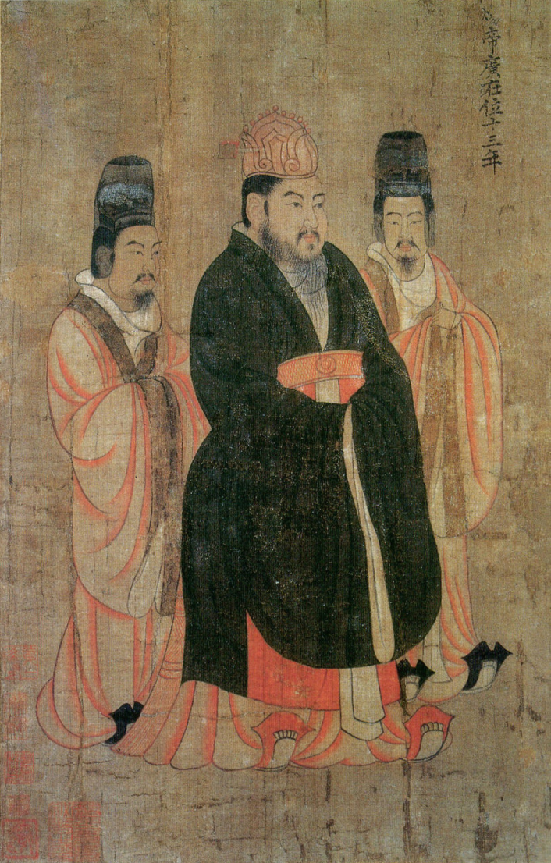
The Sui Dynasty
Ended the 3 and a half period of chaos
Yangdi: ruthless leader who murdered his father to gain the thrown

Slide 5
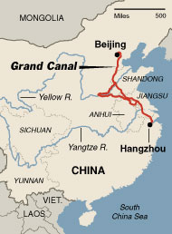
The Sui Dynasty
Most important project was the construction of the Great Canal

Slide 6
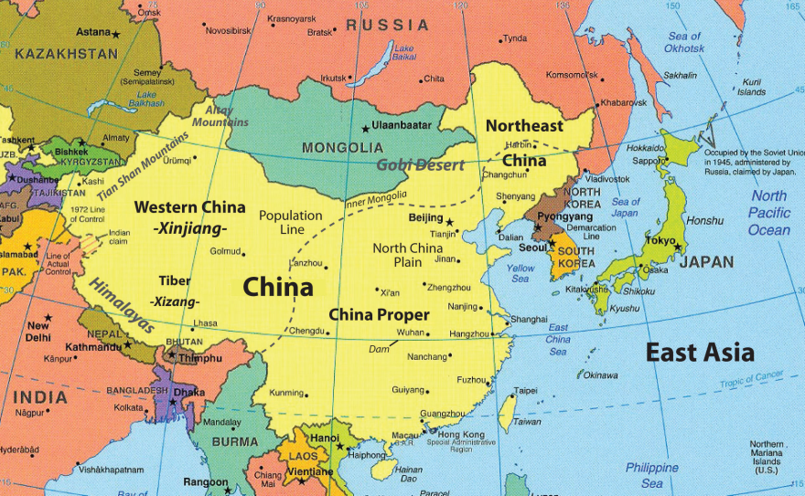
The Sui Dynasty
Over extended itself by attempting to retake the lands in Korea originally conquered by Han Wudi during the Han dynasty (108 BC)

Slide 7
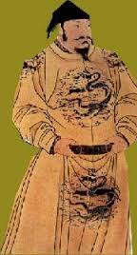
Sui Collapse
In 618 Yangdi was assassinated by one of his ministers bringing the short-lived Sui to an end.

Slide 8
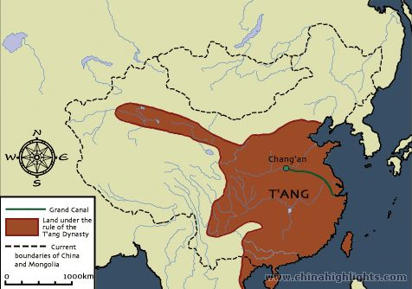
The Tang Dynasty
Tang success founded on three policies:
  1. complex system of communication and transportation
  2. 3-field system of agriculture
  3. bureaucracy based on merit

Slide 9
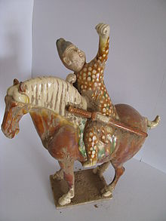
The Tang Dynasty
Tang enlist man Turkish nomads that were on the northwest frontier
Force their (T. Nomads) sons to move to the capital to be educated

Slide 10
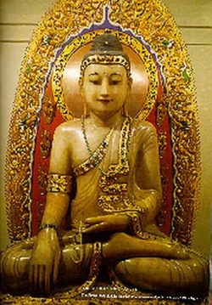
The Tang Dynasty
After Han, Buddhism surged in popularity
Especially the Mahayana (Pure Land) version that offered salvation

Slide 11
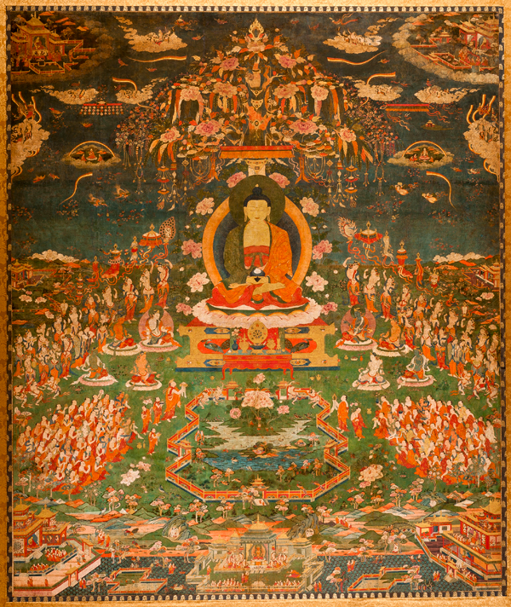
The Tang Dynasty
Another form- Chan Buddhism (Zen in Japan)
Emphasized an appreciation of artistic, literary and natural beauty and stressed the importance of meditation

Slide 12
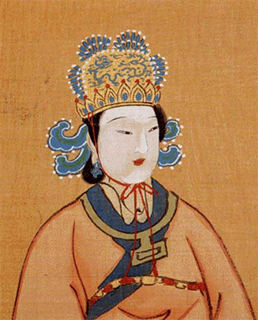
Tang Dynasty
The most important Tang ruler in supporting Buddhism was Empress Wu (the only female leader of China)

Slide 13
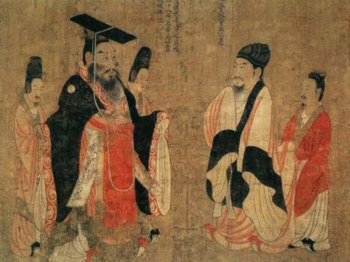
Tang Dynasty
Restoration of civil service exam re-enforced the focus on Confucian education
Scholars were troubled by the prominence of Buddhism and stressed its foreign nature

Slide 14
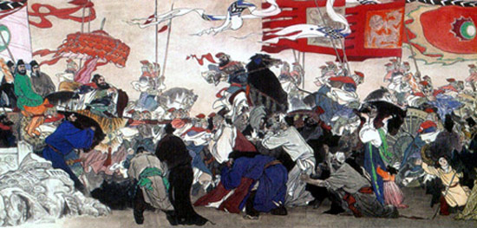
Tang Dynasty
Decline in the 2nd half of the 9th century as factions within government began feuding
In 880 northern invaders take advantage of internal feuds

Slide 15
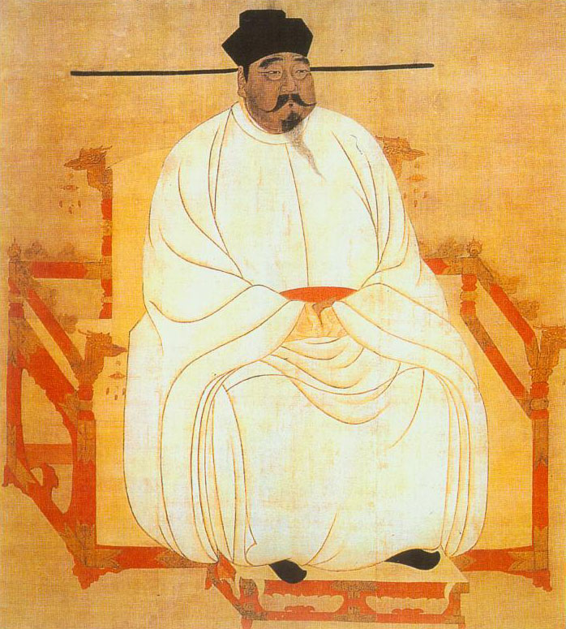
Song Dynasty, China’s Renaissance
Founder Chao K’uang-yin
General, made emperor by his soldiers in 960 AD
Conquered the southern half of China and payed annual tribute to the Khitans in the north.

Slide 16
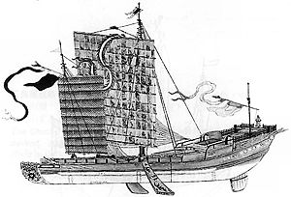
Song Dynasty (960-1279)
Used gunpowder as weapon in siege warfare
Expanded foreign trade and had the best ships in the world
  Ships- 4 decks, 6 masts, dozen of sails, stern post rudder

Slide 17
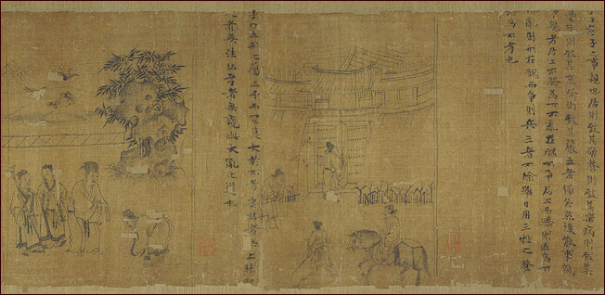
Song Dynasty
Examinations grew steadily in popularity throughout China
Education became central to the upper class

Slide 18
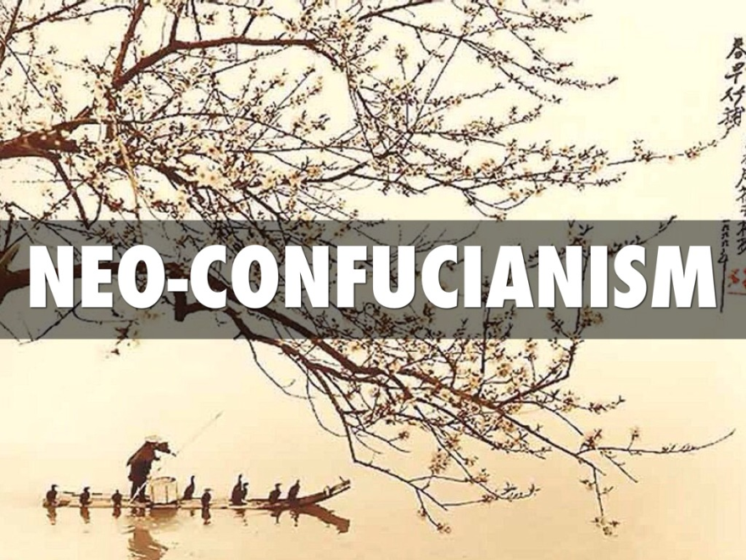
Song Dynasty
Neo-Confucianism
Zhu Xi, combined with others, synthesized writings of previous philosophers Confucius's Four Books
Most important part of Neo-Conf is the Pursuit of the Way through disciplined self cultivation formed a person’s character.

Slide 19
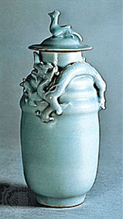
Song Dynasty
Art- Blue and white porcelain
The most common porcelain was the type known as Celadon

Slide 20
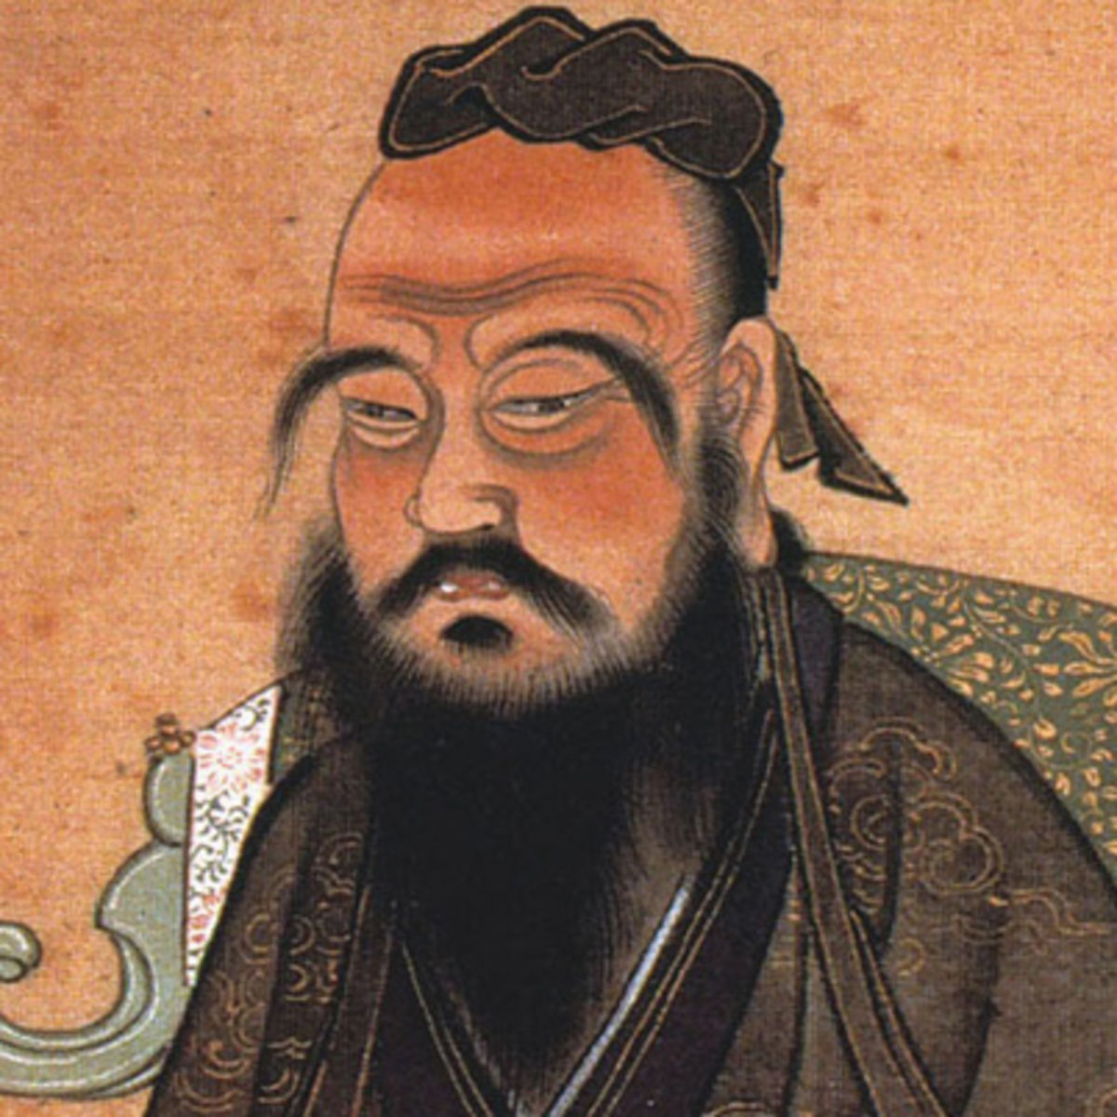
Song Dynasty
Not militarily powerful
  Part of this may be because Confucianism held military in very low regard

Slide 21
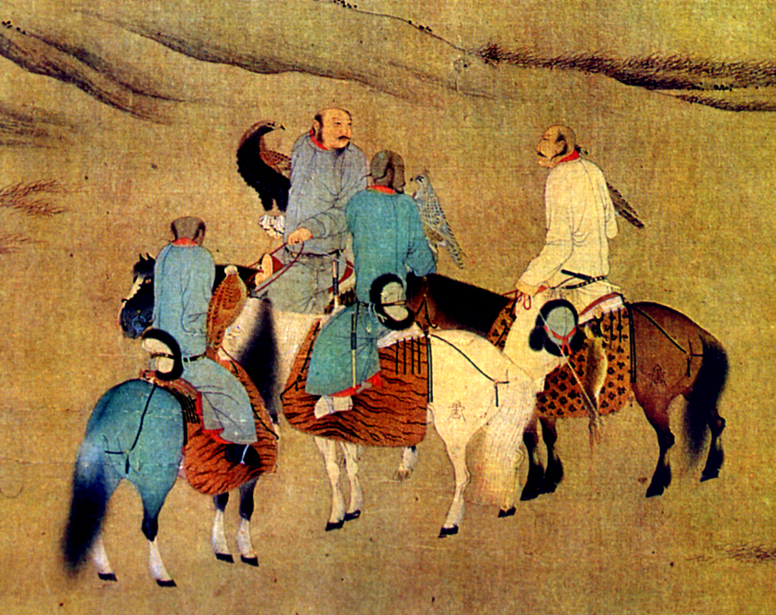
Song Dynasty
This weakness allowed for the two non-Chinese kingdoms to exist to the north of the Song (the Lai and the Western Xia)
1125 AD Jin able to conquer the Liao and the Song and part of the Western Xia

Slide 22
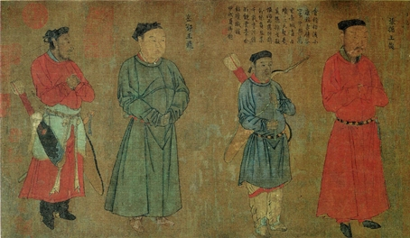
Southern Song Dynasty
Temporary peace
However power was held by the nobles and many emperors forced, by nobles, to abdicate
This period did not last long because in 1210 AD…

Slide 23
