Slide 1
1. The shift from hunting and gathering is called
A. Neolithic era
B. Ice Age
C. Neolithic Revolution

Slide 2
2. The earliest record keeping was used to
A. record births and deaths
B. record history for future generations
C. keep track of economic transitions

Slide 3
3. One characteristic of civilization is
Fertile river valleys
Developed cities
Industry

Slide 4
4. Which factor most influenced the types of crops grown?
A. animals
B. tools
C. geography

Slide 5
LEQ: What factors helped to unify China?
Standard 2

Slide 6
China’s Geographic Features Analysis
Notes:
Isolationism

Slide 8
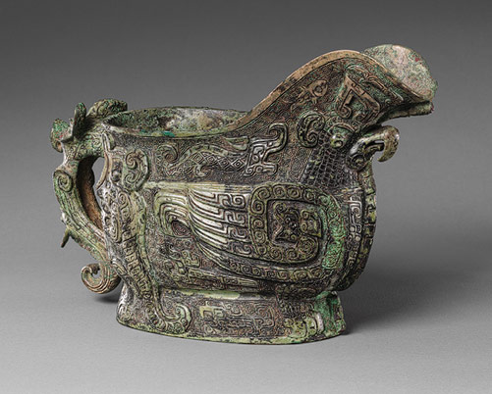
Shang Dynasty
Achievements: gov’t is Monarchy. Belief: Ancestral worship (use oracle bones)
Innovations: writing, bronze vessels and a precise calendar.
Notes:
Oracle bones: first evidence to the Chinese writing system. Historians have found that the earliest examples of Chinese writing were found on oracle bones (questions to the ancestor). Government, monarch, Shang Kings surrounded by a court, wealthy nobles.

Slide 9
Shang Decline
Conquered by the Zhou
Notes:
Growing population, too large to control. Conquered by a nearby tribe, Zhou.

Slide 10
Zhou Dynasty
Achievements: Gov’t created Mandate of Heaven
Mandate of Heaven: God support ruler.

Slide 11
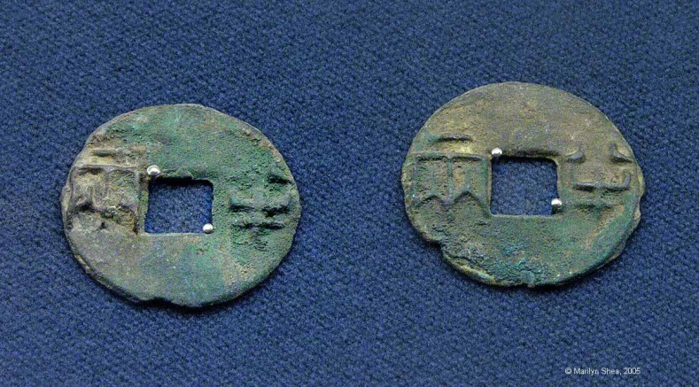
Zhou Dynasty
Innovations: Iron metal working, chopsticks, catapult and coins.

Slide 12
Zhou Decline
Enter the Warring States Period

Slide 13
Confucianism (record at bottom of chart)
Founder: Kongfuzi, born 550BC
Central Beliefs: Honor, respect and love: traditions, family and ancestors.

Slide 14
Qin Dynasty
Achievements: gov’t enforced legalism
Notes:
Legalism rejected Confucianism because Confucianism believed that rulers should be virtuous and kind to the people they ruled. Religion: Confucianism was rejected.

Slide 15
Qin Dynasty

Slide 16
Qin Decline
Civil War

Slide 17
Han Dynasty
Achievement:
Gov’t softened harsh laws and created the Civil Service System : examination prior to job

Slide 18
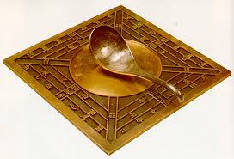
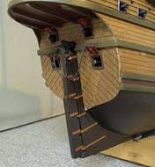
Han Achievements

Slide 19
Han Decline
Internal issues left the dynasty weak and allowed for a rebellion of a Daoist sect, the Yellow Turbans, to send the empire into a state of chaos.
Left China in an era called the Period of Disunion.

Slide 20
Map Timeline
http://timemaps.com/history/china-1000bc/

Slide 21
Classroom Summary

Slide 22
Video- 9 minutes
https://www.youtube.com/watch?v=1feTm36eMUU

