Slide 2
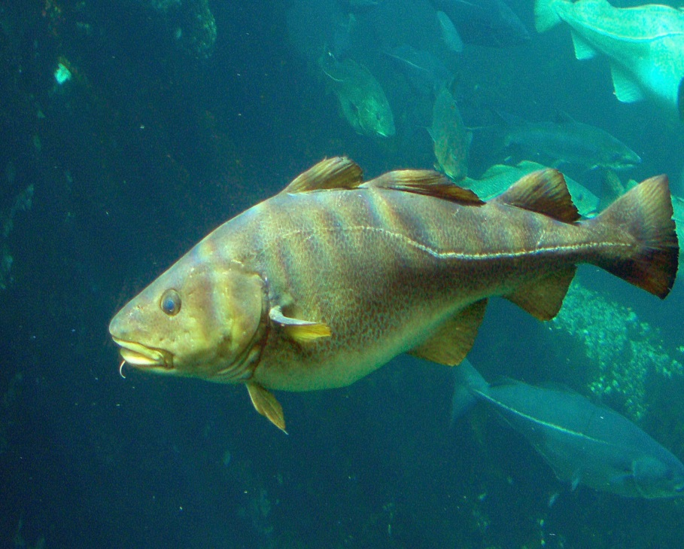
North Atlantic Crossing

Slide 3
Chronology of Conquest
1 year after 1492, the Spanish return and start colony of Hispaniola
Spaniards move further inland
Cortes (starting in 1519) conquers Aztecs
Pizarro conquered the Inca (call New Castile)

Slide 4
Treaty of Tordesilla

Slide 5
Reason for Spanish Success
Germs
Guns

Slide 6
Guaman Poma

Slide 7
We have been crushed to the ground We lie in ruins Where we once saw beauty and valor, there is nothing but grief and suffering

Slide 8
Americas
Spanish Colonial System:
Catholic dioceses with archbishops
Viceroy
King received 20% of new world goods

Slide 10
Americas
Encomienda System
Hacienda System
The Mita System
Chattel Slavery

Slide 11
Settler Colonies of North America
Early 1600s the English, Dutch, and French began to establish colonies in North America
Investment companies and government worked together

Slide 12
Social-North America
Did not find large empires
White Europeans secured land by signing treaties with natives

Slide 13
Social North America
Many women migrated from France and England to the New World
Push natives west; racism
Little desire to convert; first African slaves arrived in VA in 1619

Slide 14
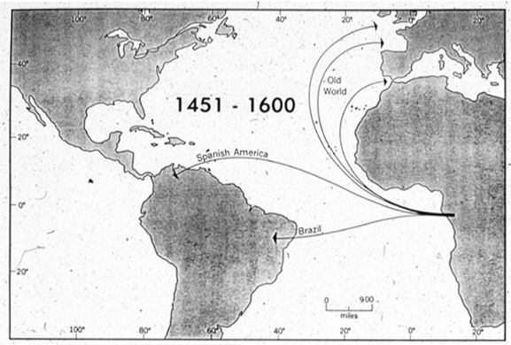
West Africa

Slide 15
Guns, Germs and Steel
https://www.youtube.com/watch?v=UsKBFXe7biQ

