Slide 1
Europe Arrives and Colonizes

Slide 2
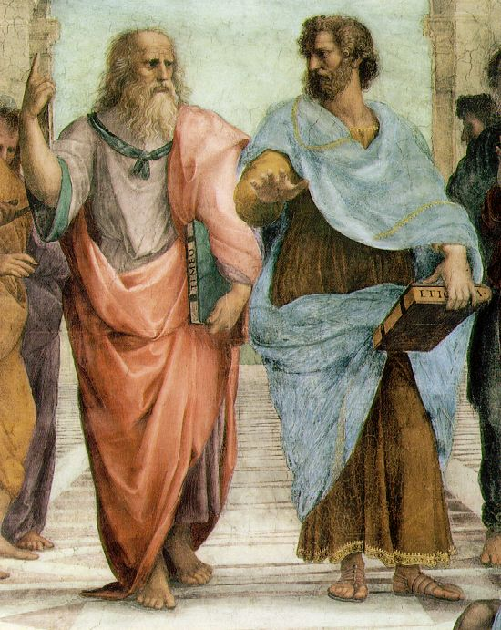
Renaissance

Slide 3
Notes:
Saint Peter’s Basilica

Slide 4
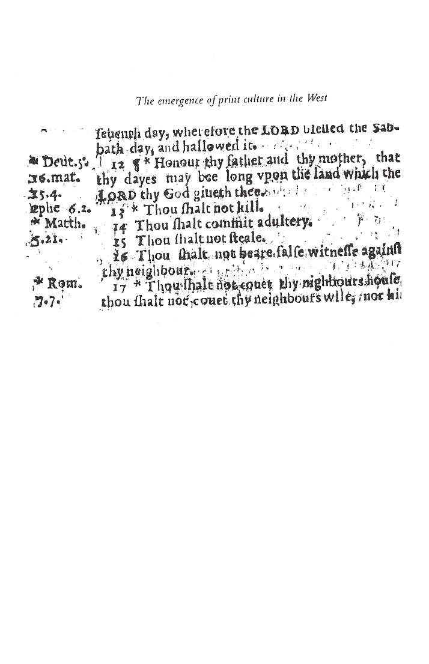
Printing Press

Slide 5
Popular Authors

Slide 6
Protestant Reformation (1517 – 1648)

Slide 7
Jesuits
The Society of Jesus
Founder: Ignatius of Loyola

Slide 8
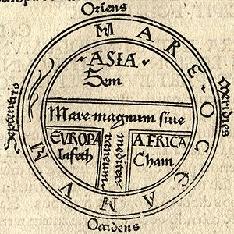
Improvement on previous technologies and knowledge
Innovations in ship design:
Caravel
New tools:
Astrolabe
Revised Maps

Slide 9
Portuguese school for Navigation
Portuguese development of a school for navigation led to increased travel to and trade with West Africa, and resulted in the construction of a global trading-post empire.

Slide 10
Changes in European Society
The size of the European family decreased because they are now economically independent from their extended family.

Slide 11
Exploration!

Slide 12
Portuguese in Indian Ocean
Bartolomeo Diaz
Vasco de Gama
Attempt to monopolize Indian Ocean trade

Slide 13
Zheng He, Chinese Admiral, in the Indian Ocean

Slide 14
Spanish in the New World: Columbus

Slide 15
Activity Time

Slide 16
North Atlantic Crossing
10/20

