Slide 1
Brainstorm: WHY do empires fall?

Slide 2
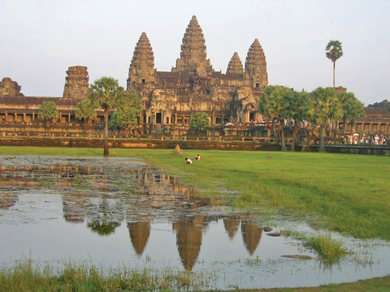
Between 200-600 CE all of the classical civilizations have fallen

Slide 3
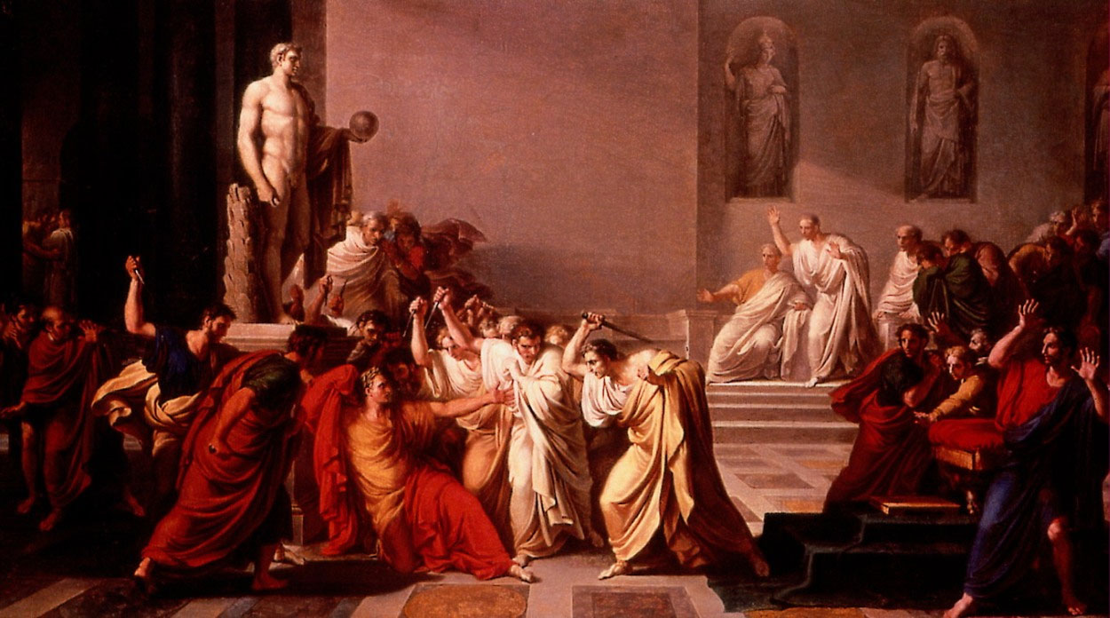
1. Political corruption and deterioration

Slide 4
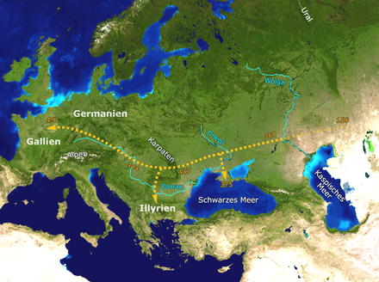
2. The migration of the Huns

Slide 5
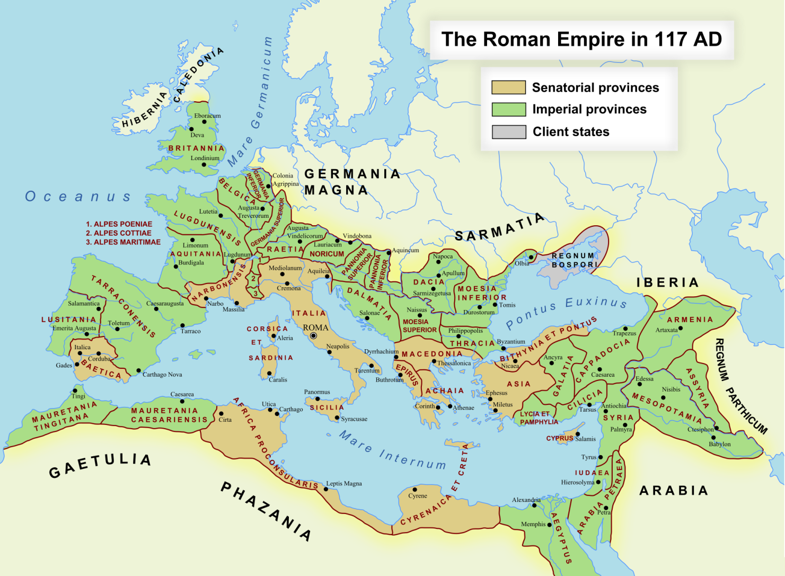
3. Over extension of borders

Slide 6
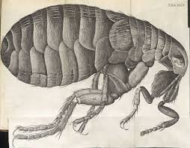
4. The spread of epidemics and disease

Slide 7
Unique Differences- Gupta
Dependence on political alliance with regional princes broke down.
Least impactful- why?

Slide 8
Unique Differences- Han
What are the unique characteristics of the Han dynasty?

Slide 9
Unique Characteristics- Rome
What is unique about Rome?

Slide 10
Changes- What will change due to the fall of empires

Slide 11
Continuities- What will remain?

Slide 12
Brainstorm- How did the building of these empires impact the environment?

Slide 13
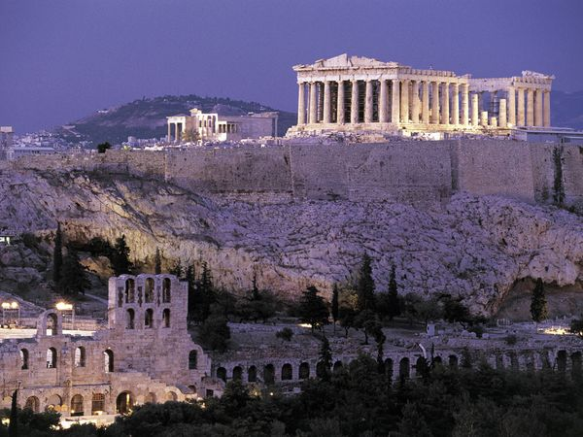
Deforestation

