Slide 1
Building Your Argument: think, pair, share
Based off of your previous knowledge and what you learned yesterday, what do you know of the Industrial Revolution? What is your impression of the Industrial Revolution?

Slide 2
From Cottage Industry to Factory
Why not stay in the home?

Slide 3
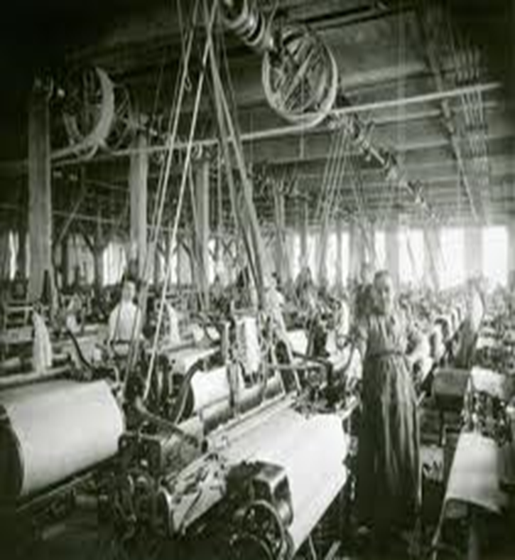
New Inventions
Spinning Jenny
Water Frame

Slide 4
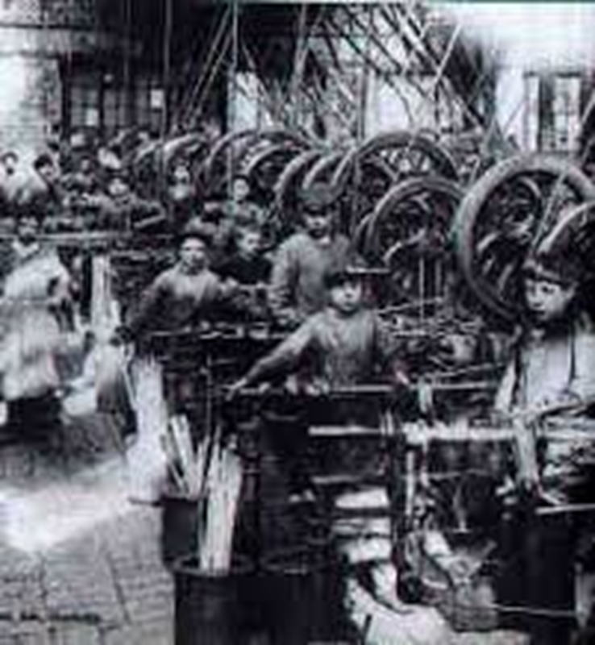
Working Conditions in Factories
Dangerous conditions
Long work days
Lack ventilation
Poor sanitation
Inadequate food

Slide 5
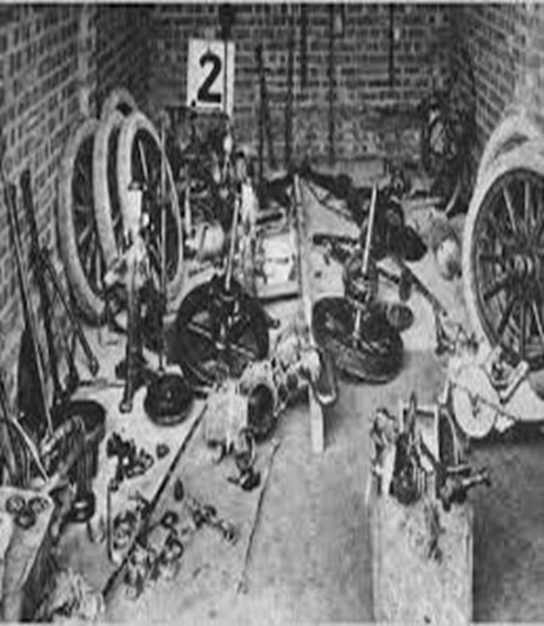
New Methods of Production
Interchangeable parts-Are identical machine made parts
Assembly Line-The product moves from worker to worker

Slide 6
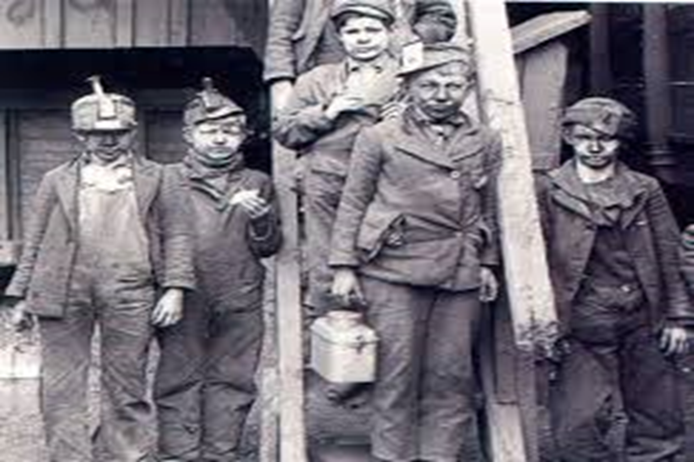
Left Hand Side- Brainstorm the Conditions of Factory Workers (think health)

Slide 7
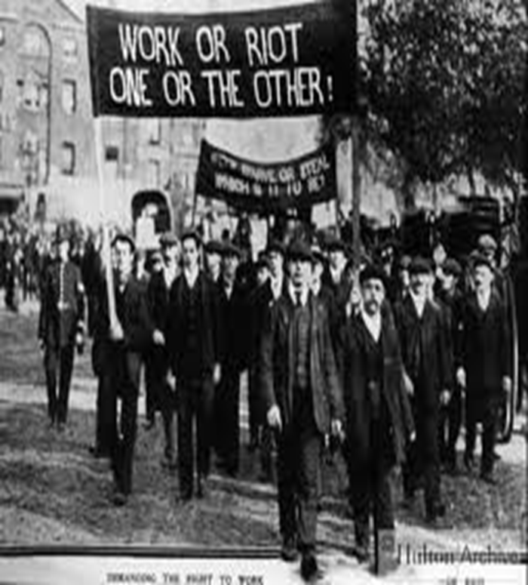
Labor Unions
Organizations representing workers interests

Slide 8
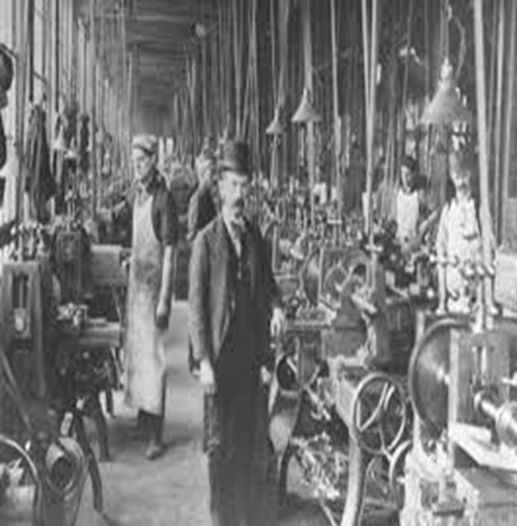
Growth of Middle Class
Groups of workers who were essential to the factory system

Slide 9
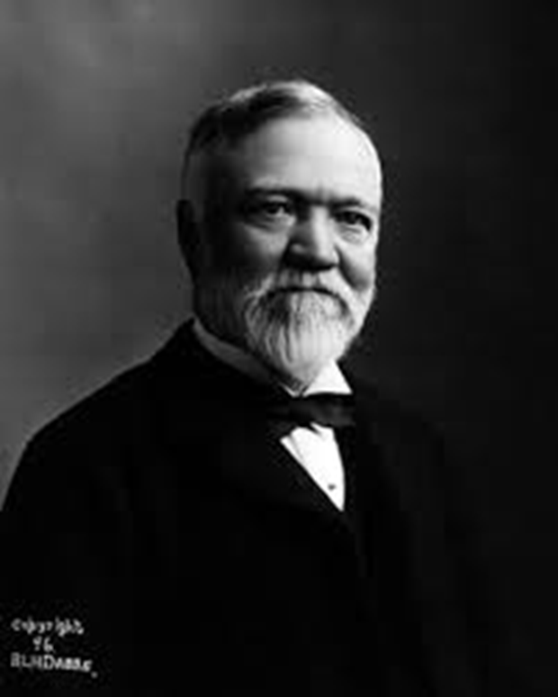
Growth of Business Entrepreneurs
Andrew Carnegie (steel)
John D. Rockefeller (oil)
Cornelius Vanderbilt (railroads)

Slide 10
New Economic Ideas
What does economics mean to you?

Slide 11

Capitalism
on the private ownership of capital and production inputs, and on the production of goods and services for profit.

Slide 12
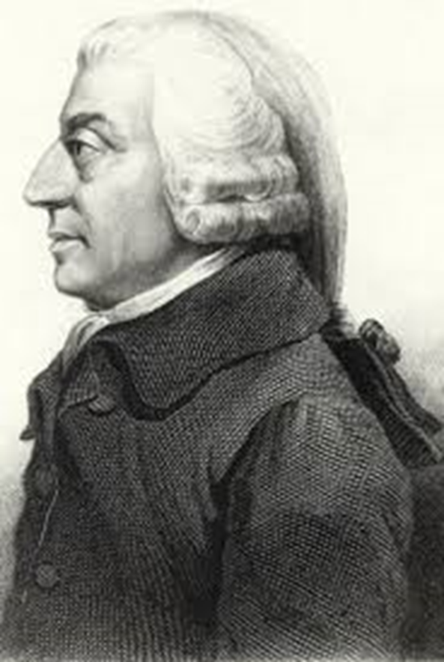
Laissez-faire Economics
Economic system in which the government does not interfere in business

Slide 13
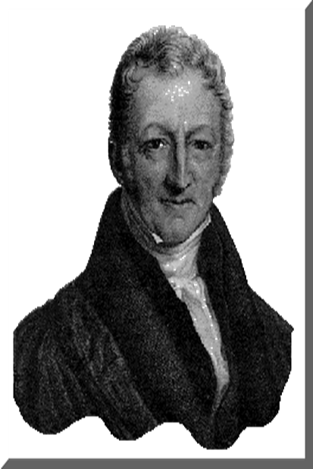
Thomas Malthus
Wrote that population growth would always grow faster than food production

Slide 14
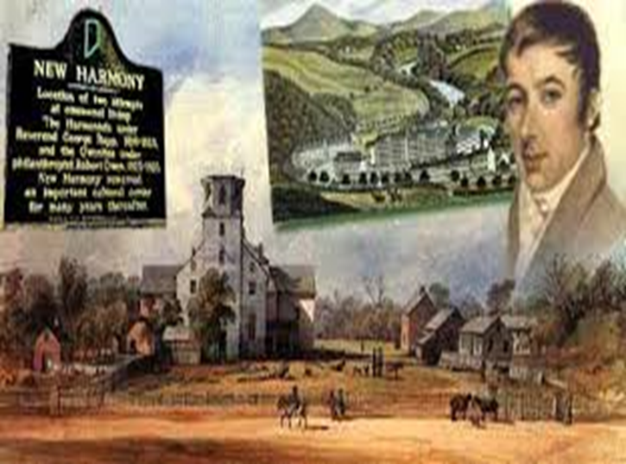
Socialism- Robert Owens
an economic system in which major industries are owned and controlled by the government rather than by individual people and companies

Slide 15
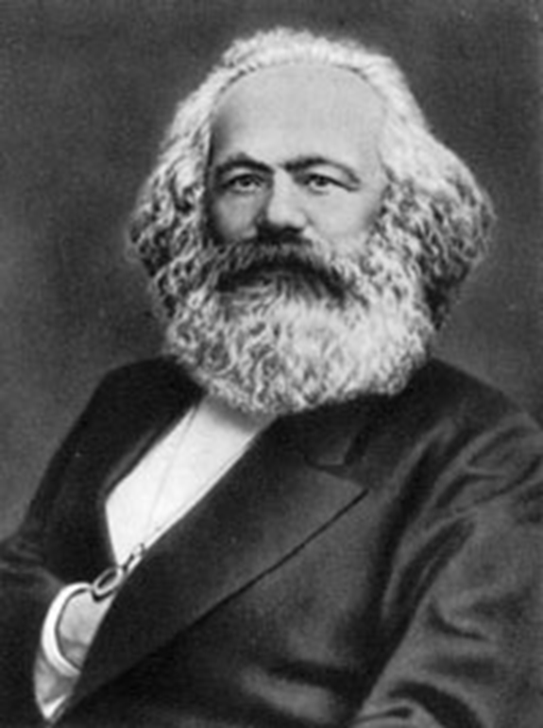
Communism- Karl Marx
Economic system in which the government own almost all the means of production and controls all economic planning

Slide 16

Industrial Globalization
Great Britain, France and Germany became leaders in the global economy

Slide 17
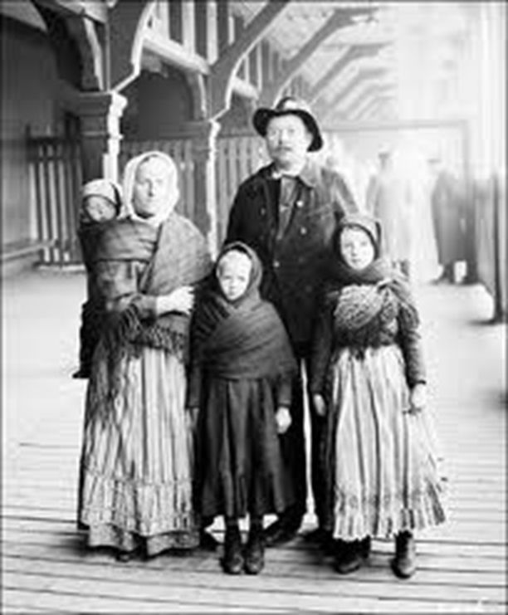
Immigration

Slide 18
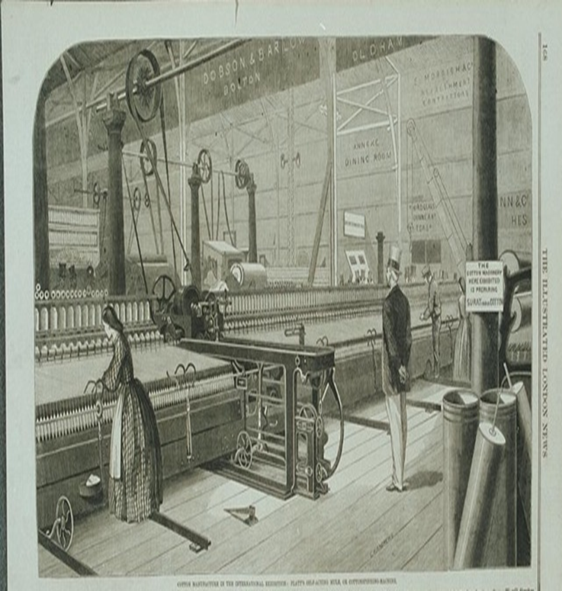
Global Trade
Importing raw materials to countries around the world

Slide 19
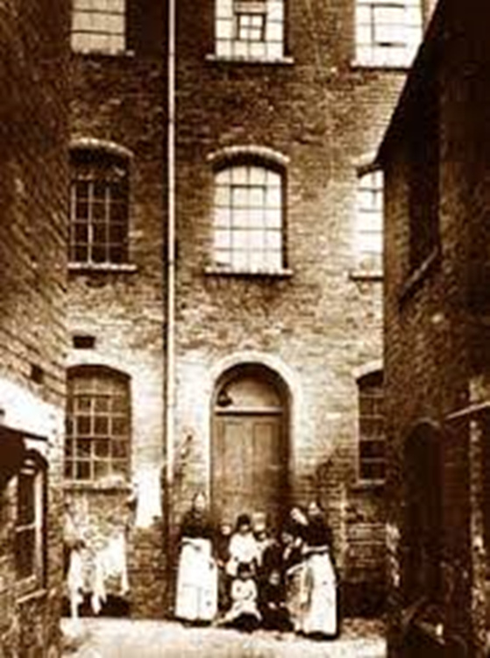
Standard of Living
Level of material comfort

Slide 20
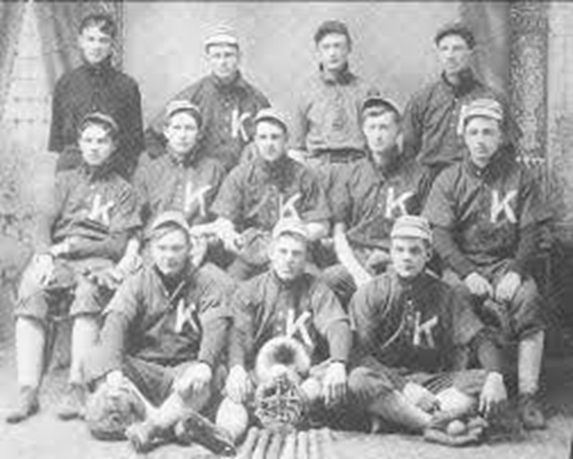
Leisure Time

