Slide 1
From Neolithic to Industrialization

Slide 2
Birth of Industrialization-Great Britain

Slide 3
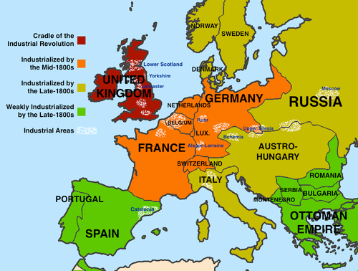
Factors that led to the rise of industrial production
Geography

Slide 4
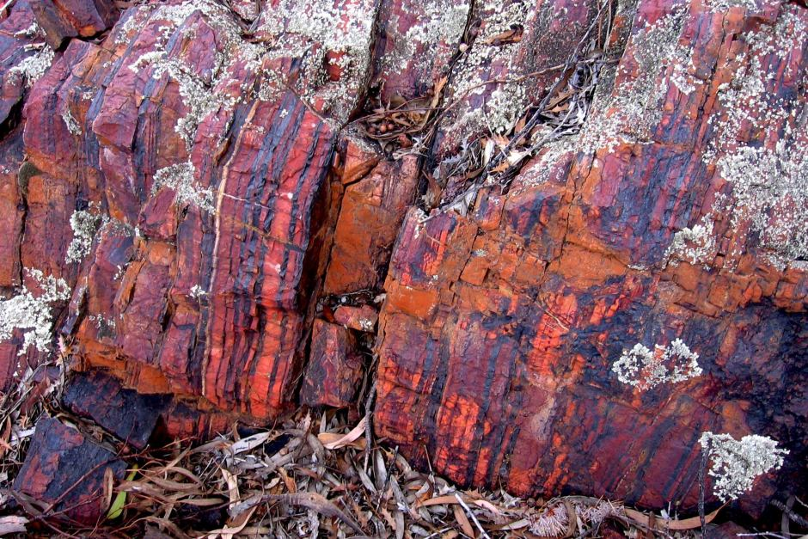
Natural Resources

Slide 5
Social Changes – a thriving bourgeois class with wealth to invest was a basis for industrialization

Slide 6
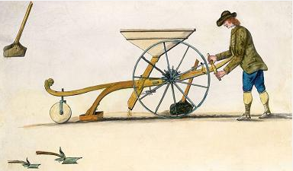
Large agricultural surpluses

Slide 7
Advanced financial practices

Slide 8
Cooperative government and political stability

Slide 9
Liberalism as economic ideology: J.S. Mill, Adam Smith (5.1.III.A.)
Capitalism- the belief that capital (wealth) and the means of production (the tools that increase the value of raw materials) should be owned privately

Slide 10
Capitalism and Adam Smith
“It is not from the benevolence of the butcher, the brewer, or the baker, that we expect our dinner, but from their regard to their own interest. We address ourselves, not to their humanity but to their self-love, and never talk to them of our own necessities but of their advantages.”

Slide 11
Closely tied with capitalism is the philosophy of Classical Liberalism
The individual choice should not be limited by those in power
John Stuart Mill

Slide 12
New machines, fuels, and system (factory) (5.1.I.B. and C.)

Slide 13
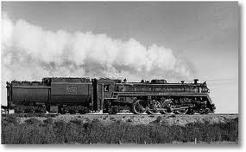

Slide 14
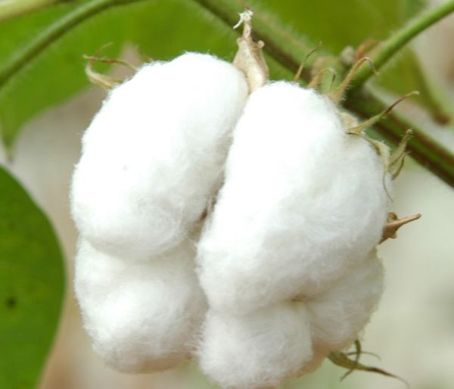

Slide 15
One invention led to another since none were useful if any part of the process was slower than the others…

Slide 16
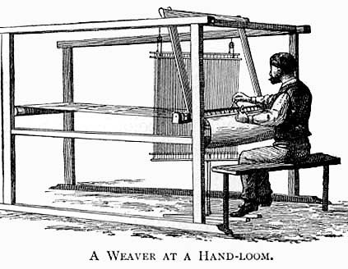
The Flying Shuttle by John Kay
https://www.youtube.com/watch?v=MSo9-PGeaVs

Slide 17
Spinning Jenny by James Hargreaves
The water frame by Richard Arkwright
Spinning mule by Samuel Crompton
https://www.youtube.com/watch?v=nnoApDMniFs

Slide 18
Changes in transportation/communication (5.1.IV.)
Once the textile industry began its exponential growth, transportation of raw materials to factories and manufactured goods to customers had to be worked out.

Slide 19
James Watt’s perfected steam engine

Slide 20
Steam Trains

Slide 21
Nevertheless, waterways still proved to be paramount for traveling

Slide 22
Spread of industrialization (5.1.I.D.)

Slide 23
Industrialization in the US

Slide 25
New methods of financing, transnational businesses (5.1.III.B and C.)
Adam Smith, Capitalism and John Stuart Mill who pioneered modern liberalism, the idea of individual freedom

Slide 26
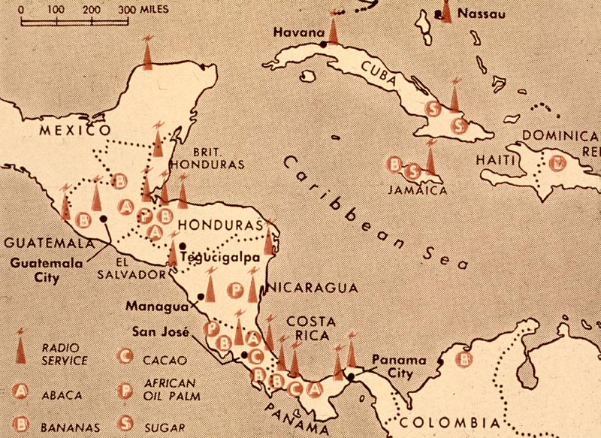
United Fruit Company

Slide 28
Second Industrialization: electricity and copper mining (5.1.I.E. and 5.1.II.D.)

