Slide 1
LEQ: What are the differences and similarities between Athens and Sparta?

Slide 2
Greek Civilization

Slide 3
Geography of Greece
Notes:
Rugged mountains that made travel and communication between city-states near to impossible. Due to it’s geography, the people of Greece had different governments, laws and customs.

Slide 4
Greek City-States
Polis- city-state
Basic political unit of Greece
Developed independently
Own government
Own laws
Own customs

Slide 5
Greek City-States
Life in the Polis
Acropolis: high area in center- fortifications
Agora: Market place

Slide 7
Sparta and Athens

Slide 8
Sparta

Slide 9
Sparta
Military orientated
Helots: slaves of the state

Slide 10
Sparta
Harsh lifestyle
Trained from birth to be a soldier
Hoplites: foot soldiers

Slide 11
Now Let’s Review
Let’s work on the Venn Diagram.

Slide 12
Athens-Development of Democracy
World’s first democracy, 500 BCE
Conflict between rich and poor

Slide 13
Athens- Development of Democracy
Attempted to ease tension between the people by enforcing harsh city laws and punishments
Draconian Law

Slide 14
Athens- Development of Democracy
Cleisthenes divided Athens into 10 tribes
Each tribe had social groups which would elect 1 general and 50 to serve on Council

Slide 15
Athens
Notes:
Direct Democracy, ask students what this picture represents?

Slide 16
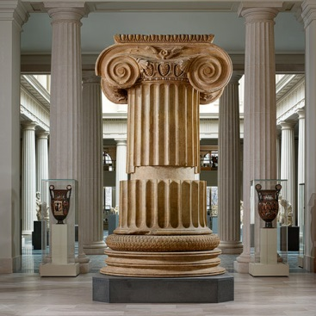
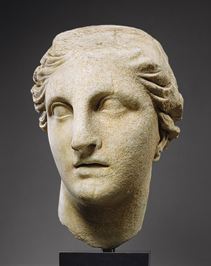
Art and Architecture
Notes:
Pottery is important because the Egyptians and Syrians always used geometric shapes. The Athens utilized human like figures with smooth, rounded shapes.

Slide 17
Now Let’s Review

Slide 18
Philosophers
Socrates
Truth , justice, virtue
Answered questions with questions

Slide 19
Philosophers
Plato
Student of Socrates
Studied nature of truth and forms of gov’t
Wrote The Republic
Founded an academy

Slide 20
Philosophers
Aristotle
Attended Plato’s academy
Concerned with nature of the world around him
Reason and Logic

Slide 21
Alexander the Great

Slide 22
Hellenistic World
Notes:
Iraq

Slide 23
Hellenic- purely Greek culture
Hellenistic- new type of culture created.
Blending of Greek, Persia, Egypt and Central Asia

Slide 24
Draco’s Laws Writing Activity
Pull out your writing hamburger… you got this in your introduction packet.

