Slide 2
Start of Islam
Arose during the 600s CE in the Arabian Peninsula
Golden Age of Islam 900 to 1000 and is associated with the Abbasid Caliphate

Slide 4
A cubical shrine called the Ka’ba, a holy well called Zamzam, and a sacred precinct that prohibited killing contributed to Mecca’s emergence as a pilgrimage site
Muhammad was born in Mecca in 570

Slide 5
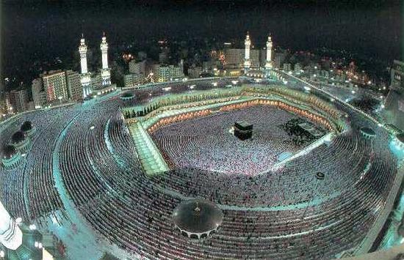

Slide 6
Formation of the Umma
Unsafe for Muhammad and his family/followers in Mecca so they moved to Medina
Umma- a community defined by acceptance of Islam

Slide 7
632 Muhammad died and Abu Bakr would succeed him
Abu Bakr was called the Khalifa or successor
Caliph was both a political and religious leader

Slide 8
Abu ordered those who worked as secretaries to organize Muhammad’s revelations into a book
Quran

Slide 9
Conflict over secession
The “Rightly Guided Ones” (First Four Caliphs)
The Shi’a: Caliph must be from Muhammad’s tribe (a Blood relative) Imams and twelvers
Sunni: Caliph is chosen from any tribe by the community
Both believe in the Quran, Sharia and Hadith

Slide 10
Spread of Islam
Umayyad Caliphate- 661 to 750 (supported by Sunnis)
Abassad Caliphate- 750 to 1258

Slide 12
Abbasids
Provide renewed religious leadership
Islamic law, collecting sayings of the Prophet, translate Greek works
Conversions to Islam among conquered people increased during the 9th century

Slide 13
Abbasids Decline
Began to lose power in the second half of the 9th century
New revolts, over extension, Turkish slaves (Mamluks) rebelled and took over Baghdad.

Slide 14
Shi'ites Control
945 Abbasid Caliphate collapsed and Shi’ites gained control
As caliphate declined, various provincial regimes rose to power
Religious and cultural developments, particularly the rise of a social group of religious scholars known as the ulama worked against any permanent division of the Islamic umma.

Slide 15
1050-1258
In Central Asia and Middle East another nomad group, Seljuk Turks took advantage of the decline of the Abbasids
By early 1100s, Baghad was in ruins
Notes:
1096 1st crusades

Slide 16
Islamic Law
Shari’a evolved over time in response to the Muslim’s community’s need for a legal system
Source of the law was the traditions of the prophet (sunna) as revealed in reports (hadith)

Slide 17
Conversion
Conversion and urbanization were related
In many areas converting meant migration to Arab governing center. Converts encountered discrimination if they stayed in their Christian or Jewish community

Slide 18
Women and Slaves
Seclusion of women and veiling in public became fixtures of Muslim social life
Women could inherit property, remarry, receive payment upon divorce, could initiate divorce with certain conditions
Islam allowed slavery but forbade Muslims from enslaving other Muslims or “people of the book” – Zoroastrians, Jews and Christians

Slide 19
The five Pillars
Belief
Prayer
Alms Giving
Fasting
Pilgrimage to Mecca

