Slide 1
Russia and Japan

Slide 2
Growth of Russian Empire, Crimean War
Sowing the seeds of World War I
https://www.youtube.com/watch?v=F_SMMpUFZT0

Slide 3
Example of Reform: Emancipation of Serfs
A 1907 painting by Boris Kustodiev depicting the muzhiks listening to the proclamation of the Emancipation Manifesto in 1861

Slide 4
State Sponsored Industrialization: Witte System. Tran Siberian Railroad

Slide 5
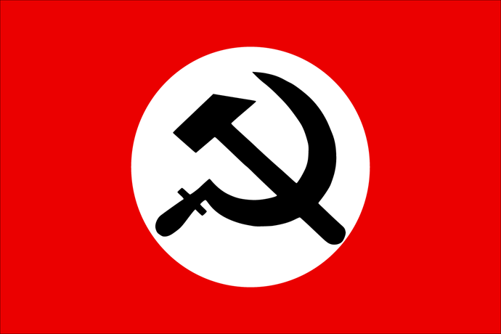
Development of Political Ideologies: Communism (Bolsheviks) and Anarchism

Slide 6
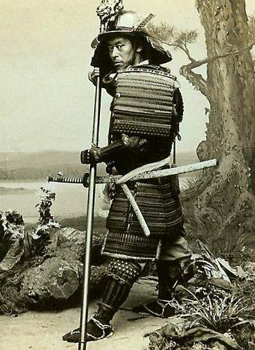
Japan- Responds to US Imperialism, Matthew Perry

Slide 7
Political Reform Under Meiji Japan (1868-1912)
1. Abolished feudalism
2. Borrowed western ideas about justice
3. Constitutional Monarchy
4. Remodeled military
5. Postal service
6. New educational system
7. Promoted industrialization
8. Railroad network

Slide 8
State Sponsored Industrialization under Meiji

Slide 9
Japanese Nationalism

Slide 10
Japan Builds Empire: Sino- Japanese War, Russo-Japanese War
Sino-Japanese War (also known as the Chinese-Japanese War) dispute over the involvement/influence China had over Korea. Ended with the victory of Japan in 1895. China had to give up Liaotung (Taiwan)
Russo-Japanese War exposed the weakness of Russia and highlighted the strength of Japan.

Slide 11
Migration of Japanese Agricultural Workers in the Pacific
Government began to encourage agricultural workers to take contract, or seasonal work in Hawaii, Guam and other locations.

