Slide 1
Bell Ringer
Analyze one factor that led to the decline of the Roman Empire.

Slide 2
LEQ: How influential was the power of the Church during the Medieval Period?

Slide 3
Division in the Roman Empire
Western Roman Empire collapses
Eastern Empire became known as the Byzantine Empire

Slide 4
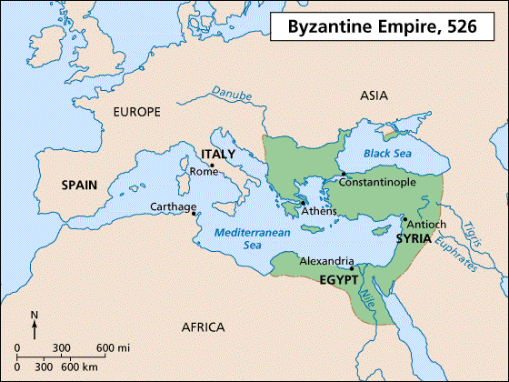
Byzantine Empire
Notes:
Capital: Constaninople, well situated for trade and defense. Emphasis on religion in society. Picture of Justinian is an example of a mosaic, picture created with tiny colored tiles of glass, stone or clay that fit together and cement into place. Iconclasts- breaking of Icons.

Slide 5
Characteristics of Byzantine Empire:
Strong
Capital: Constantinople, trade center

Slide 6
Justinian Code- a code of laws that provided equality, especially women

Slide 7
Now Let’s See It!
https://www.youtube.com/watch?v=8Y2pAGcW51Y (1:33)

Slide 8
Now Let’s Review
Construct 3 questions about this section of content.

Slide 9
The Great Schism
Christianity spread due to trade and missionaries
Western Christians- Roman Catholic
Eastern Christians- Orthodox

Slide 10
The Christian Schism

Slide 11
East vs West Schism of 1054
Roman Catholic (West)
Roots in Roman Law and Latin
Accept Pope as ultimate authority
Does not allow members of clergy to marry
Use of Icons
Orthodox (East)
Roots in Greek philosophy
Did not accept Pope as the ultimate authority
Allows members of clergy to marry

Slide 12
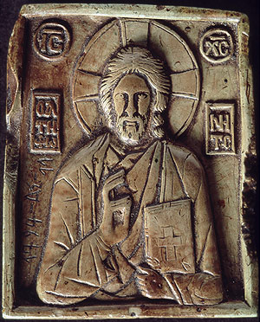
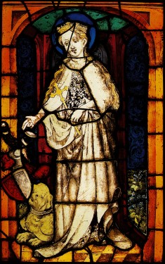
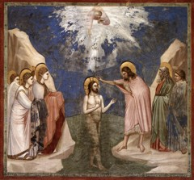
Non-Secular Art and Icons

Slide 13
Now Let’s Review
Venn Diagram

Slide 14
Power of the Church
Pope ruled the Papal states in Italy and was head of the Roman Catholic Church

Slide 15
Map showing spread of Christianity
http://www.eduplace.com/kids/socsci/ca/books/bkf3/imaps/AC_14_463_christianity/AC_14_463_christianity.html

Slide 16
Christendom- the Spread of Christianity
Christianity:
Offered people hope
Afterlife
Sense of community
Notes:
As Christianity spread to the diverse population of Europe, eastern Mediterranean and northern Africa, people interpreted the faith in various ways.

Slide 17
Monasticism
The Benedictine Rule:
1. Obedience
2. Poverty

Slide 18
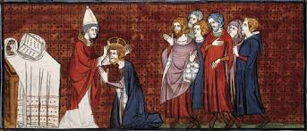
Charlemagne -
Crowned as Emperor of the Holy Roman Empire by Pope Leo III
Unified Europe
Spread Christianity

Slide 19
Justinian Point of View Exercise
Read the two accounts of Justinian
Who is telling the truth? Who can you trust? Why?
Think author, date, motivation
Your answer should be at least 3 sentences long

Slide 21
http://highered.mcgraw-hill.com/sites/0072957549/student_view0/chapter17/interactive_map_quiz.html

Slide 22
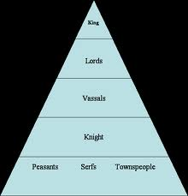
Feudal System
A political, social and economic system based on the granting of land in exchange for loyalty, military aid and other services.
Fief- the land that was given
Vassal- the person who accepted the fief.

Slide 23
Manorial System
Notes:
Observe how the castle was built for protection with the moat, it was self sufficient, area for serfs to live on the manor.

Slide 24
Costs Benefits
The Manorial System

Slide 25
http://highered.mcgraw-hill.com/sites/0073406929/student_view0/chapter7/interactive_maps.html

Slide 26
Journal Entry
You are the lord of the manor! Construct a journal entry. What is your daily life like?
Do you like it on the manor?
Be creative
At least 5 sentence

Slide 27
Magna Carta
Restricted the King’s power
Outlined the rights of the people
Contributed to the formation of modern democracy
Notes:
King John being forced to sign the Magna Carta; formation of Parliament.

Slide 28
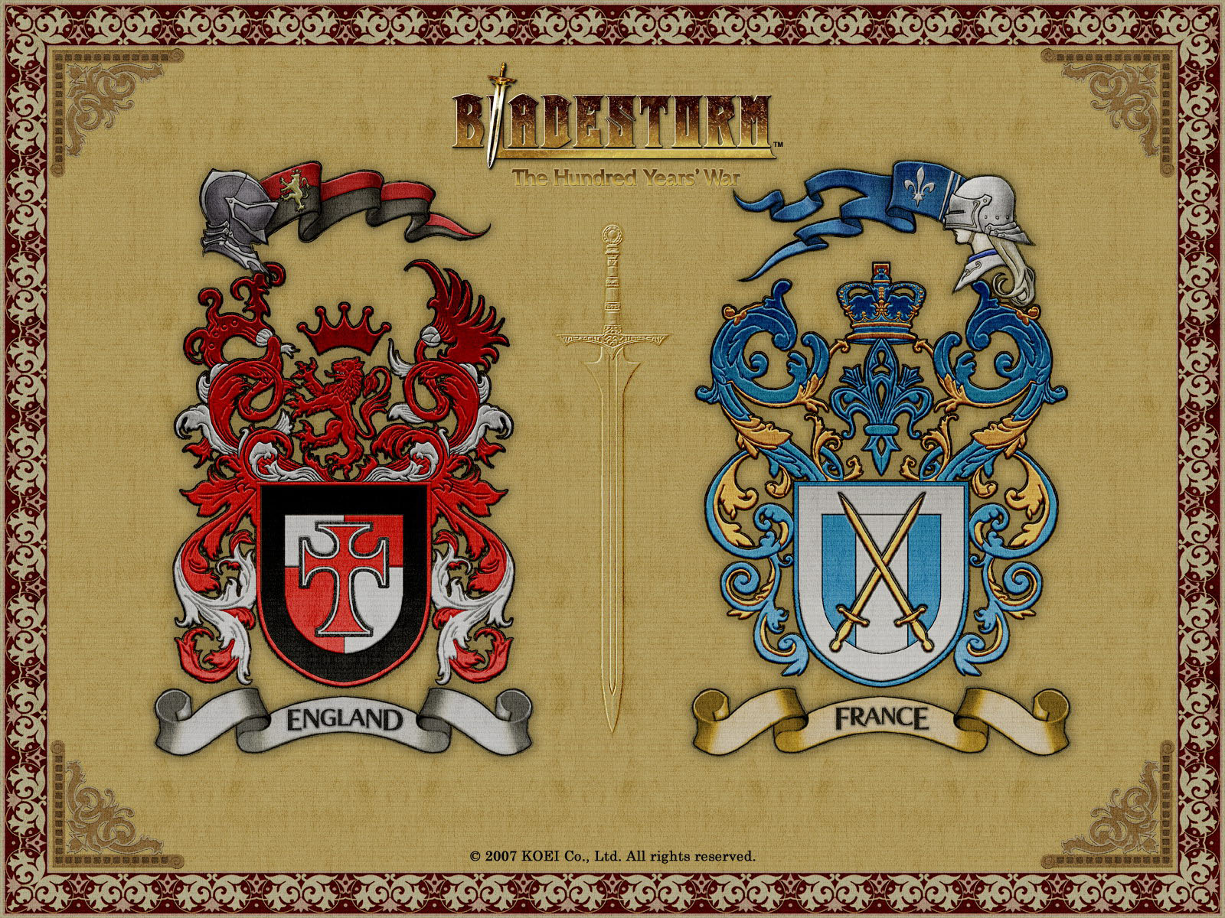
Hundred Years War

Slide 29
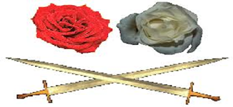
War of the Roses

Slide 30
LEQ: How is the power of the Church visible in the Crusades and peoples’ reaction to the Black Plague?

Slide 31
Origins of the Black Plague
1346 plague that struck the Mongol armies
Infected fleas bit humans

Slide 32
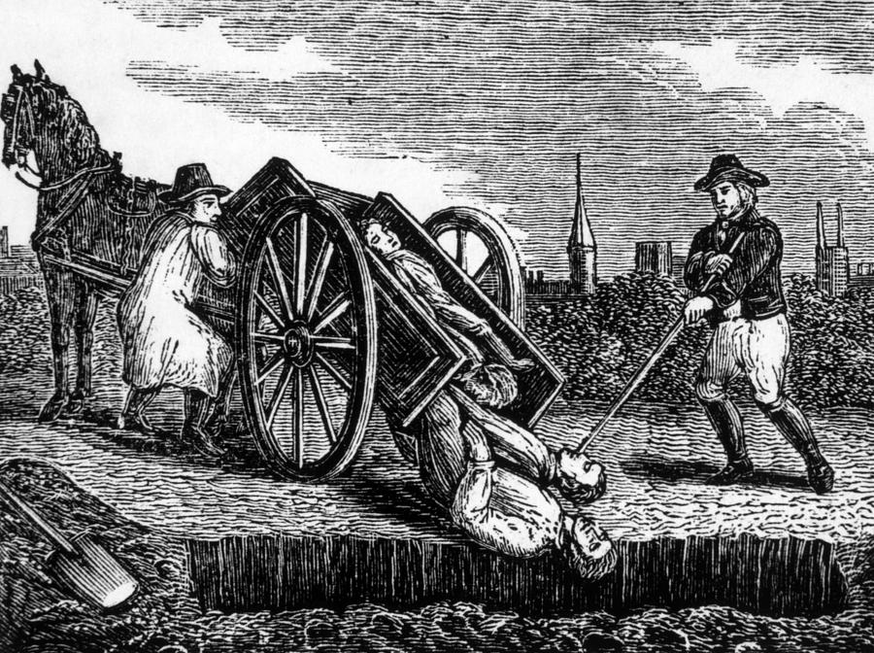
The Black Death or Bubonic Plague
Effects of the Plague:
Collapse of manorial system
Killed 1/3 of the population
The Church grew richer
Notes:
Killed 1/3 of population, airborne, spread from mice to fleas to humans. People believed god was punishing them, blamed the jews. The manorial system collapsed.

Slide 33
The Spread of the Bubonic Plague
Notes:
Note that it started in Asia

Slide 34
Interactive Map of the Spread of the Black Plague
http://wadsworth.cengage.com/history_d/templates/student_resources/0534627218_spielvogel/spielvogel_maps/swfs/map11_1.html

Slide 35
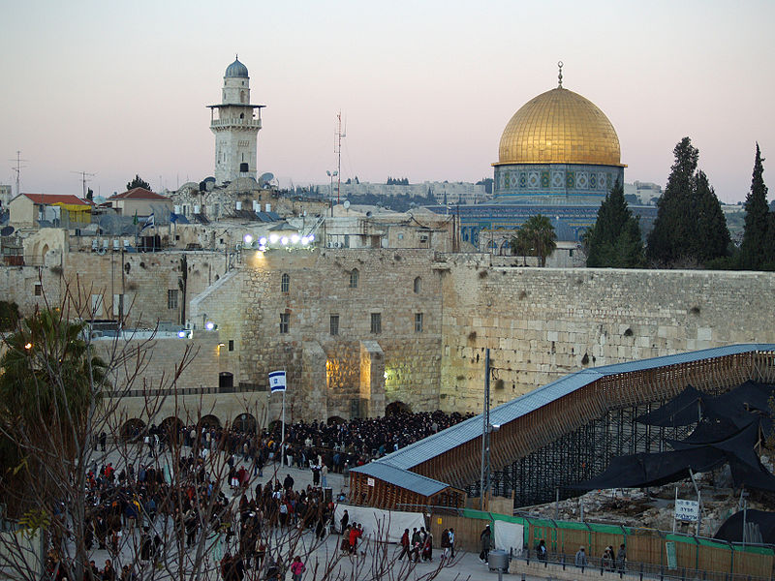
Present day Jerusalem

Slide 36
Crusades- series of religious wars

Slide 37
Causes of Crusades
Byzantine emperor called on the help of Pope Urban when Turks invaded the Byzantine Empire

Slide 38
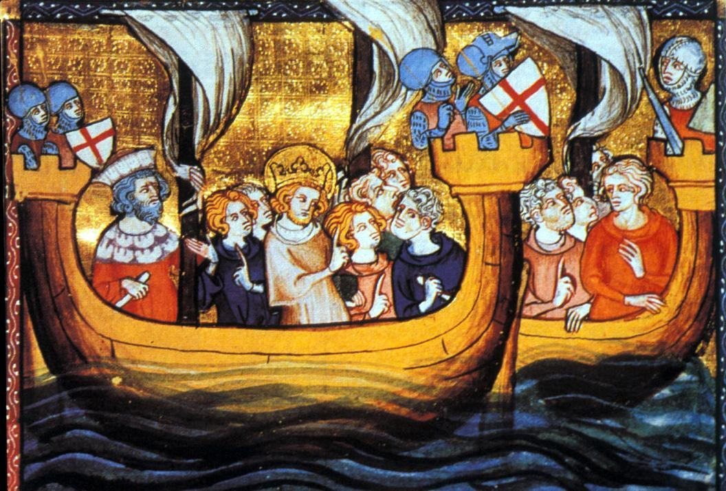
The Crusades- Christian Holy Wars
Effects of the Crusades:
Insert image for crusades
Trade increased
Kings gained more power
Knowledge of Muslim culture spreads
Relations between Christians and Muslims becomes strained

Slide 39
Interactive Crusades Map
https://highered.mcgraw-hill.com/sites/0072957549/student_view0/chapter20/interactive_map_quiz.html

Slide 40
Trade Fairs- Then
Notes:
For the increase in trade, Italy trade center, Venice, Milan, Genoa. Origin of Credit, Guilds, Farming technology allowed people to move into the city.

Slide 41
Trade Fairs- Now

