Slide 1
Bell Ringer:
Explain why farming would lead to the development of villages and communities. Why are communities necessary to settled farmers?

Slide 2
LEQ: How do empires of the western hemisphere develop?

Slide 4
Where is Mesoamerica?

Slide 5
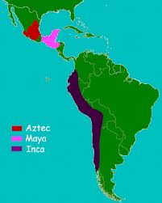
Geographic Location of the Mayan, Incan and Aztec Civilizations

Slide 6
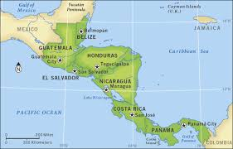
Map of the Mayan Civilization

Slide 7
Mayan Civilization
City-states linked by trade and warfare
Polytheistic and rituals included human sacrifice

Slide 8
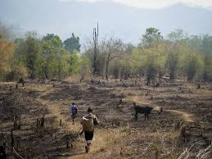
Mayan Civilization- Agriculture technique for clearing the land: Slash and Burn Method

Slide 9
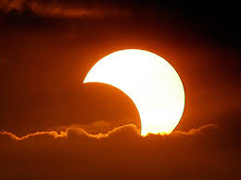
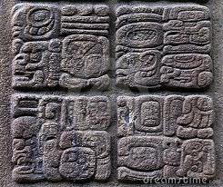
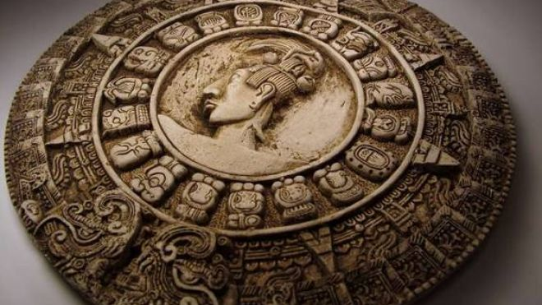
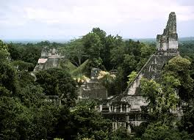
Mayan Achievements
Calendar
Predicted solar eclipses
Written language
Buildings
and Architecture

Slide 10
Mayan Sport

Slide 11
Mayan Decline
Overuse of the land and drought
Disease
Internal conflicts
Historians are not sure…

Slide 12
https://www.youtube.com/watch?v=3odJDGKPPTU

Slide 13
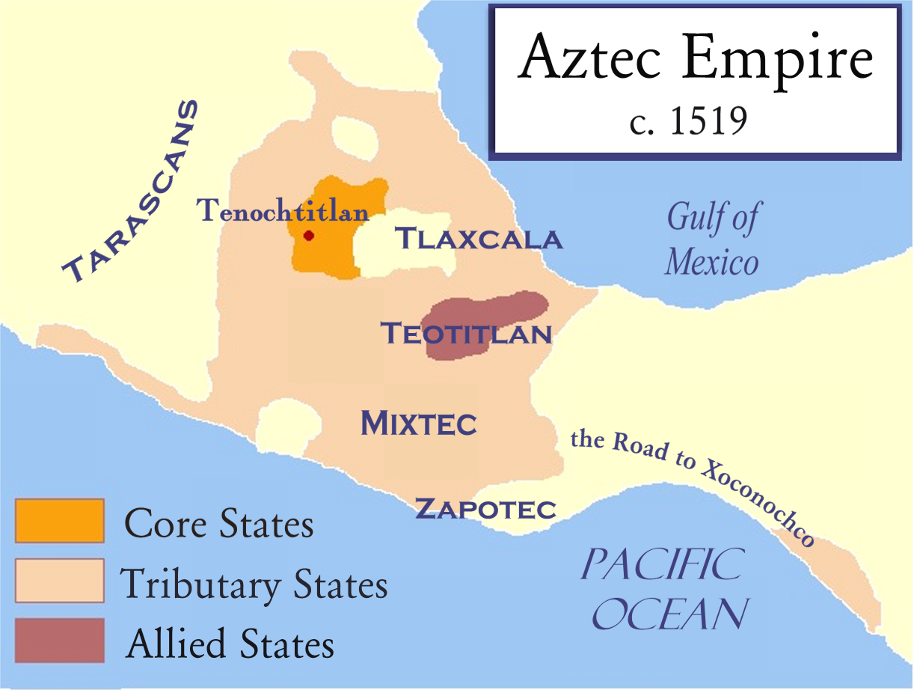
Aztec Civilization

Slide 15
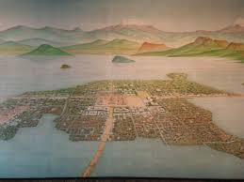
Tenochtitlan

Slide 16
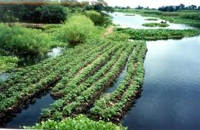
Chinampas- the floating gardens

Slide 17
Aztecs
Corn was staple of diet
Conquered people were required to pay a tax called a tribute

Slide 18
Aztec Social Structure- strict

Slide 19
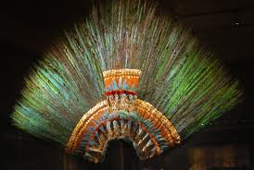
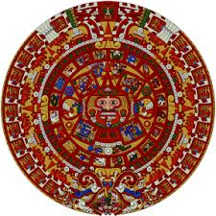
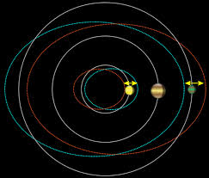
Aztec Achievements
Elaborate headdress
Calendar
Predicted the movement of planets

Slide 20
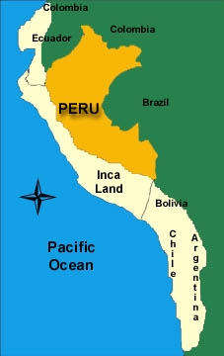
Incan Civilization

Slide 21
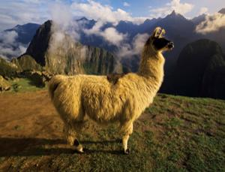
Inca
Inca gov’t strictly controlled economy
Terrace farming; potatoes
Human sacrifices
Intricate road system; llamas used for transportation

Slide 22
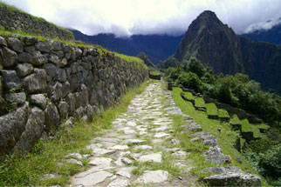
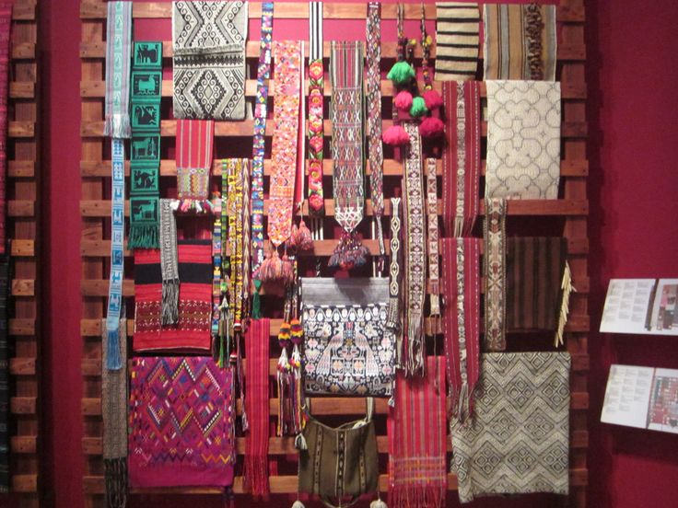
Achievements
Infrastructure-roads
Textiles

Slide 23
Homework
Describe the religious and political role that the pharaoh played in Ancient Egyptian society. You must use complete sentences when writing your response.

Slide 24
Video 6 min

Slide 25
Exit Ticket
How did the Aztecs maintain control of their empire?

Slide 26
Links:
Chichen Itza: http://www.youtube.com/watch?v=q0kOyGZxKh4 (2:16)
Aztec Lecture 1:
http://www.youtube.com/watch?v=yUpiwigKzS8
Aztec Lecture 2:
http://www.youtube.com/watch?v=KFfMmonAL7M
Aztec Lecture 3:
http://www.youtube.com/watch?v=AHQ7o1DTnXs

