Slide 1
Midterm review part 1

Slide 2
River Valley Civilizations
Indus
  Indus River
China
  Yellow River
Mesopotamia
  Tigris and Euphrates Rivers
Egypt
  Nile River

Slide 3
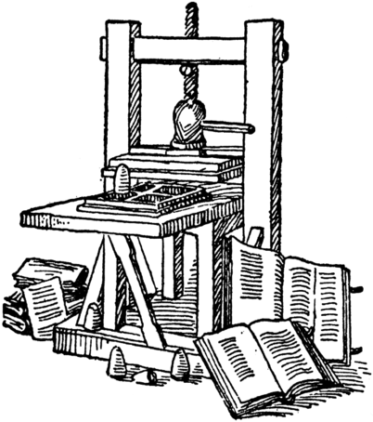
Printing Press
Invented by Johannes Gutenberg
First publication the Bible

Slide 4
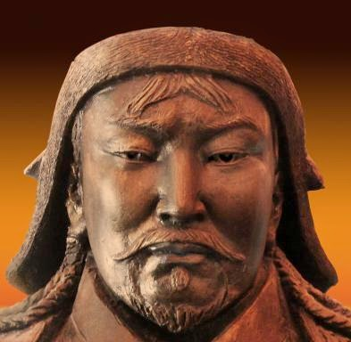
Genghis Khan
Universal Ruler

Slide 5
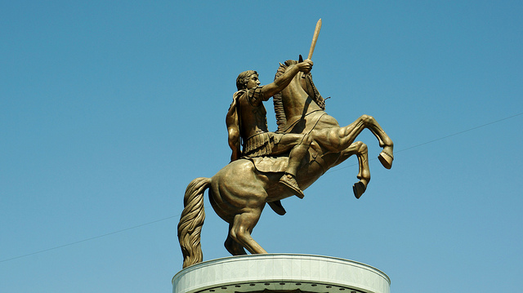
Hellenistic
Spread of Greek culture

Slide 6
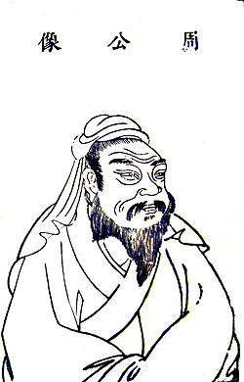
Mandate of Heaven
The Chinese belief that royal
Authority is the result of divine
approval.

Slide 7

Monotheistic Religions
Judaism- Torah
Christianity- Bible
Islam- Quran

Slide 8
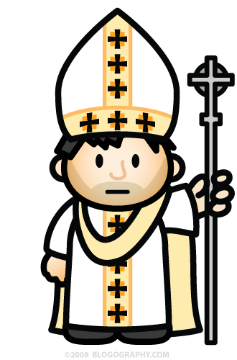
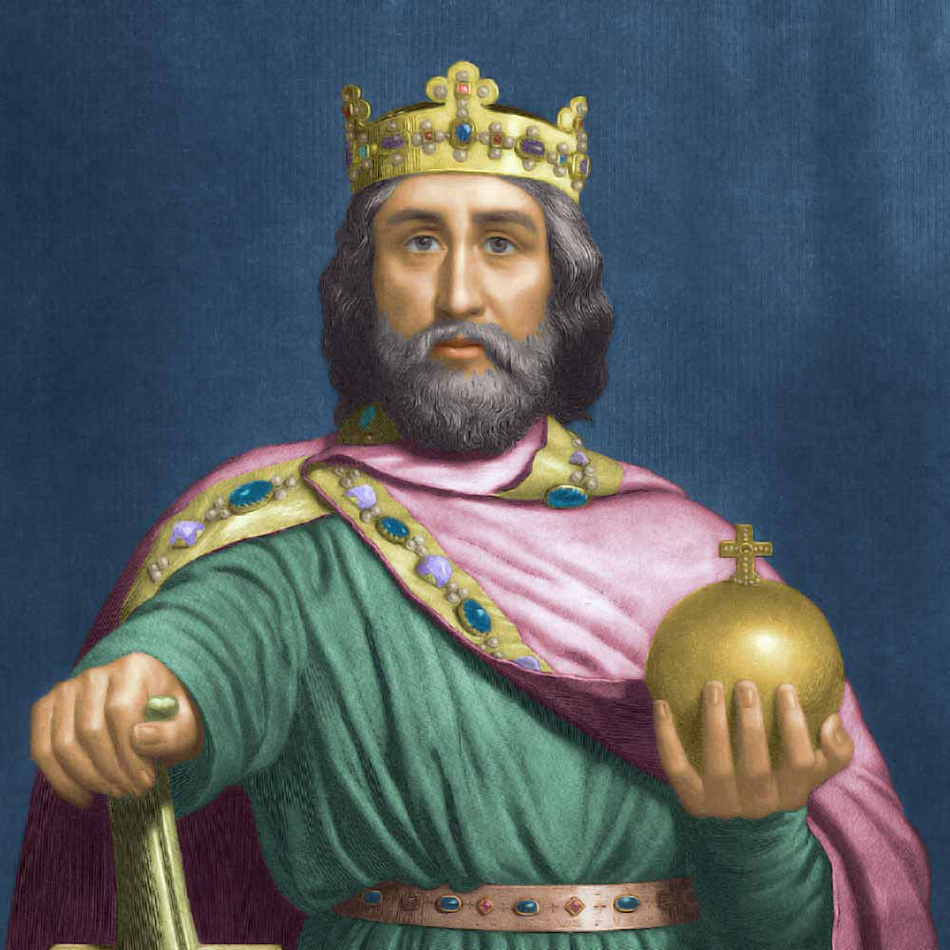
First Holy Roman Empire…
Charlemagne
Pope crowned Charlemagne as the Holy Roman Empire
This crowning signified the power of the Pope

Slide 9
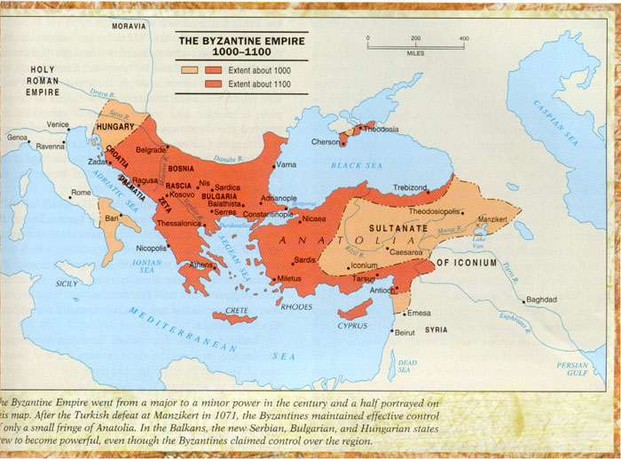
Geographic Location of Constantinople

Slide 10
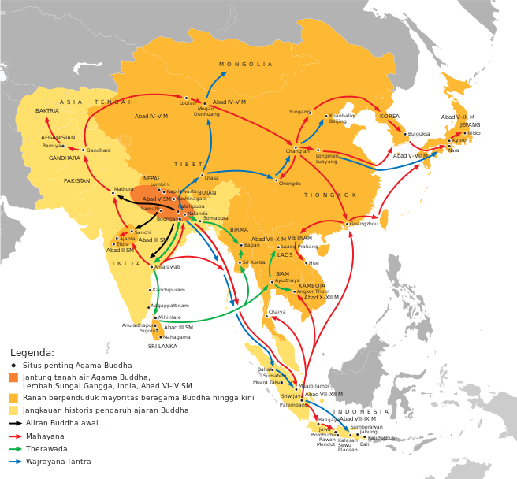
Trade Routes and Religion
Silk Roads

Slide 11
Power of the Pope
Taxation
Army/Military
Excommunication

Slide 12
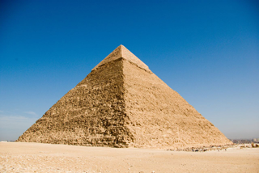
Pyramids and Math
Geometry

Slide 13
Neolithic Revolution

Slide 14

How were officials of the Roman republic selected?
Through elections

Slide 15
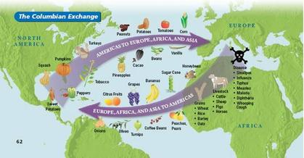
Define the Columbian Exchange.

Slide 16
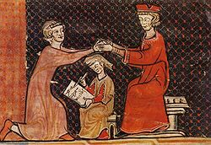
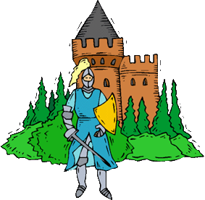
What was feudalism a response to?
The kings inability to protect the people and their holdings.

Slide 17
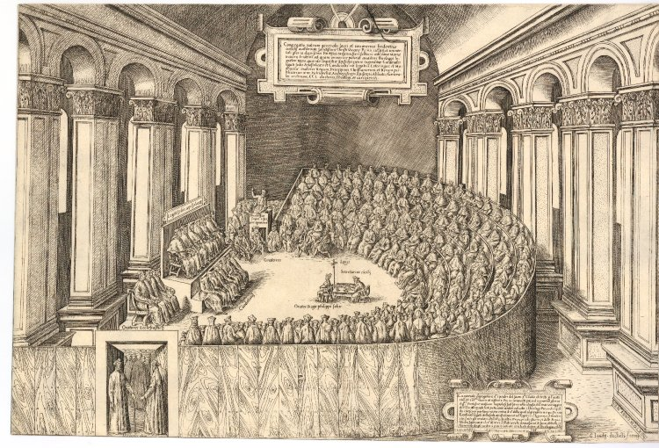
The Council of Trent
Banned the selling of indulgences
Re-educate the priests
Open up the schools

Slide 18
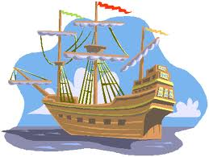
Monarch that opened up a school of navigation…
Prince Henry the Navigator

Slide 19
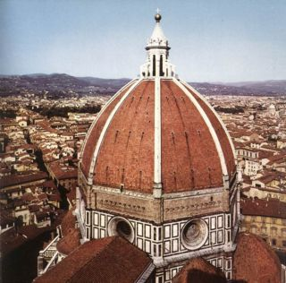
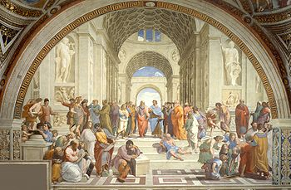
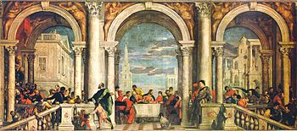
Three characteristics of the Renaissance
Renewed interest in art
Renewed interest in Latin and Greek
Renewed interest in learning

Slide 20
Motivations for Exploration
Gold
Glory
God

Slide 21
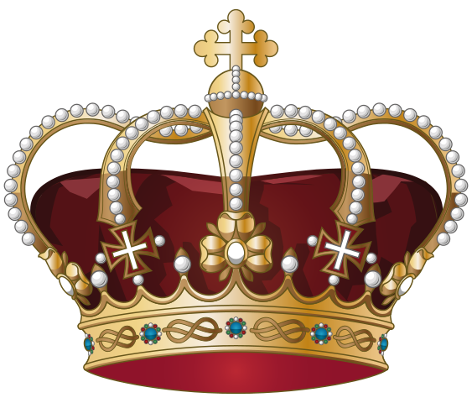
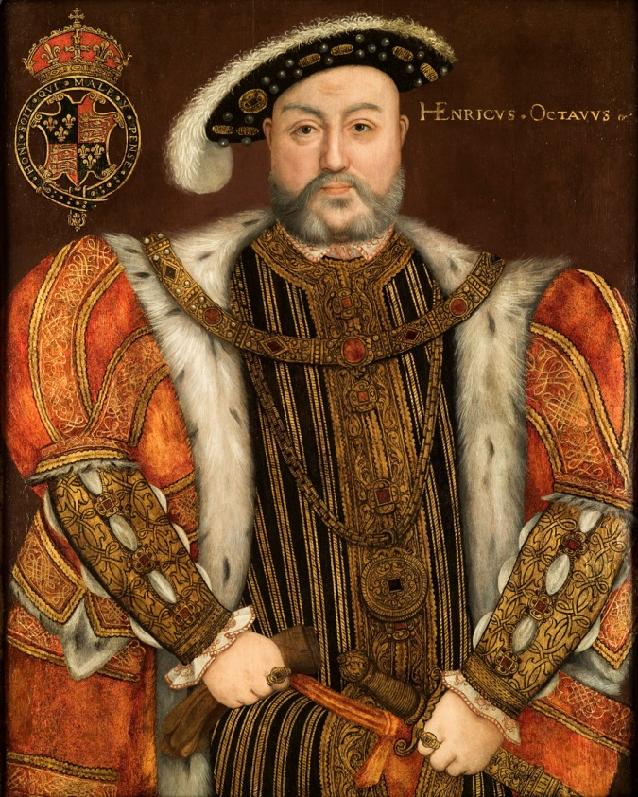
Why did King Henry decide to break away from the Roman Catholic Church?
He wanted a divorce

Slide 22
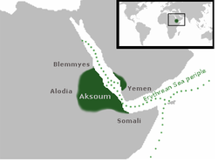
African Kingdoms
Aksum- east coast of Africa, access to Red Sea

Slide 23
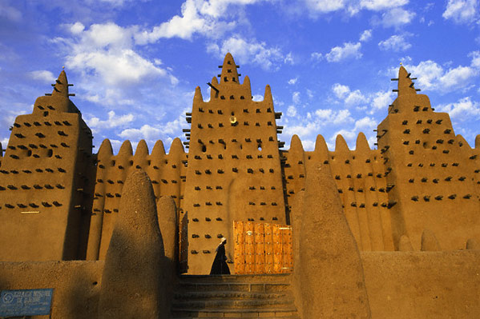
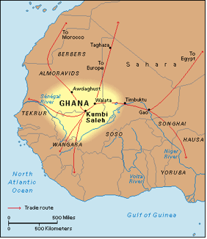
African Kingdoms
Ghana- located off the west coast of Africa. Grew in power due to the Salt for Gold trade in the Sahara desert.

Slide 24
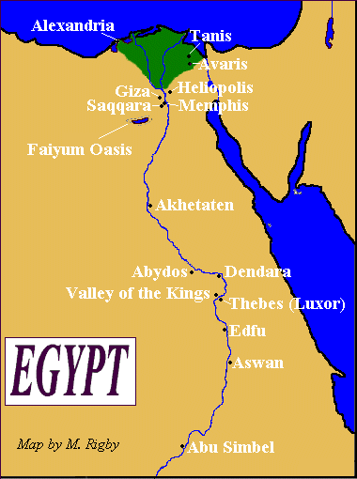
African Kingdoms
Egypt- Access to the Mediterranean Sea and the Red Sea, protected by the Sahara Desert.

Slide 25
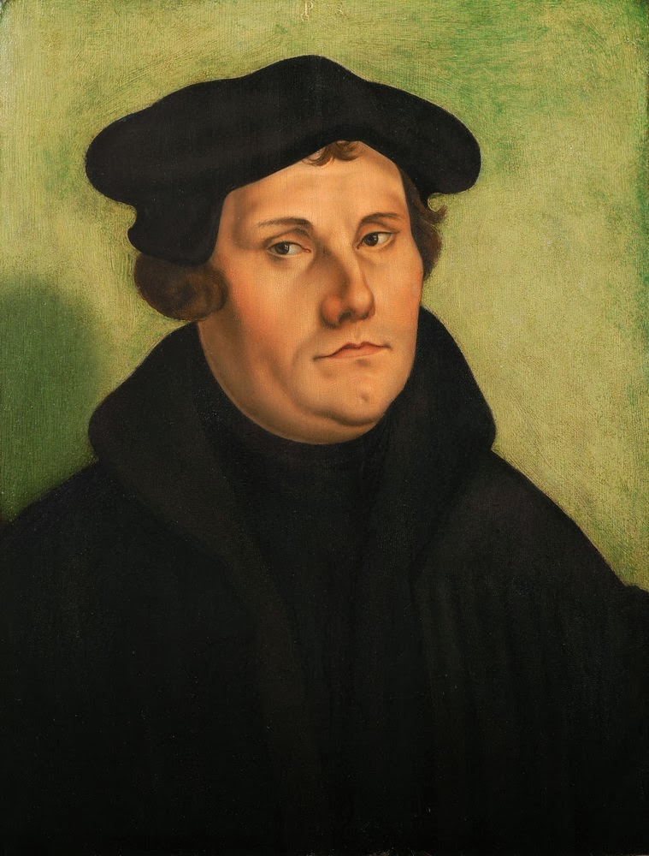
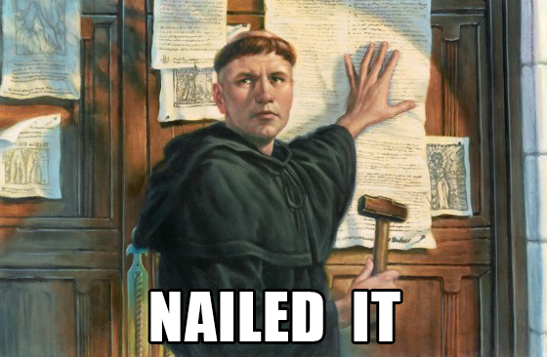
Luther is an outlaw…
Edict of Worms

Slide 26
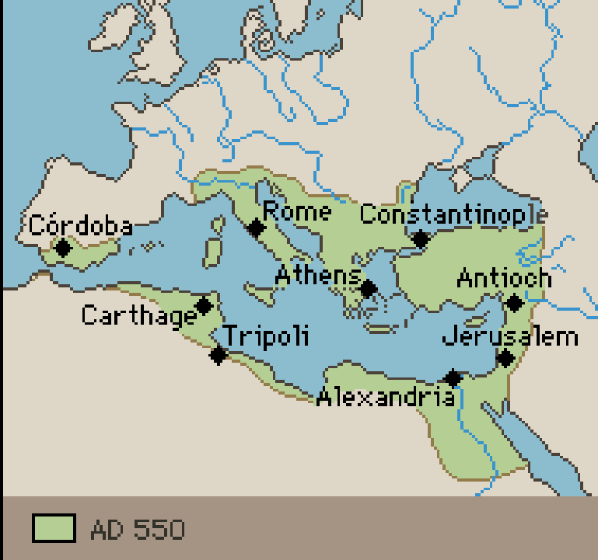
How will the collapse of the Byzantine Empire lead to the Age of Exploration?

Slide 27
Forms of Slavery…
Chattel slave- bound to a human for life.
Indentured Servant- bound to a human for a limited amount of time
Serf- bound to land for life.

Slide 28
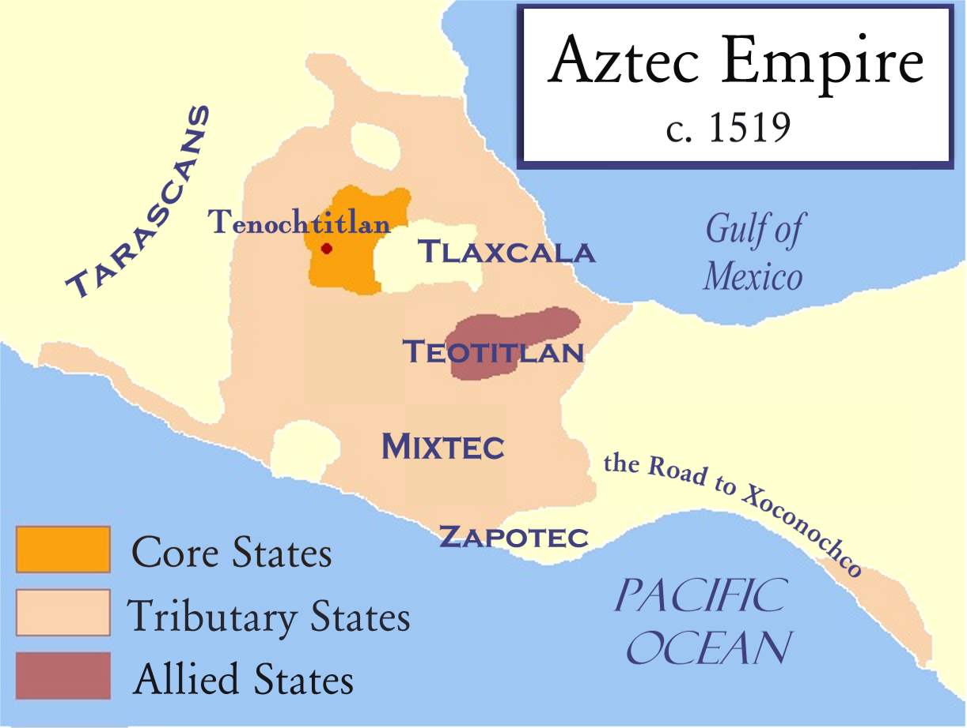
Achievements of the Aztec Empire
Calendar
Prediction of planetary movement
Elaborate headdresses

Slide 29
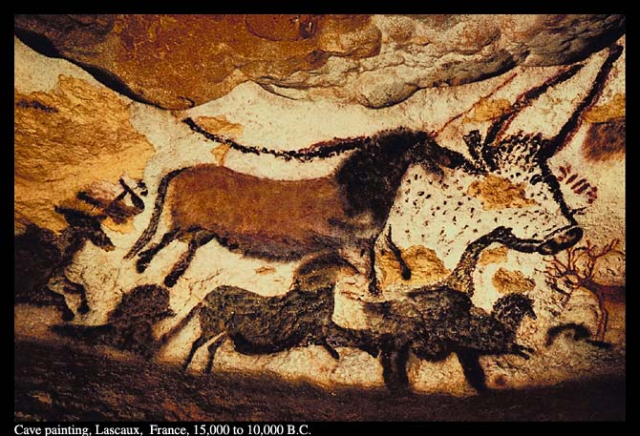
Old Stone Age…
Paleolithic

Slide 30
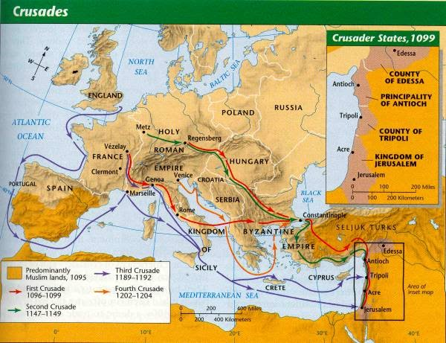
Crusades and a revival of trade

Slide 31
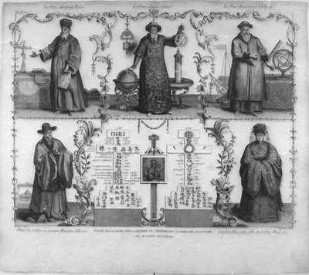
Jesuits…
Society of Jesus
Goal to spread Christianity around the world

Slide 32
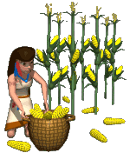
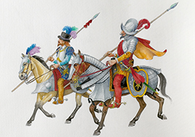
Conquistador
Spanish conqueror of the Americas
Examples- Hernan Cortes conquered the Aztecs; Francisco Pizarro conquered the Incas

Slide 33
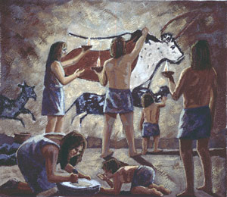
The Life of a Hunter/Gather
Nomadic
  Follow the herds and vegetation
Gender equality

Slide 34
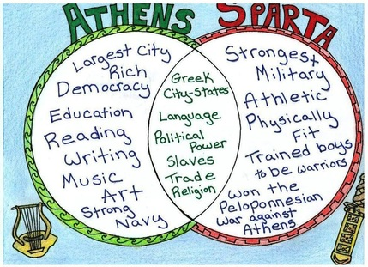
Athenian vs. Spartan

Slide 35
Why did the Roman Empire collapse?
Too big
Foreign invaders
Internal government collapse
Drought

Slide 36

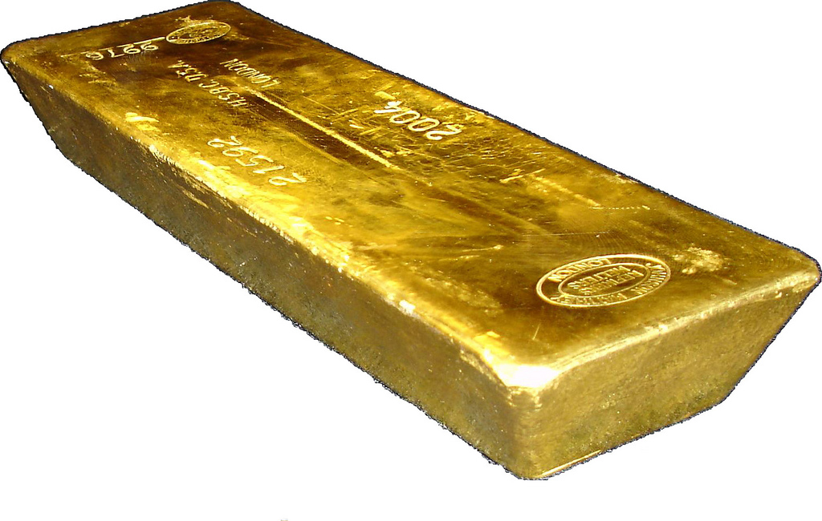
Trade Networks
Trans Saharan

Slide 37
Mediterranean Trade Route
Pax Romana- height of the Roman Empire the Romans maintained control over the Mediterranean Sea
Sea connects Europe, Africa, and Middle East

Slide 38
https://www.youtube.com/watch?v=WrYZT4FxsU0

Slide 39
Indian Ocean
Monsoon winds

