Slide 1
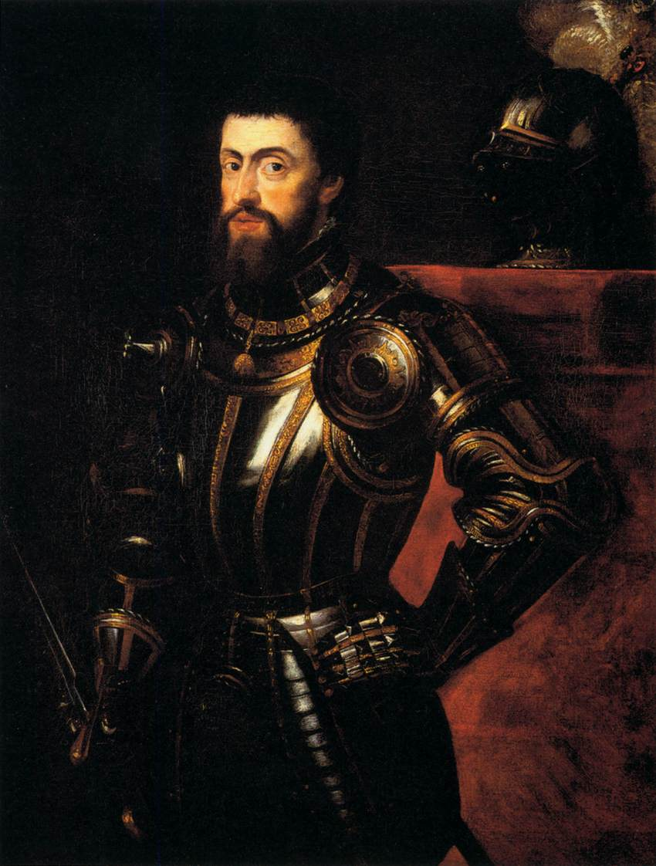
Charles V- Spain
Peace of Augsburg

Slide 2
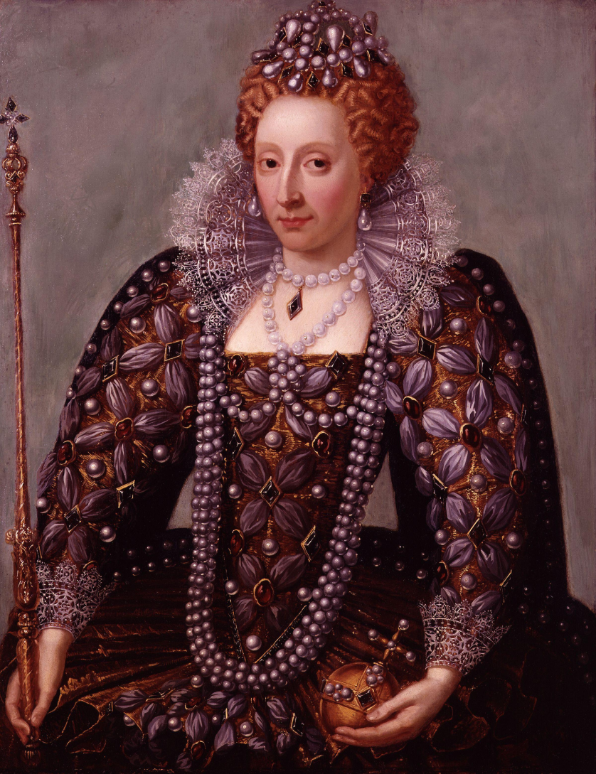
Queen Elizabeth I- England
Went to war with Spain

Slide 3
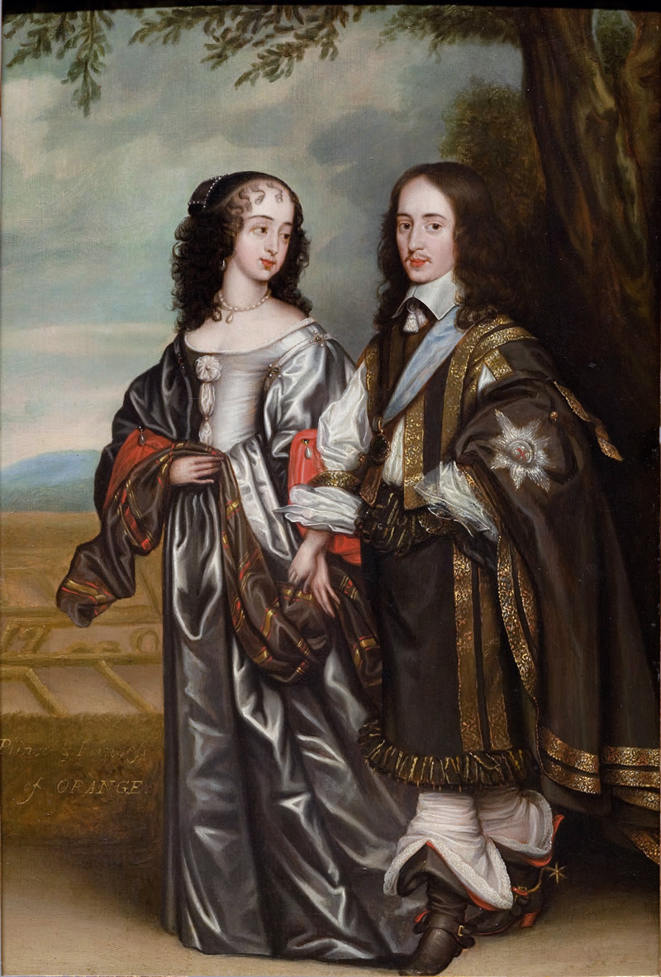
William and Mary- England
Glorious Revolution

Slide 4
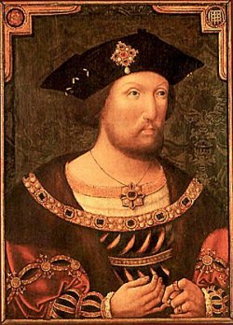
Henry VIII-England
Split with the Pope

Slide 5
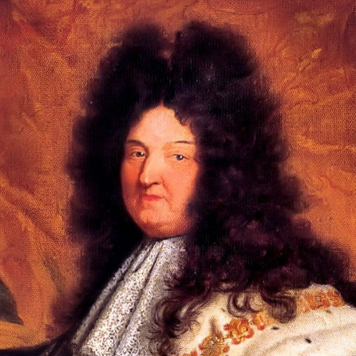
Louis XIV-France
Built the palace of Versailles

Slide 6
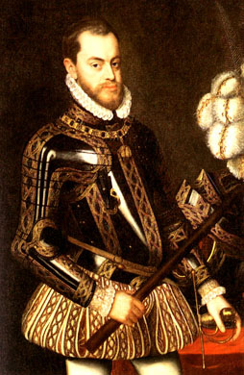
Philip II- Spain
His armada was defeated by England

Slide 7
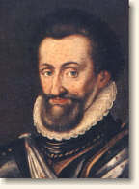
Henry IV
Survived a massacre

Slide 8
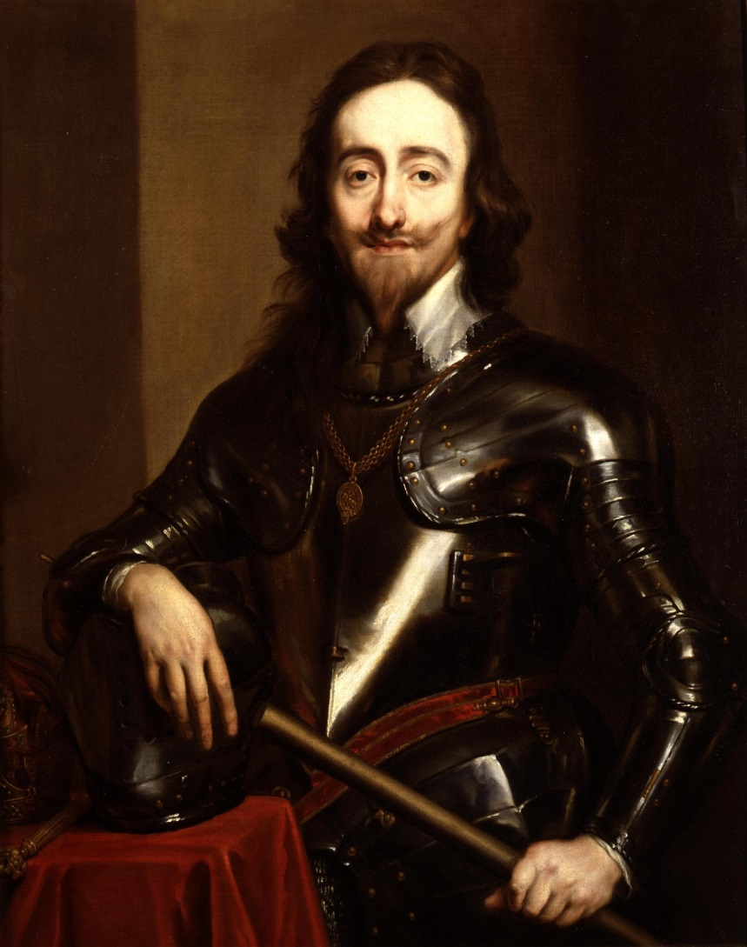
Charles I- England
He will be executed during the English Civil War

Slide 9
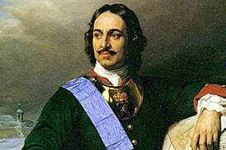
Peter I- Russia
Westernization

Slide 10
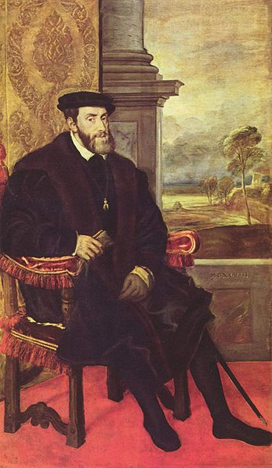
Charles V- Spain
Issued the Edict of Worms against Martin Luther

Slide 11
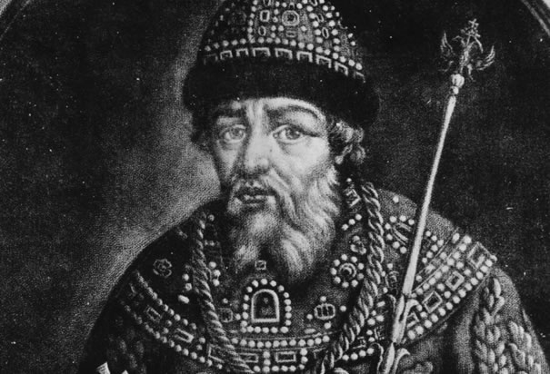
Ivan IV- Russia
Terror
Expanded territory

Slide 12
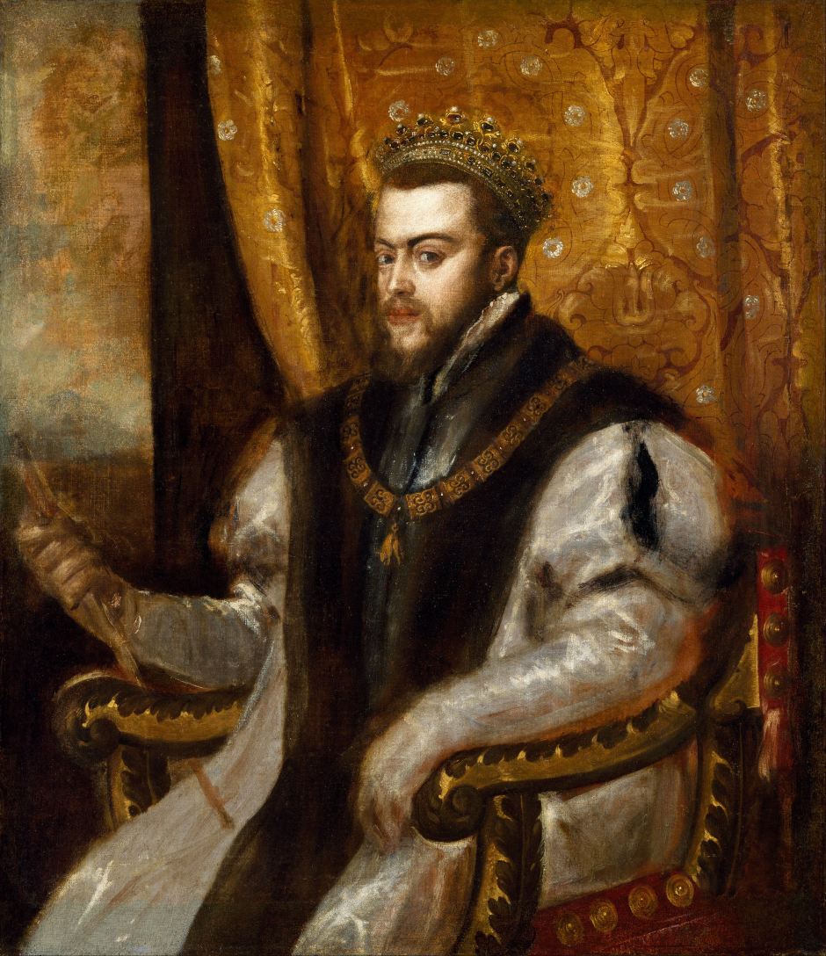
Philip II- Spain
Result of reign- Spain is left weakened

Slide 13
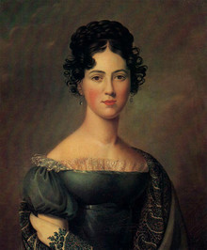
Catherine II- Russia
Czarina

Slide 14
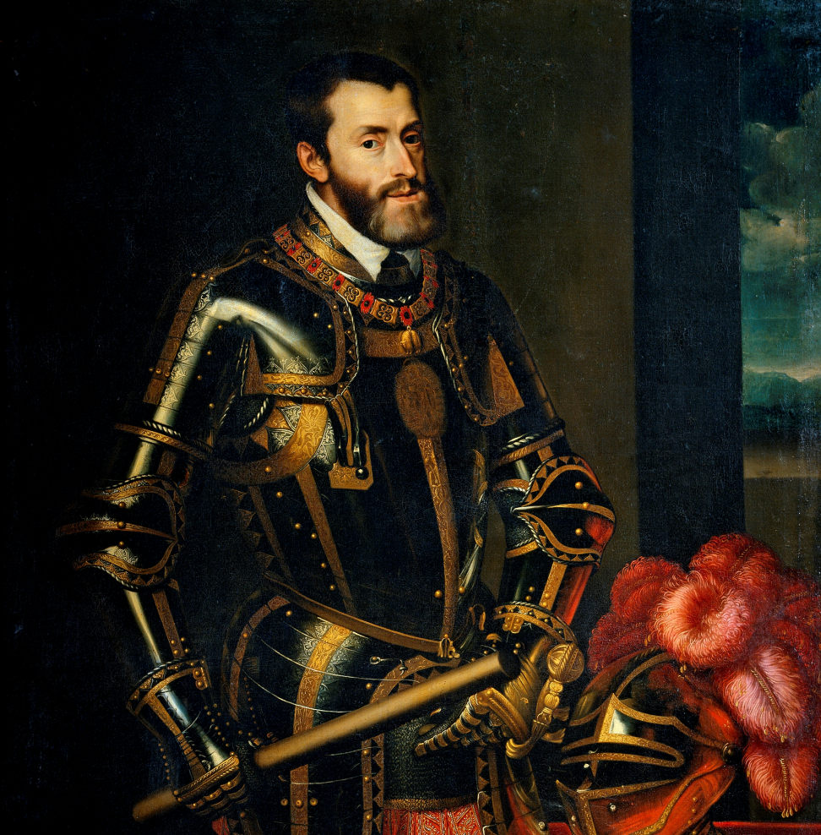
Charles V- Spain
Divided empire between son and brother

Slide 15
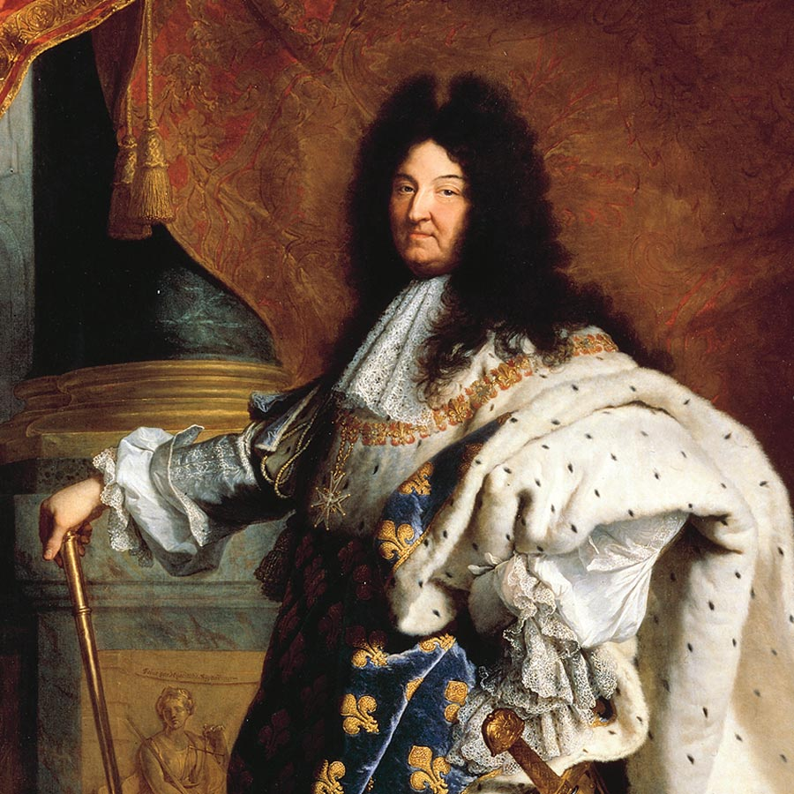
Louis XIV- France
Revoked the Edict of Nantes

Slide 16
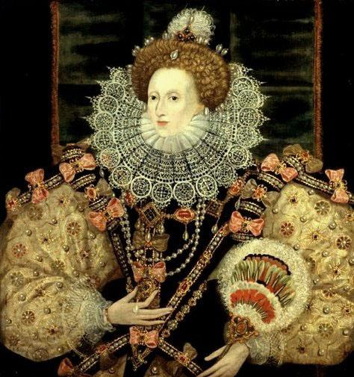
Elizabeth I- England
The “Virgin Queen”

Slide 17
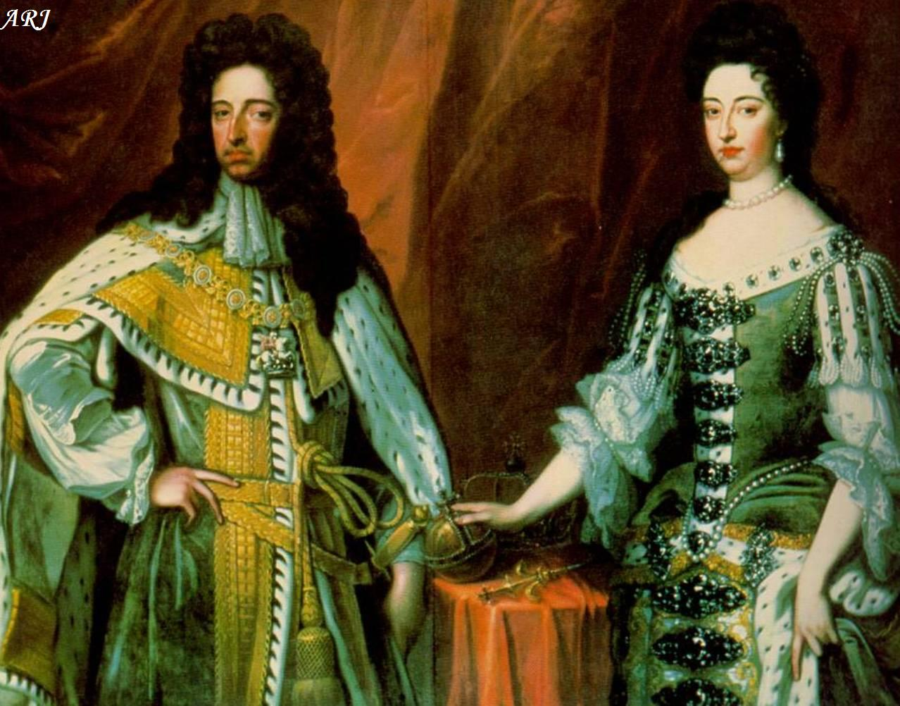
William and Mary- England
English Bill of Rights

Slide 18
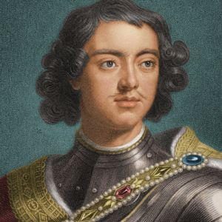
Peter I- Russia
Founded St. Petersburg

