Slide 1
Napoleon and the Revolutions that followed

Slide 2
From subject to citizen: the idea of the nation (5.3.II.)

Slide 3
Napoleon and the spread of Nationalism (5.2.II.E.)
Beginning in the 18th century, peoples around the world developed a new sense of commonality based on language, religion, social customs and territory. These newly imagined national communities linked this identity with the borders of the state, while governments used this idea to unite diverse populations.

Slide 4
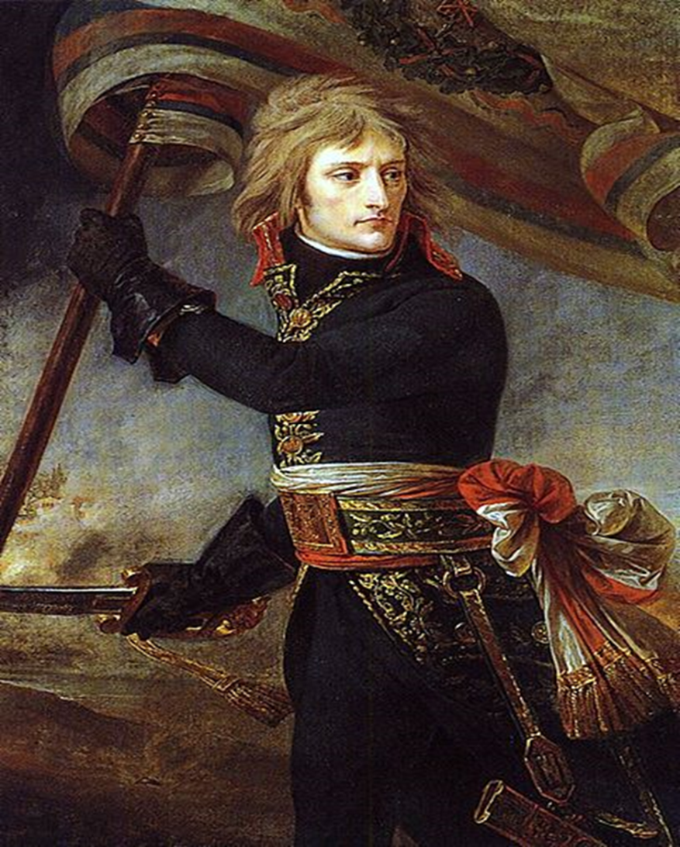
Napoleon
Background- who was he?

Slide 5
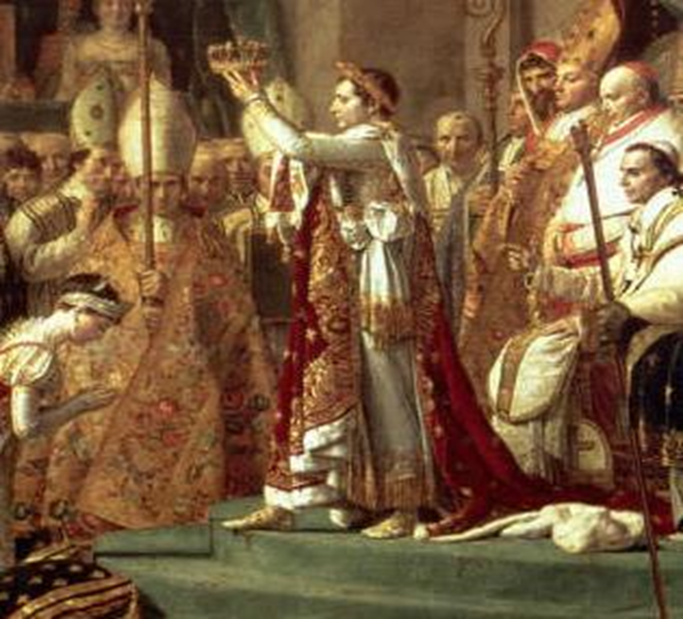

Slide 6
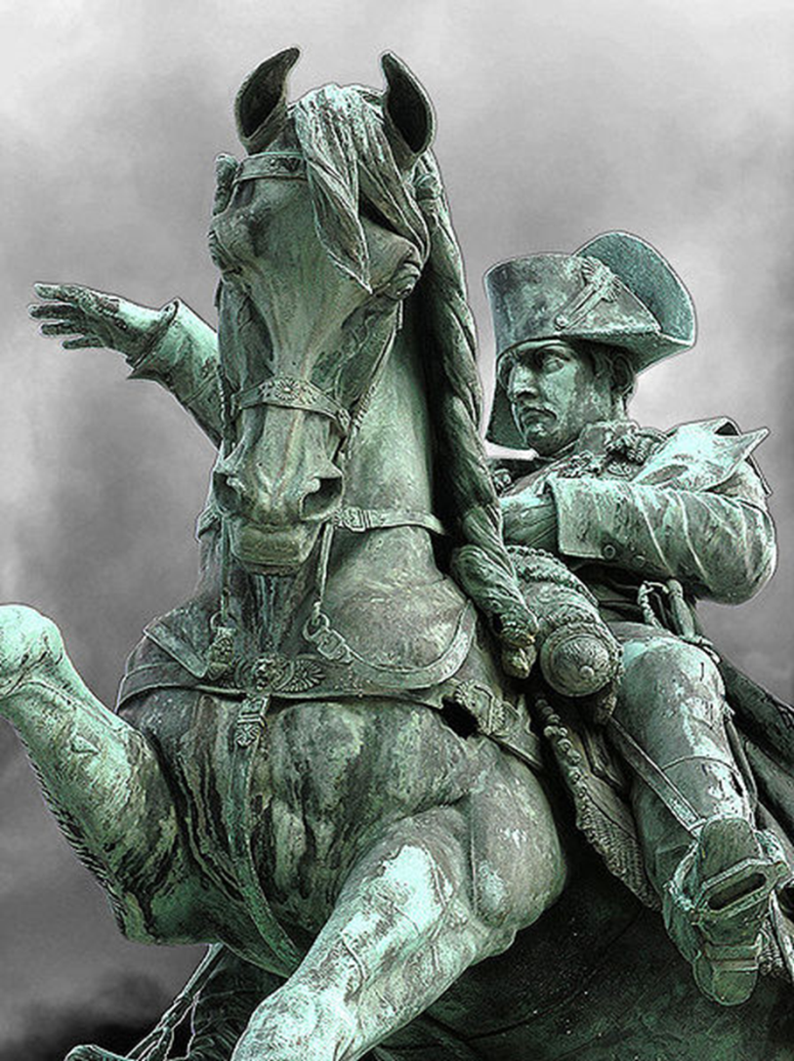
Code of Napoleon

Slide 7
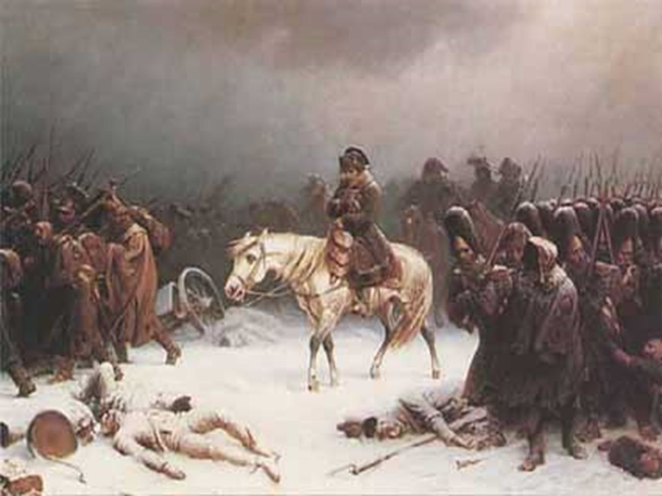

Slide 8
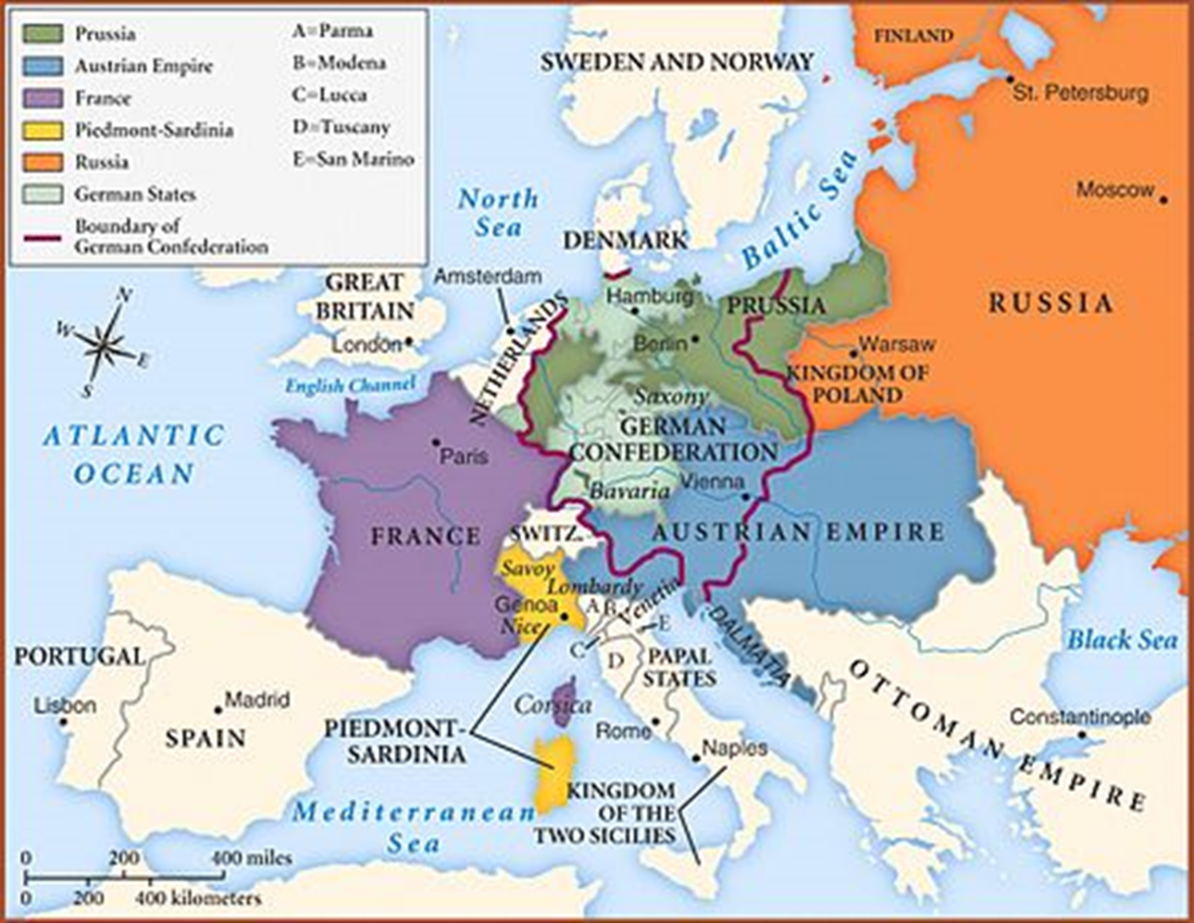

Slide 9
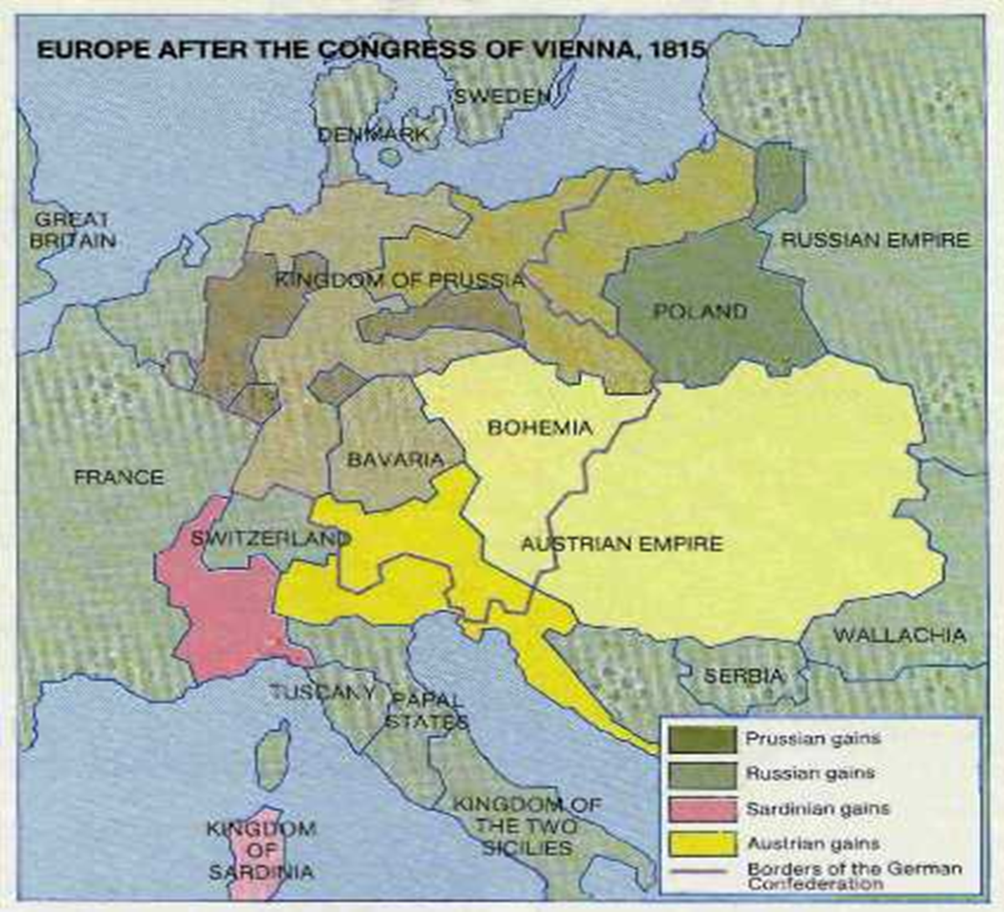

Slide 10
French Revolution and Napoleonic Wars catalyst for other Rebellions and Revolutions (5.3.III.B.)

Slide 11
Haitian Independence as true social revolution (5.3.III.B.)
Slave resistance (such as the establishment of Maroon societies) challenged existing authorities in the Americas

Slide 12
Simon Bolivar’s Jamaica Letter (5.3.I.D.)
Along with the Declaration of the Rights of Man and Citizen, and the Declaration of Independence, this document demonstrated the ideals of the Enlightenment
“Generous souls always interest themselves in the fate of a people who strive to recover the rights to which the Creator and Nature have entitled them, and one must be wedded to error and passion not to harbor this noble sentiment.”

Slide 14
Latin American Independence movements: Mexico (5.3.III.B)
Father Miguel Hidalgo
Antonio Lopez de Santa Anna (conflict with US)
Benito Juarez- Mexico’s first president, La Reforma

Slide 15
The Limits to Liberty: Slaves and Women (5.3.III.D. and 5.3.IV.B.)
Declaration of the Rights of Woman and of the Female Citizen by Olympe de Gouges

