Slide 1
Bell Ringer

Slide 2
What period do I belong to?
Yuan Dynasty
Period 3

Slide 3
What period do I belong to?
Gutenberg Bible was printed
Period 4

Slide 4
What period do I belong In?
French and Indian War
Period 5

Slide 5
What period do I belong in?
Apostle Paul spreading the word of Christianity.
Period 2

Slide 6
Imperialism allowed for emergence of settler colonies such as Australia

Slide 7
https://www.youtube.com/watch?v=HGTBo1P_VZY

Slide 8
Marathas challenge Mughal Rule
VS.

Slide 9
Sepoy Rebellion
https://www.youtube.com/watch?v=2yXKbd5IDzU

Slide 10
Anti-colonial Movements- formation of INC
INC- Indian National Congress, founded in 1885 during the British Raj
Swadeshi- “of our own country”- called for the boycott of imported British goods
By 1920s and ‘30s the Congress was led by Mohandas Gandhi

Slide 11
Africa

Slide 12
Berlin Conference
1884-1885
Agreed that when a European nation claimed a new African territory, it had to notify other European nations.

Slide 13
Belgium in congo
Leopold III
Rubber

Slide 14
Settler colonies: French in Algeria
France’s conquest of Algeria anticipated the scramble for Africa after 1870
France hoped that this conquest would stir up a sense of nationalism

Slide 15
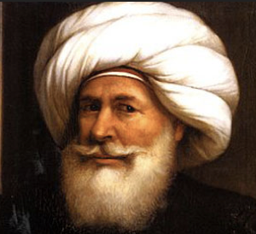
Contraction of Ottoman Empire, their loss of Egypt
Modernization
Muhammad Ali began the reforms that created modern Egypt

Slide 16
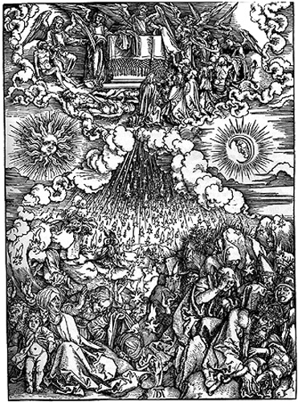
Anti-colonial movements: Millenarian anti-colonial revolt
Millenarianism- end of the world hysteria

Slide 17
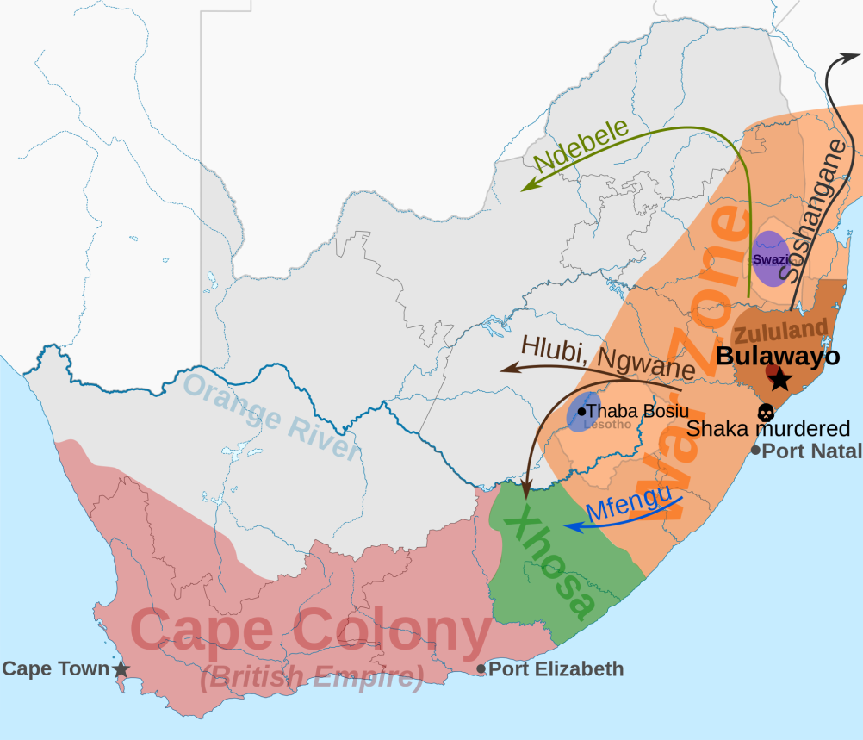
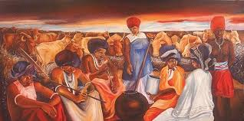
Anti-colonial movements: Xhosa cattle killing movement
Mass passive resistance movement

