Slide 1
Bell Ringer
How did Peter the Great attempt to modernize, westernize, and secularize Russia?

Slide 2
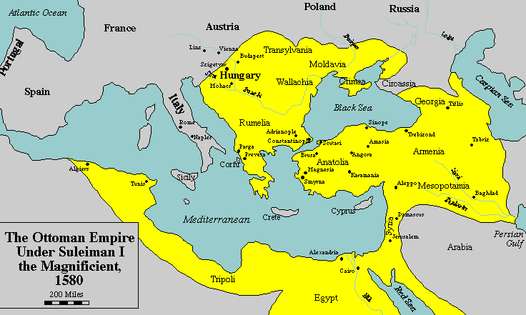
Origin
Turkish nomadic people

Slide 3
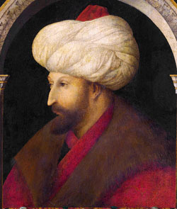
1453- Mehmed II conquered Constantinople

Slide 4
Ottoman treatment of non-Muslims
Christian Orthodox churches allowed to remain
Jewish, Christian, and other minorities were allowed to maintain autonomy

Slide 5
Devshirme (collecting or gathering)
Large conquered Christian regions had to hand over a quota of young boys.
Taught Turkish, converted to Islam. Many would become Janissaries
Elite soldiers, raised by the state

Slide 6
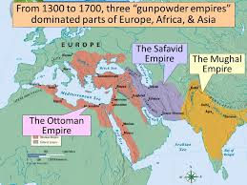

Slide 7
Religion
Ottoman- Sunni (some religious tolerance under Suleiman)
Safavid- Shia, No tolerance, Ismail I made conversion mandatory for population
Mughal- Tolerance under Akbar, his blend of Hinduism and Islam was not popular.

Slide 8
Taxes/Economy
Ottoman- Taxes on non-Muslims. Taxes on peasants.
Safavid- Taxation policies used to encourage adherence to Shia Islam.
Mughal- Taxes on unbelievers were abolished by Akbar but later reinstated. Taxes on peasants.

Slide 9
Military
Ottoman- Warriors (often trained Janissaries) were granted villages to provide their upkeep. Leaders made the military independent of central government. Strong navy.
Safavid- Warriors were the Qizlibash, Turcoman militants who helped establish the empire. Leaders made the military independent of central government. No significant navy.
Mughal- Warriors were granted villages to provide their upkeep. Officials known as zamindars made the military independent of central government. Small navy.

