Slide 1
Bell Ringer

Slide 2
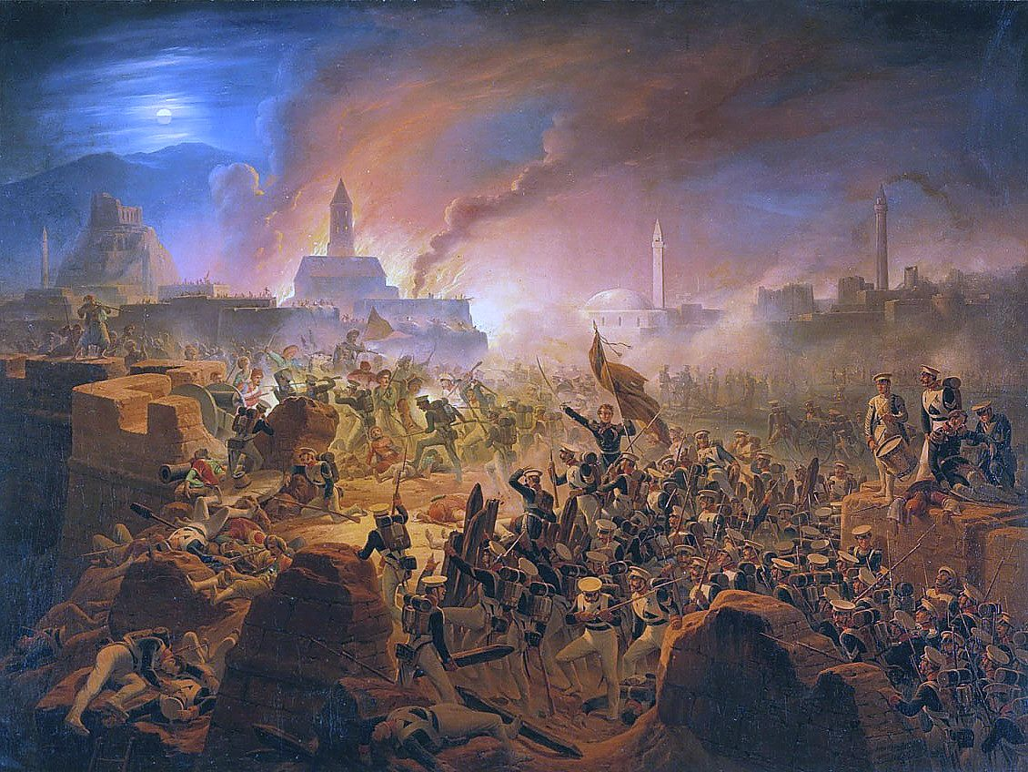
Ottoman: Growth of Russian Empire (clash with Russia) (5.2.I.B.)
Russo-Turkish War

Slide 3
Ottoman loss of territory: Egypt, Balkans (5.2.II.C.)

Slide 4
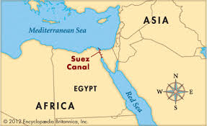
Egypt

Slide 5
Examples of Reform: Tanzimat
1. Identify and root out corruption

Slide 6
Examples of Reform: Tanzimat
Secular system of education

Slide 7
Examples of Reform: Tanzimat
Infrastructure

Slide 8
Examples of Reform: Tanzimat
Codified Laws

Slide 9
Examples of Reform: Tanzimat
Hatt-I Humayun (Ottoman Reform Edict)

Slide 10
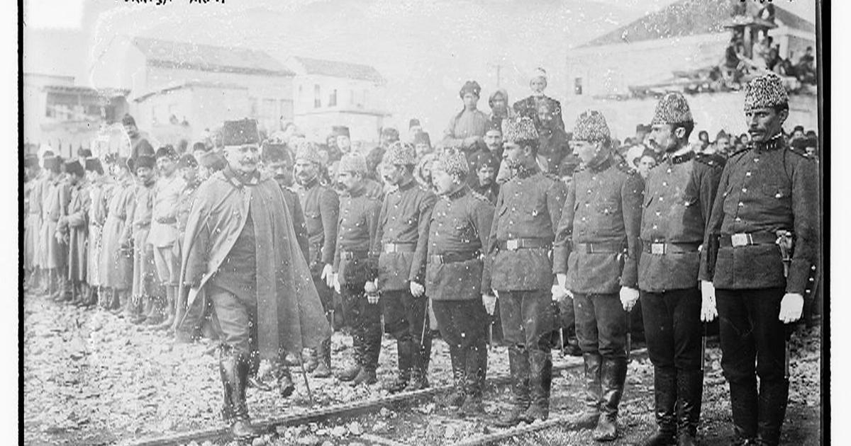
Examples of Reform: Tanzimat
Introduction of Islamic culture

Slide 11
Examples of Reform: Young Turks

Slide 12
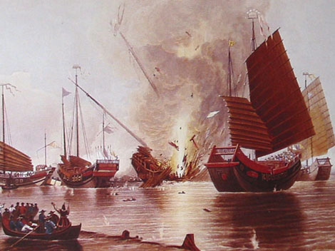
Economic Imperialism, British and Opium (5.2.II.E.)

Slide 13
Letter from Commission Lin Tse-Hsu to Queen Elizabeth
We have heard that in your own country opium is prohibited with the utmost strictness and severity:---this is a strong proof that you know full well how hurtful it is to mankind. Since then you do not permit it to injure your own country, you ought not to have the injurious drug transferred to another country, and above all others, how much less to the Inner Land! Of the products which China exports to your foreign countries, there is not one which is not beneficial to mankind in some shape or other. There are those which serve for food, those which are useful, and those which are calculated for re-sale; but all are beneficial. Has China (we should like to ask) ever yet sent forth a noxious article from its soil?

Slide 14
Rebellions influenced by millenarianism, Taiping Rebellion (5.3.III.E.)

Slide 15
Examples of Reform, Self Strengthening Movement (5.3.III.F)

Slide 16
Anti-colonial Movements, Boxer Rebellion (5.3.III.D.)

Slide 17
https://www.youtube.com/watch?v=e3XAYIr0478
https://www.youtube.com/watch?v=nxmWfbXS4Pw

