Slide 1
Ivan III
Married niece of the last Byzantine Emperor
Moscow as “Third Rome”
Close relationship with Orthodox Church legitimized wars of territorial expansion

Slide 2
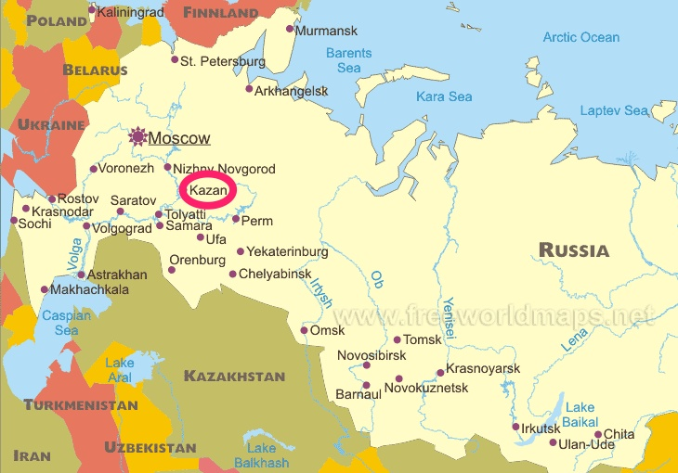
Ivan IV
Defeated Mongol stronghold in Kazan
St. Basil’s Cathedral, architectural symbol of the union of church and state

Slide 4
Ivan IV
Stripped the boyars of power
Autocrat

Slide 5
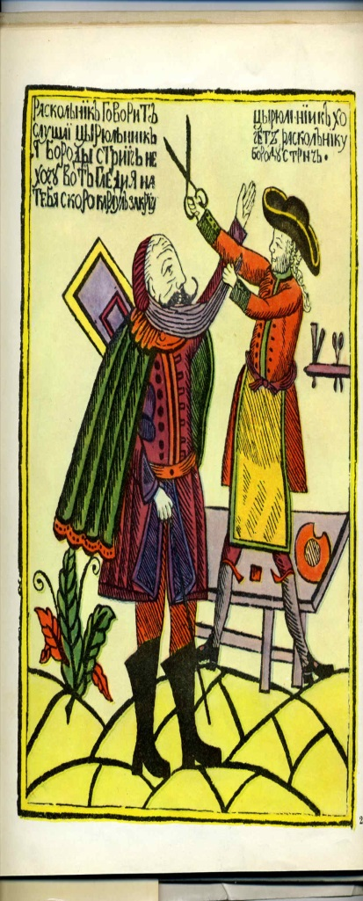
Peter the Great
Traveled to Europe where he studied shipbuilding and other western technologies
Westernize the Russian empire with a series of Reforms…

Slide 6
Peter the Great: The Petrine Reforms
Education
Noble boys required education
Established universities
Control
Police System
Internal Passport

Slide 7
Peter the Great: Military Reform
Drafted peasants for service as professional soldiers
Built navy
Introduced modern firearms, and gunpowder did much to bring success to Russian military campaigns

Slide 8
Building the Infrastructure
Organized peasants to work on roads
Postal service system

Slide 9
Expansive Territory
Gained territory along the Baltic Sea
Pushed empire far to the east in Siberia, reaching the Bering Strait across from Alaska

Slide 11
Reorganization of the bureaucracy
Merit based employees- Table of Ranks
Taxation- per person taxation

Slide 12
Relocation of the capital
From Moscow to St. Petersburg
Symbolically and literally break the hold that old Russian religious and culture traditions had on government.

Slide 13
Ivan IV Trial

