Slide 1
Key Concept 2.3- Emergence of Transregional Networks of Communication and Exchange

Slide 2
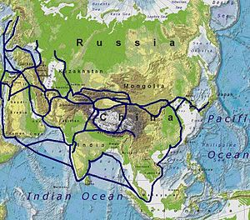
Classical Age
Classical Age empires created massive amounts of goods and became markets for imports
Notes:
Note- the silk roads connected all classical civilizations

Slide 3
2.3: I. Land and water routes became the basis for transregional trade, communication, and exchange networks in the Eastern Hemisphere

Slide 4
Silk Roads
Notes:
Europeans became captivated by the idea of a trade route linking the lands of the Mediterranean with China by way of Mesopotamia, Iran, and Central Asia.

Slide 5
Where does the term “Silk Road” come from anyways??
In 1877 the term "Seidenstraße" (Die Seidenstrassen, literally "Silk Road") was coined by the German geographer, cartographer and explorer Ferdinand von Richthofen.

Slide 6
Origin of the Silk Road… Where it all began!

Slide 7
Chinese and Nomad Traders

Slide 8
Technology

Slide 9
Oasis towns became stepping stones of cultural dissemination
Notes:
As the silk road grew necessary and traveling became somewhat easier Merchants became agents of cultural diffusion

Slide 10
Spread and Synchronization of religions
Nestorian Christianity
Mahayana Buddhism
Buddhism spreads to China
Notes:
Nestorian Christanity- Eastern Byzantine, Logos, spirit and Jesus body
MB- awakening consists of understanding the true nature of reality, vs B emphasizes the absence of the self in person, MB- everyone can become buddhas

Slide 11
The role of law in the empires as it concerns trade
Notes:
Jus gentium, jus civile

Slide 12
http://www.history.com/shows/mankind-the-story-of-all-of-us/videos/mankind-the-story-of-all-of-us-the-silk-road
http://www.mitchellteachers.org/ChinaTour/SilkRoadProject/silk_road-main.html
http://www.youtube.com/watch?v=vfe-eNq-Qyg

Slide 13
Mediterranean Sea Routes

Slide 14
The Phoenicians

Slide 15
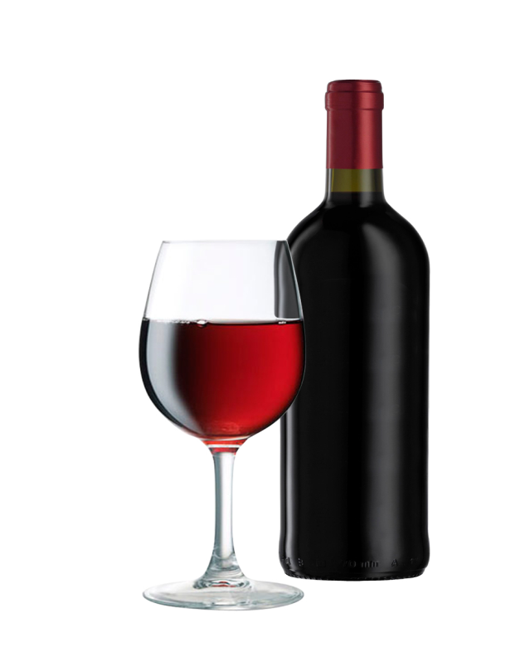
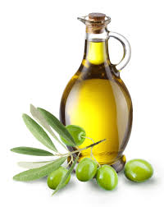
The Greeks- consequence was diffusion of Greek Culture

Slide 16
Most significant change in Mediterranean trade occurred when Carthage fell to Rome and the rim of the Mediterranean Seas was controlled by the Roman government.

Slide 17
Widespread use of Latin
Roman Navy
Mare Nostrum

