Slide 1
Standard 4, Unit 3- Chapter 14
LEQ: What were the causes of the Renaissance?

Slide 2
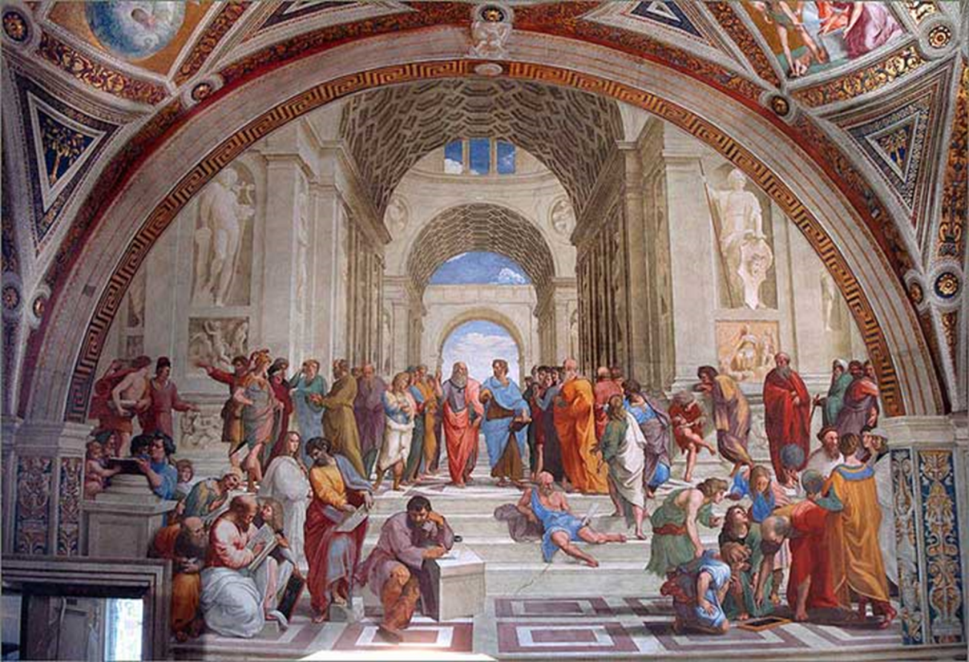
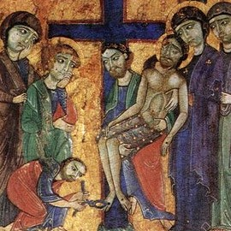
Bell Ringer
Based on your reading from last night, how did Renaissance different from that of the art of the Middle Ages?

Slide 3
School of Athens by Raphael

Slide 4
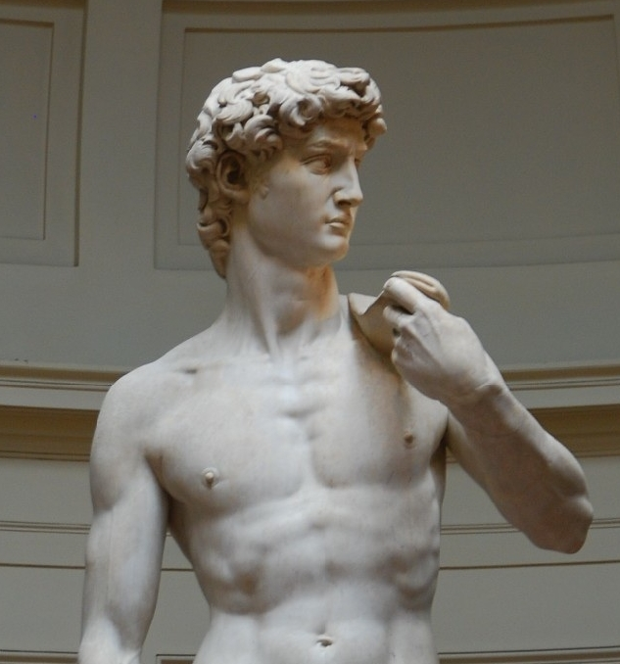
David by Michelangelo

Slide 5
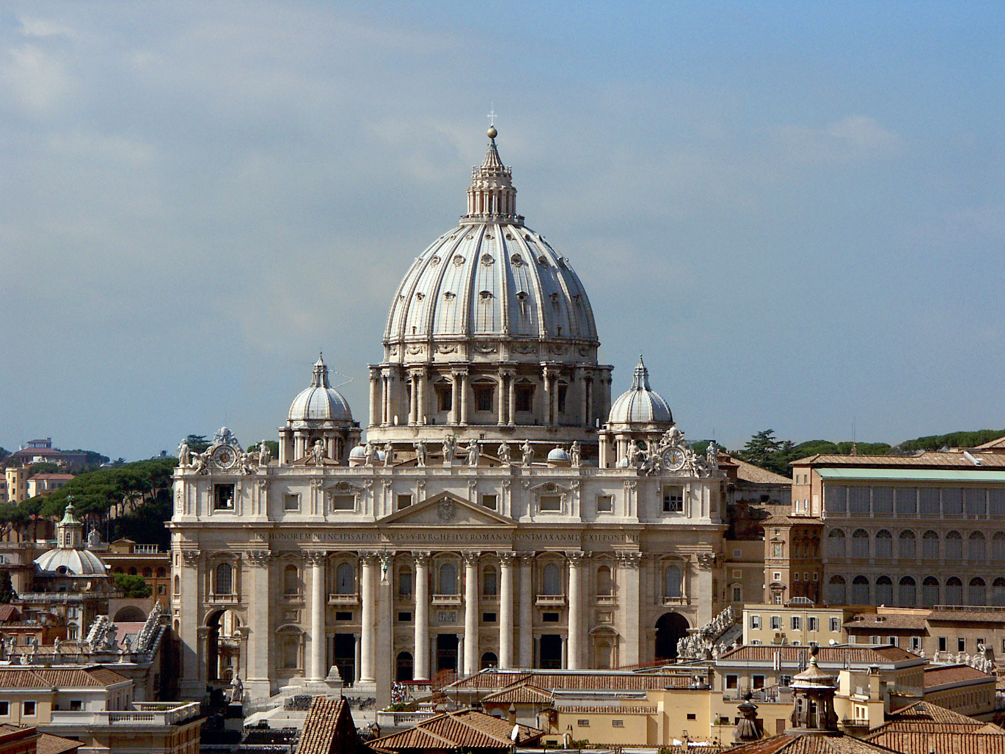
Saint Peter Basilica

Slide 7
Analyze how Italy’s geographic location will impact it’s ability to trade.

Slide 8
Rise of Italian City-States
No Italian nation exists at this time
Italy is compromised of individual and unique city-states

Slide 9
Rise of Italian City States
Urban areas began to specialize
Merchants became very wealthy

Slide 10
Routes of the Crusades

Slide 11
Trade Routes

Slide 12
Refuge for Scholars

Slide 14
Venice- Trading Center
Venice was the first and biggest trading center before 15th century
Luxury goods from the east and raw materials from the north.

Slide 15
Florence and it’s Banks!
The power of credit (promise of later payment)
International business adventures

Slide 16
The Rise of Powerful Merchants
Patrons
Showed status by financing new buildings and purchasing art

Slide 17
Political Views of the Renaissance

Slide 18
Political Views
Niccolo Machiavelli
The Prince
Ruler must do whatever necessary to maintain power
“The end justifies the means”

Slide 19
Now Let’s Review
Why Italy?
What was Venice known for? Florence?
What is a merchant?
Who are the Medici family? What do they do?
What does Renaissance mean?

Slide 20
DBQ
“The Prince ought to have no other aim or thought, nor select anything else for his study, than war and its rules and discipline; for this is the sole art that belongs to him who rules, and it is of such force that it not only upholds those who are born princes, but it often enables men to rise from a private station to that rank. And, on the contrary, it is seen that when princes have thought more of ease than of arms they have lost their states.”
According to Machiavelli, what should a prince focus on and why?

Slide 21
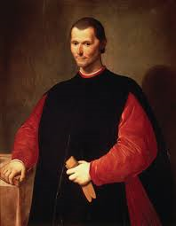
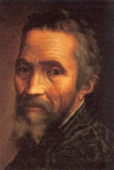
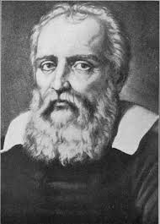
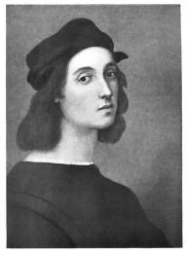
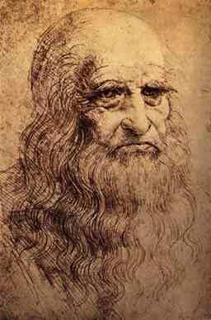
Humanism
Talented Individuals
Notes:
Interpret these images.

Slide 22
Humanism
An intellectual movement during the Renaissance that focused on the study of worldly subjects, such as poetry and philosophy and on human potential and achievements.

Slide 23
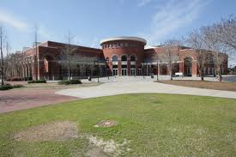
Humanities
Study of:
Foreign languages
Literature
Philosophy
Religion
Visual and Performing Arts
History
Anthropology
Communication Studies
Cultural Studies
Linguistics

Slide 24
Secular Writings
Baldassare Castiglinone
“The Courtier”

Slide 25
DBQ
“Within The Courtier they discuss how courtiers and court ladies should behave, suggesting they should:
1. Speak of serious subjects as well as amusing ones.
2. Have a knowledge of Latin and Greek.
3. Be well-acquainted with poetry and history.
4. Be able to write prose as well as poetry.
Based on the source above and your background knowledge, analyze one effect The Courtier had on society .

Slide 26
Answer you lesson essential question…
How will the Renaissance transform people’s lives?

Slide 27
Reflective Summary
What does Renaissance mean?
Why Italy?
What are the factors that will cause the Renaissance?
What is humanism?
Who was Niccolo Machiavelli? What book did he write?

Slide 28
Page 440-441
Interpreting Visuals
Answer questions 1 and 2

Slide 29
Foldable instructions
Open textbook to page 443
Each outside flap will have a major Renaissance figure.
Flap 1: Leonardo da Vinci
Flap 2: Michelangelo
Flap 3: Raphael
Flap 4: Bramante
Open the flap. On the left inside flap you will record the field(s) that these figures participated in. (For example: painter, musician)
On the right inside flap you will record their major achievements. (For example: “The David”)

Slide 30
And they looked to the stars…

Slide 31
The Printing Revolution

Slide 32
Interactive map of the spread of the Printing Press
http://atlas.lib.uiowa.edu/

Slide 33
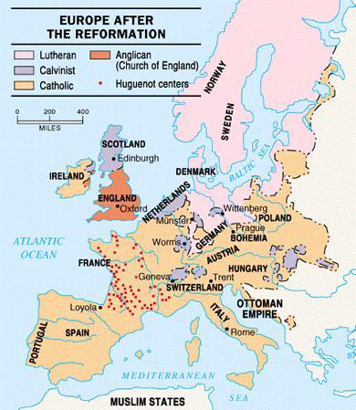

Slide 34
The Counter Reformation

Slide 35
The Jesuits
Concentrated on education as a means of combating Protestant Reformation
Established missions, schools and universities

Slide 36
Women and the Church
Women take more active role in religious orders
Nuns could help, the poor, orphaned or the sick.

Slide 37
Inquisitions
Spanish Inquisition
Imposed religious conformity
Religious intolerance and anti-Semitism increased

