Slide 1
Bell Ringer
What are two European countries will establish colonies in the new world?
What goods/items will they be looking for?
What economic system will they function under?

Slide 2
Standard 6
LEQ: What were the advantages and disadvantages of the Spanish and English monarchies?

Slide 3
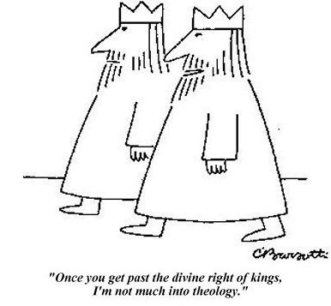
Monarchs of Europe
Absolute Monarch- a ruler who:
Had limitless power
Did not have to consult nobles when making decisions
Ruled by divine rights
Divine Right-monarchs received their power from God.

Slide 4
The King Becomes an Emperor
Charles V became Holy Roman Emperor
Empire so large “the sun never set” over it
Notes:
1519, the throne of the Holy Roman empire became vacant, position elective; Charles borrowed money to buy votes, became Holy Roman emperor (Holdings expanded to parts of Italy, Austria, various German states.

Slide 5
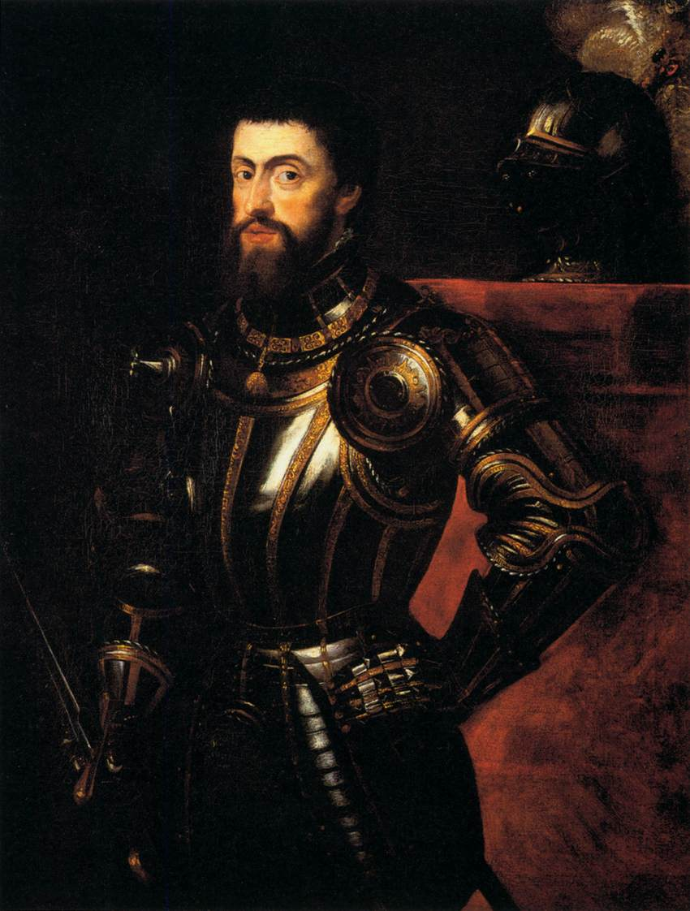
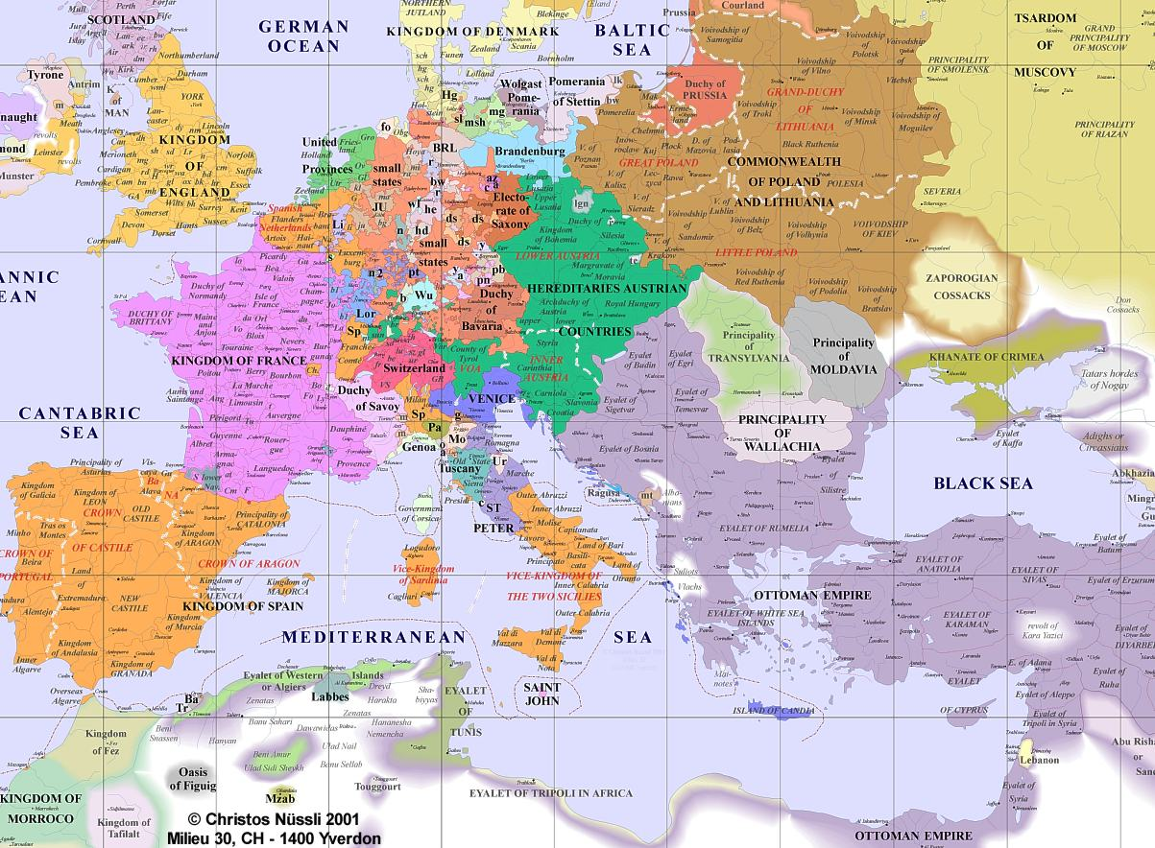
Spanish Monarchs
Charles V- King of Spain

Slide 6
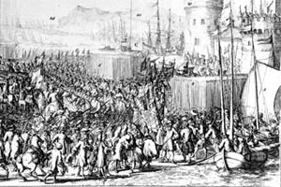
Catholicism vs. Protestantism
Protestant followers gained influence within Europe
Rebellions spread throughout Europe against the Catholic rulers

Slide 7
Peace of Augsburg
Notes:
Gave the right of German princes the right to decide if his state would be Catholic or Protestant.
Charles vision of a Catholic Europe never became a reality
Constant warfare also brought Charles to brink of bankruptcy

Slide 8
Peace of Augsburg
1555
Gave each German prince the right to decide his faith (Protestant or Catholic)

Slide 9
Division of the empire
Charles V gives up throne
Divides empire between brother and son

Slide 10
Division of the Empire
Notes:
Frustrated by failures in Europe, 1556 Charles V gave up thrones, decided to divide large empire, Split empire between his brother and son. Brother took over the Hapsburg holdings in Austria, Son Philip II ruled Netherlands, Spain, Sicily and Spain’s colonies.

Slide 11
King Philip II (son of Charles V)
Spain grew wealthy due to the gold from the colonies

Slide 12
England vs. Spain
England
Protestant
Sea Dogs
Court of Blood- Protestant rebellions
Spain
Catholic
Spanish Armada
Notes:
Queen Elizabeth allowed her ship captains to attack Spanish ships that were leaving the colonies with gold and silver

Slide 13
England is the Victor!
The Spanish Armada was defeated
England remained Protestant
http://www.schoolhistory.co.uk/lessons/armada/map.htm
https://www.youtube.com/watch?v=AsuSxqG_-ko

Slide 14
The Decline of Spain
Internal Problems
King Philip’s centralized government
King Philip trusted no one
Spain’s economy relied on traditional economy

Slide 15
Monarchs of France

Slide 16
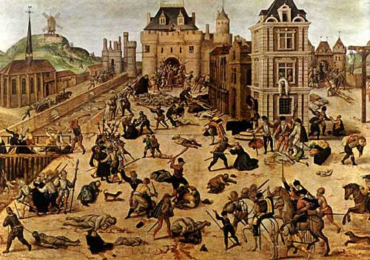
French Monarchs- Henry IV
Saint Bartholomew’s Day Massacre

Slide 17
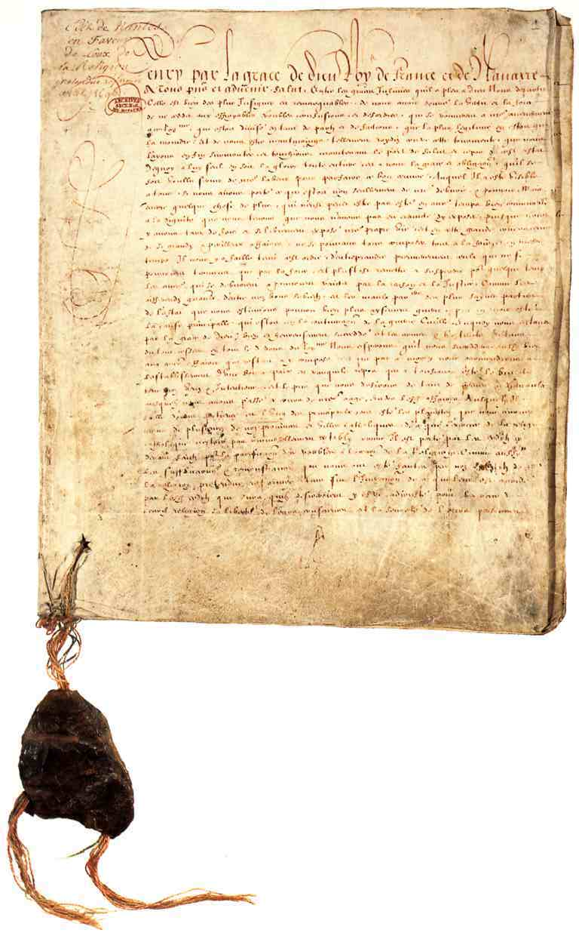
French King Henry Vi
Edict of Nantes

Slide 18
French King- Louis XIV the sun King

Slide 19
Tour of the Palace of Versailles
https://www.youtube.com/watch?v=XxIzMr2Ekpo
https://www.youtube.com/watch?v=852eroBwDrA

Slide 20
Monarch in England

Slide 21
Henry VIII
Protestant Church of England

Slide 22
Elizabeth I Daughter of King Henry VIII
Protestant Ruler
“Virgin Queen”
Defeated the Spanish Armada

Slide 23
Charles I Son of Scottish King James I
Forced to sign the Petition of Right
Limit kings power
Limit taxation
Direct challenge to absolutism
English Civil War

Slide 24
The English civil War
The Royalists vs. Parliament
Oliver Cromwell- Lord Protector of the Commonwealth of England

Slide 25
https://www.youtube.com/watch?v=u3h_RyFEV0M

Slide 26
The Glorious Revolution
English nobles invited William and Mary to England.
William was the brother of James
James fled to France and the Parliament throne William II and Mary II as joint rulers.

Slide 27
Mini Activity-Answer in Notes
Page 550
Primary Source- the English Bill of Rights
Below your answers copy this sentence in your notes:
The Bill of Rights was central to England’s growth as a constitutional monarchy, the term for a monarchy limited by law.

Slide 28
What is an absolute monarch?

Slide 29
Rulers of Russia

Slide 30
Ivan the Terrible
Became suspicious of his advisors
Created a private police force in order to maintain order
Killed his own son

Slide 31
Peter the great
Westernized Russia:
Modernized army
Increased industry
Started the first Russian newspaper
Sponsored new schools
Founded new cities

Slide 32
St. Petersburg

Slide 33
Catherine the Great
Declared czarina
Reformed the legal and educational systems of Russia
Promoted the arts and sciences

Slide 34
Standard 6
Revolutions and Rebellions
SWBAT: Understand the effects that the new revolution and rebellions would play on World Hitory

Slide 35
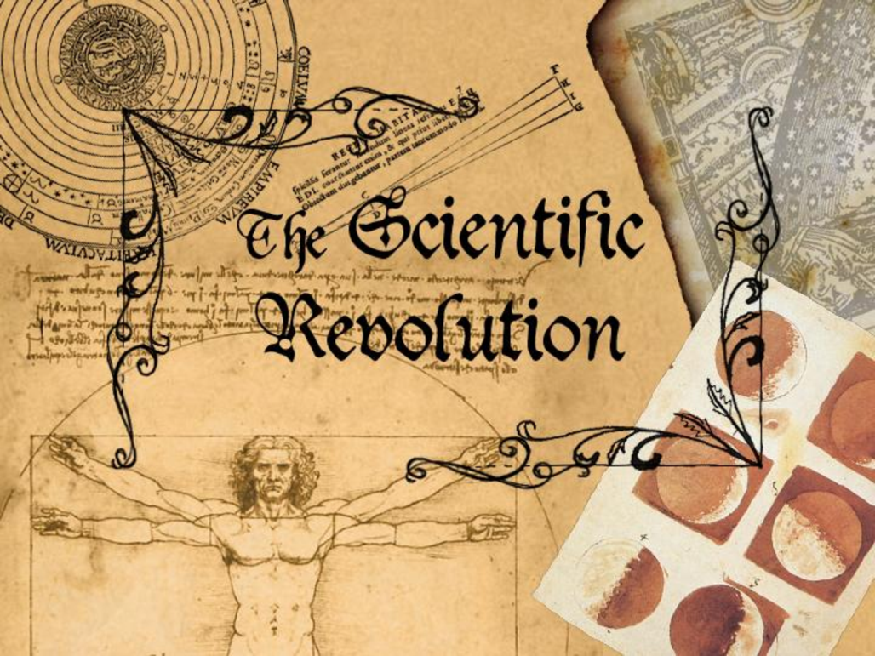
Scientific Revolution
A revolution in human understanding and knowledge about the physical universe

Slide 36
Science Before the Scientific Revolution
The science of the Middle Ages was based in religion and superstition.

Slide 37
Geocentric vs. Heliocentric
Nicolas Copernicus and Galileo Galilee
Aristotle

Slide 38
Galileo Galilee
“Father of Science”
Invented the telescope
Proved the heliocentric theory

Slide 39
The Church vs. Galileo
Galileo was put in front of a Roman Inquisition
His views are punishable by death
Galileo recants

Slide 40
The Scientific Method

Slide 41
Creators of Scientific Method: Sir Francis Bacon and René Descartes

Slide 42
Sir Francis Bacon
Gain knowledge through experimentation
Observing
Measuring
Explaining
Verifying

Slide 43
Rene Descartes
French scientist
“Cogito ergo sum”
Emphasis on reason as source of all knowledge

Slide 44
Johannes Kepler
Disagreed with Copernicus theory that planets moved in circular motion
Claimed that planets moved in an elliptical motion

Slide 45
Sir Isaac Newton
The universe was like a large clock that operated by a consistent set of rules
Gravity effects all objects in the universe
Developed calculus in order to predict the effects of gravity.

Slide 46
The mechanisms of the Human Heart
Henry Harvey
Based off of the work of Andreas Vesalius
Harvey explained the functions of the human heart

Slide 47
The Periodic Table of Elements

Slide 49
The Enlightenment The Age of Reason

Slide 50
Thomas Hobbes
Believed that people were naturally selfish and greedy
Social Contract
People needed government in order to have order
Best form of government- Absolute Monarchy

Slide 51
John Locke
Believed that people were naturally happy, tolerant and reasonable
Natural rights of people
Life
Liberty
Property

Slide 52
Jean-Jacques Rousseau
Believed that people were born good
Society corrupted people
Government benefit everyone and not a select few
All people are created equally

Slide 53
Baron de Montesquieu
Argued that the best form of government included a separation of powers
System of checks and balances
Wrote The Spirit of Laws

Slide 54
Adam Smith
Used reason to analyze economic systems
Wrote The Wealth of Nations
Promoted laissez-faire economics
Economic system that worked without government regulation

Slide 55
The American Revolution

Slide 56
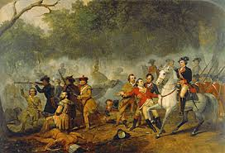
Causes for the American Revolution
The French and Indian War

Slide 57
The Enlightenment

Slide 58
“No taxation without Representation”

Slide 59
The American Revolution
Battle of Lexington and Concord
Fought on April 19, 1775
Province of Massachusetts Bay
Mark the start of the Revolutionary War

Slide 60
Declaration of Independence
“We hold these truths to be self-evident, that all men are created equal, that they are endowed by their Creator with certain unalienable Rights, that among these are Life, Liberty and the pursuit of Happiness.--That to secure these rights, Governments are instituted among Men, deriving their just powers from the consent of the governed…”
~Declaration of Independence, July 4th, 1776

Slide 61
Declaration of Independence
Was printed on July 4, 1776
Drafted by a committee of 5 from the second Continental Congress

Slide 62
Treaty of Paris
Signed on September 3, 1783
Recognized the United States as an independent nation
Negotiators: John Adams, Benjamin Franklin and John Jay.

Slide 63
A new Form of Government
55 Delegates met in Philadelphia to revise the Articles of Confederation
From May 14th to September 17th they considered plans and proposals

Slide 64
A Federal Republic was formed

Slide 65
Bill of Rights gave rights to the people

