Slide 1
Bell Ringer
What are the characteristics of a 15th century explorer?

Slide 2
Standard 5 Exploration
LEQ: What will motivate Europeans to explore uncharted territories?

Slide 3
Reasons for Coming to the New World
Glory and Fame
Gold/Resources
Spread Christianity

Slide 5
Marco Polo

Slide 6
Interactive Map
http://www.eduplace.com/kids/socsci/books/applications/imaps/maps/g2_u5/index.html

Slide 7
Advances in Technology
Caravel: a light, fast sailing ship.
Notes:
Compass, lateen sails.

Slide 8
Advances in Technology
Astrolabe- allowed navigators to calculate their location based on the position of the sun and stars in relation to the horizon.

Slide 9
Advances in Technology
Magnetic Compass: let sailors know at any time which direction was north.

Slide 10
Pause… Mini Activity
What motivated Europeans to explore?
Are these the same motivations that spur individuals to explore?
What technologies helped the Europeans explore?
What technologies help us to explore new areas today?

Slide 11
Explorers
Are you ready for exploration?????

Slide 12
Portugal
Henry the Navigator: patron of those who wished to explore.
His goal was to find a route around Africa to India.

Slide 13
Now Let’s See It!
https://www.youtube.com/watch?v=9y4PIel81kc

Slide 14
Portugal
Bartolomeo Dias: in 1488 he was the first European to sail around the southern tip of Africa.

Slide 15
Now Let’s See It!
https://www.youtube.com/watch?v=oHfBf18HwX8 (stop at 2:46)

Slide 16
Portugal
Vasco de Gama- sailed all the way from Portugal to India (10 month journey)

Slide 17
Now Let’s See It!
https://www.youtube.com/watch?v=oFIyuYPP6PE

Slide 18
Spain- Christopher Columbus
King Ferdinand and Queen Isabella of Spain agree to pay for Columbus’s voyage

Slide 19
Spain- Christopher Columbus

Slide 20
Predictions
How will life change for Europeans after Columbus’s journeys?
How will life change for the people in Asia after his journeys?
How will life change for the people of the Americas after his journeys?

Slide 21
Let’s Put History on Trial
https://www.youtube.com/watch?v=GD3dgiDreGc

Slide 22
Bell Ringer
Do you agree or disagree with this statement: “The Age of Exploration could not have occurred without the Protestant Reformation”? Provide two sentences to support your answers.

Slide 23
Spain- Amerigo Vespucci
Sailed along the coast of South America and concluded that it was not Asia but a new land.

Slide 24
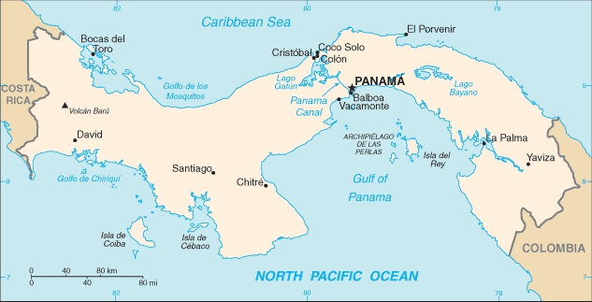
Spain- Vasco Nunez Balboa
First European to cross the Isthmus of Panama

Slide 25
Spain- Ferdinand Magellan
http://www.the-map-as-history.com/demos/tome10/14-magellan_demo.php

Slide 26
Spain- Ferdinand Magellan

Slide 27
Ferdinand Magellan
Portuguese navigator; his ships were the first to circumnavigate the globe.

Slide 28
https://www.youtube.com/watch?v=Y94s85-Crew

Slide 29
English- Sir Francis Drake

Slide 30
English- Sir Francis Drake
He rounded the tip of South America and explored the west coast. He was the second man to circumnavigate the globe.

Slide 31
French- Jacques Cartier
Searched for Northwest passage
Explored present day Canada

Slide 32
Dutch- Henry Hudson

Slide 33
Dutch- Henry Hudson
English navigator; sailed for the Dutch East India Company and discovered the Hudson River in present-day New York.

Slide 34
https://www.youtube.com/watch?v=wuk21ciiZ6U

Slide 35
I Am Poem
I am an explorer.
I wonder…
I hear…
I see…
I am an explorer.
I pretend…
I feel…
I touch…
I worry…
I cry…
I am an explorer.
I understand…
I say…
I dream…
I try…
I hope…
I am an explorer.

Slide 36
2. Conquest and Colonies

Slide 37
Bell Ringer
List two achievements of the Aztec civilization.

Slide 38
LEQ: Why did the Portuguese and Spanish utilize harsh methods of colonization?

Slide 39
Spain in the Caribbean
Encomienda System- a colonist was given a certain amount of land and a number of Native Americans to work the land for him.

Slide 40
Hernan Cortes
Defeated the Aztec Empire

Slide 41
Francisco Pizarro
Spanish conquistador who killed Inca leader, Atahulpa
Viceroys- officials who ruled a large area in the new world in the Spanish king’s name
Notes:
Pizarro and Atalupha

Slide 42
Mini Activity
Open your textbook to page 478. Read “The Treatment of Native Americans”
Answer questions 1-2
Be prepared to discuss your answers
Answer in your notes

Slide 43
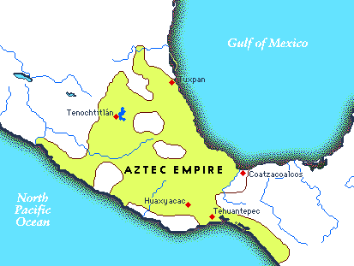
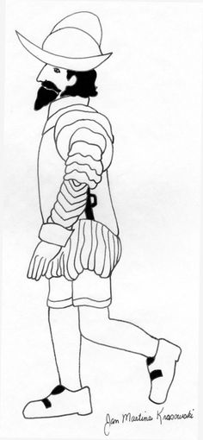
Who-What-When-Where-Why Poetry
Who: Hernan Cortes
What:
Where:
When :
Why?

Slide 44
Treaty de Tordesillas

Slide 45
Treaty of Tordesillas
Drew an imaginary line through the Atlantic. Everything to the west of this line, including most of the then un-discovered America, belonged to Spain. Everything east would be Portuguese.

Slide 46
French in Canada

Slide 47
New France
Hoped to find gold
Found foxes, lynx, otter and rivers with an abundance of fish

Slide 48
English in Americas
Jamestown- First permanent colony (1607)
Pilgrims (1620)

Slide 49
French and Indian War
Causes:
English tried to settle on land that France had claimed
Native American groups allied with each other to fight their opponents

Slide 50
Effects:
The French lost nearly all of their territory in North America
Great Britain amassed huge debts

Slide 51
HW: Acrostic
C
O
L
O
N
Y
Example:
Football
Autumn
Look! A pumpkin!
Leaves are falling…

Slide 52
https://www.youtube.com/watch?v=Yer7OfHyynU

