Slide 1
Sub-Saharan Africa

Slide 2
Islam Spreads
Spread Islam, Arabic language, and the cultivation of cotton, sugar and citrus crops.

Slide 3
North Africa- Berbers
Group of people in North Africa who converted to Islam during the Umayyad dynasty

Slide 4
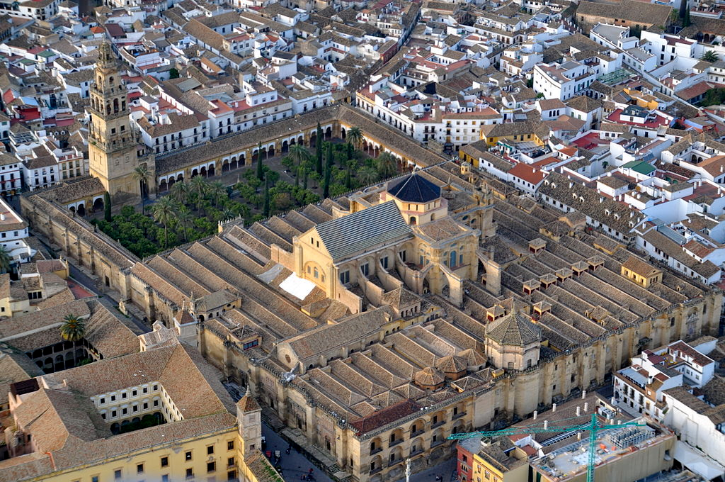
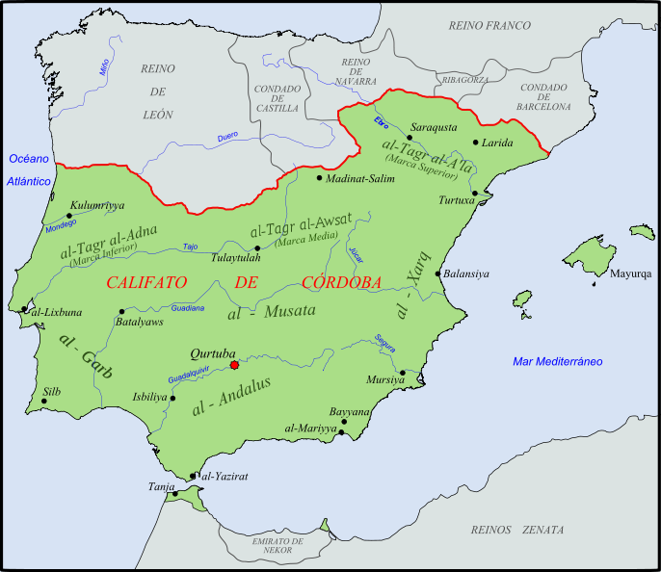
Cordova
Notes:
Abd-ar-Rahman I became Emir of Córdoba in 756 after six years in exile after the Umayyads lost the position of Caliph inDamascus to the Abbasids in 750. Intent on regaining power, he defeated the existing Islamic rulers of the area and united various local fiefdoms into an emirate.^{[4]} Raids then increased the emirate's size; the first to go as far as Corsica occurred in 806.
The emirate's rulers used the title "emir" or "sultan" until the 10th century, when Abd-ar-Rahman III faced a threatened invasion by the Fatimids (a rival Islamic empire based in Cairo). Since the invading Fatimids claimed the caliphate in opposition to the generally recognized Abbasid Caliph of Baghdad, Abd-ar-Rahman III claimed the title of caliph himself.^{[5]} Even after repulsing the Fatimids, Abd-ar-Rahman III kept the more prestigious title.^{[6]} Although his position as caliph was not accepted outside of al-Andalus and its North African affiliates, internally the Spanish Umayyads considered themselves as closer to Muhammad, and thus more legitimate, than the Abbasids.

Slide 5
Sub Saharan Africa
Sub-Saharan Africa developed along difference lines than northern Africa
Bantu:
  By 1000 CE they had migrated across most of sub-Saharan Africa

Slide 6
Bantu
Iron metallurgy skills
The importation of bananas to Africa from Asia (via Madagascar)

Slide 7
Bantu
Although united by basic language and religious commonalities, these societies were extremely diverse.

Slide 8
Bantu
Set up stateless societies
  Kinship and family unites provide social controls at a very local level
  Kongo-14th century

Slide 9
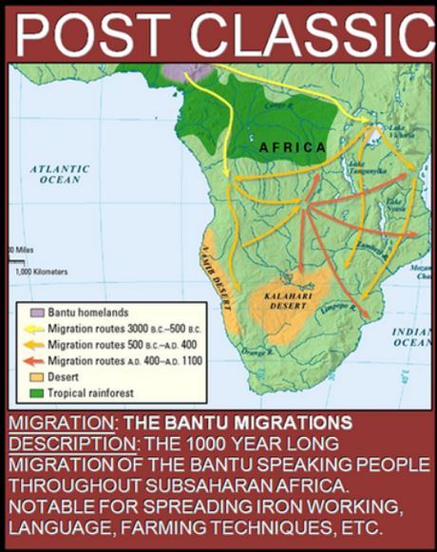

Slide 10
Short clip
https://youtu.be/ohB416-S4nA
GGS Bantu and Ancient Africa

Slide 11
Bantu Religion
Basic African religion before Islam:
  Animism (belief that spirits inhabited objects), ancestral worship and one supreme god reigned over all others.

Slide 12
Bantu Religion
When Africans learned to domesticate camels, the Sudanic states were able to make trade with northern Africa and sub-Saharan Africa
  And along with trade… came Islam
Notes:
(especially in former systems of classification) of or relating to aresidual category of African languages including most of the non-Bantu and non-Hamitic languages of northern and central Africa:most now reclassified as part of the Niger-Congo subfamily.
Caravanserai

Slide 13
Effects of Islam on Sub-Saharan Africa
Strengthened the notions of kingship, uniting political authority, thus only the kings and powerful members of the upper wealthy class converted
Notes:
Tie in comparison of South Asia Islam and Sub-Saharan Islam

Slide 14
Mini Activity

Slide 15
Effects of Islam on Sub-Saharan Africa
Facilitated trade
  Islam brought its concepts of the prestige of merchants, legal system and trade laws

Slide 16
Effects of Islam in sub-Saharan Africa
Slave trade increased
  Islamic law approves the enslavement of non-Muslims and views it as a path to conversion
  Women- Harems, children for labor
Notes:
Persia influence, head dress and reverence for leader (Mesopotamia influence)

Slide 17
Effects of Islam in sub-Saharan Africa
Blended with African animistic religion
Varying degrees of Islam influence
  African women had higher positions within society relative to other societies at this time
  Islam did not alter the status of women and drive them into harsh submission to men

Slide 18
Ghana
Controlled gold across Sahara
Replaced by Mali
  Mansa Musa
  Griot- story teller
  Timbuktu
    Center of Islamic scholarship, trade
Notes:
Mali- Today Chad and Niger

Slide 19
https://www.youtube.com/watch?v=jvnU0v6hcUo

Slide 20
Songai
Empire
Trading Center
Sonni Ali- powerful emperor
Notes:
Songhai empire, also spelled Songhay, great trading state of West Africa (fl. 15th–16th century), centred on the middle reaches of the Niger River in what is now central Mali and eventually extending west to the Atlantic coast and east into Niger and Nigeria.

Slide 21
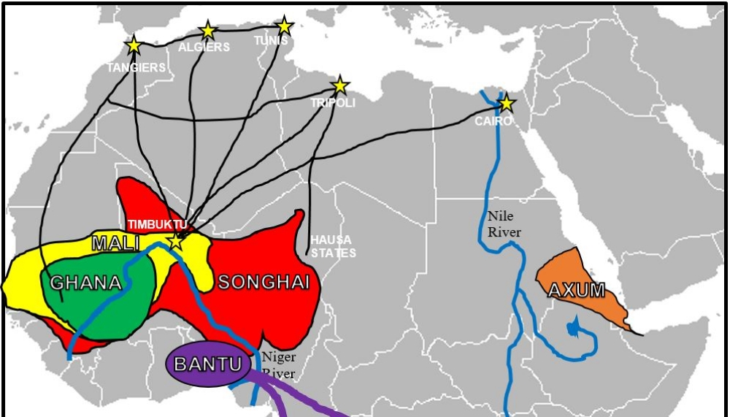

Slide 22
Swahili Coast Cities
Swahili is a combination of Bantu and Arabic – a syncretic language
Mogadishu
Mombasa
Mozambique
Kilwa

Slide 23
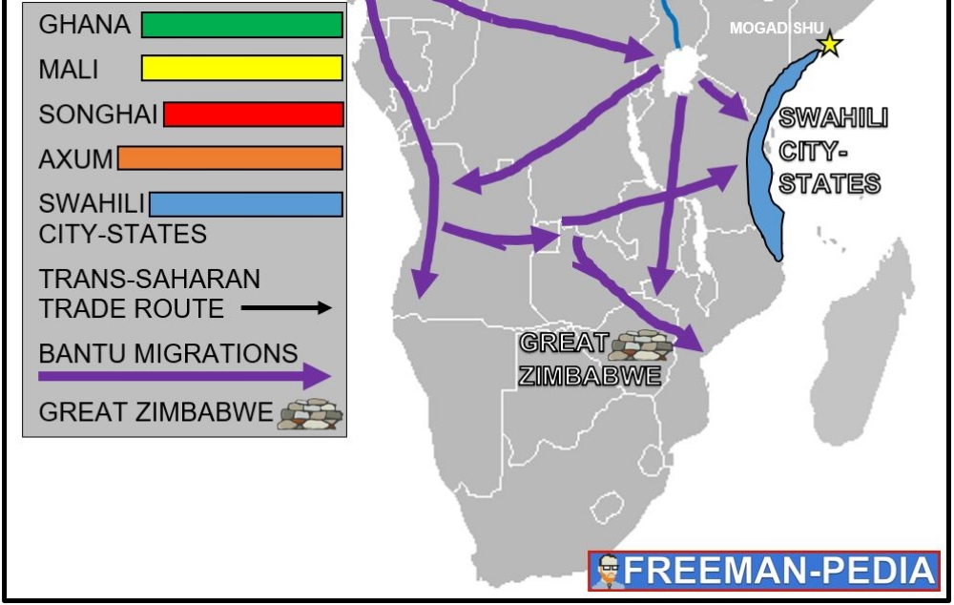

Slide 24
Ibn Battuta
Mankind story of all of us- first 11 minutes

