Slide 1
The American Revolution
American Revolution
  Declaration of Independence (5.3.I.D.)
  American Revolution as Independence rebellion (5.3.III.B.)
  Liberalism as political ideology (5.3.IV.A.)

Slide 2
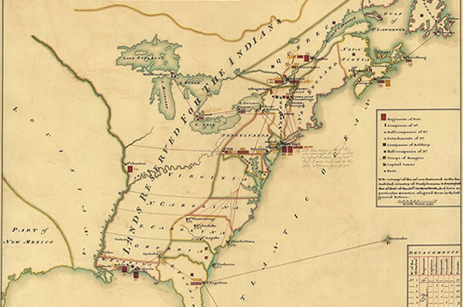

Slide 3
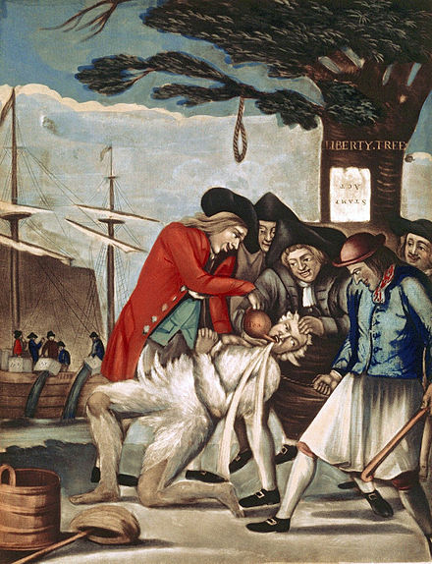

Slide 4
You tell me… what are some causes of the American Revolution?

Slide 5
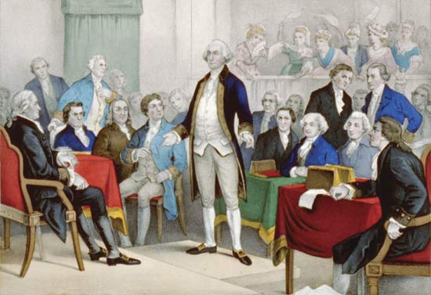
Course of the War- Continental Congress

Slide 6
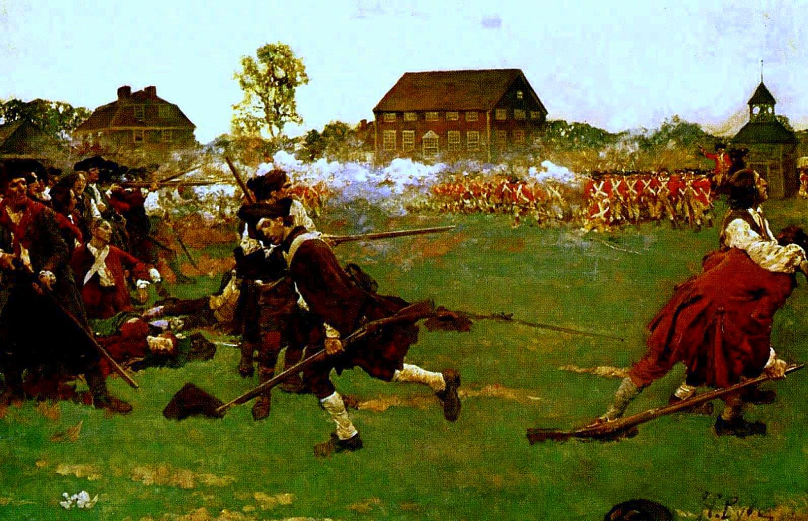
Course of the War
Began in 1775
Treaty of Paris signed in 1783

Slide 7
Articles of Confederation
Why didn’t they work?

Slide 8
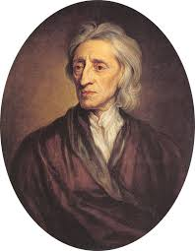
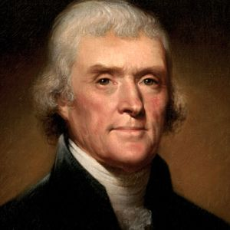
Liberalism as Political Ideology

Slide 9
Thanking the Veterans
https://www.youtube.com/watch?v=w1gde9Q0U7k

