Slide 1
The Atlantic World and Global Trade

Slide 5
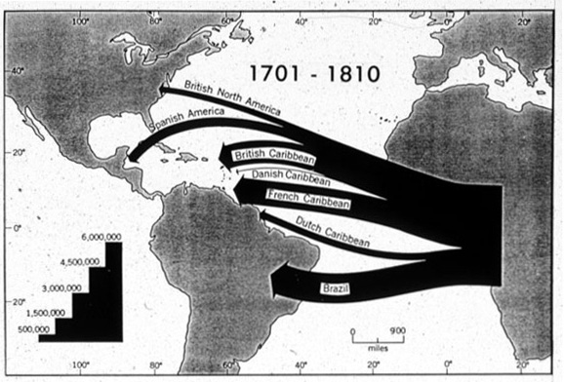

Slide 7
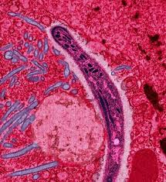
Columbian Exchange
Germs

Slide 8
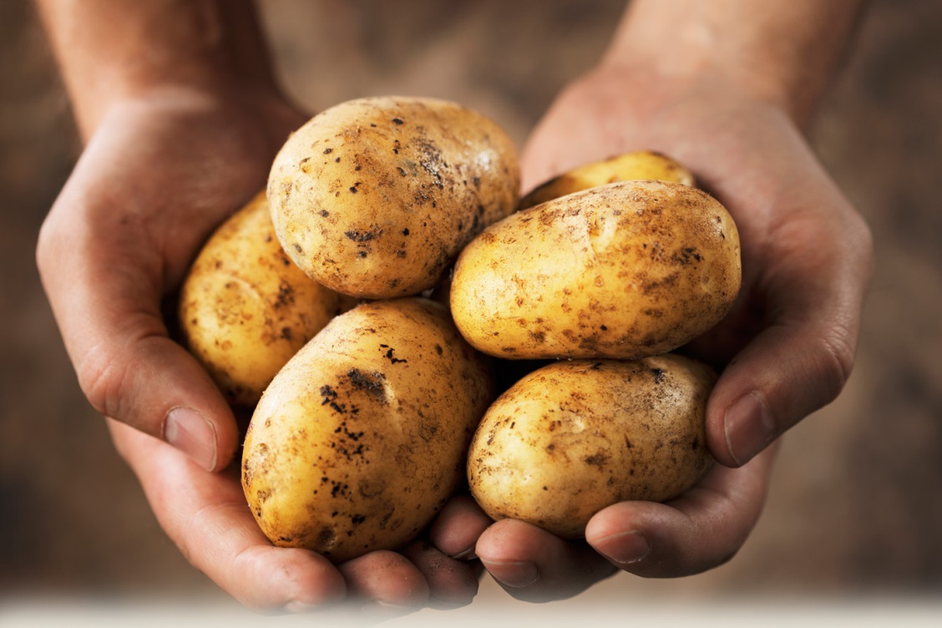
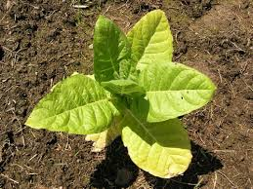
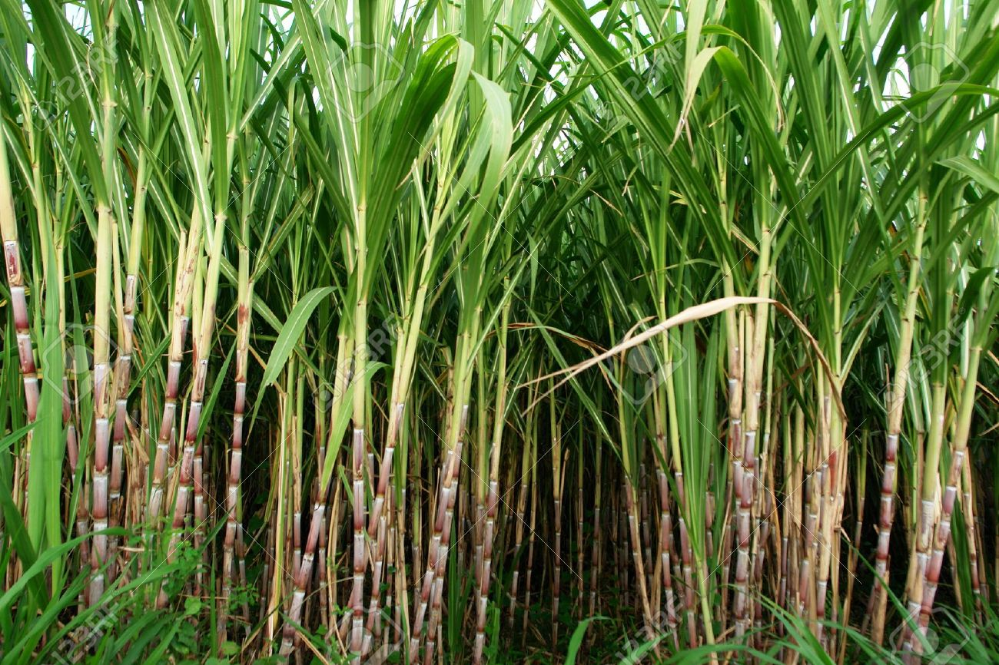
Columbian Exchange
Agriculture

Slide 9
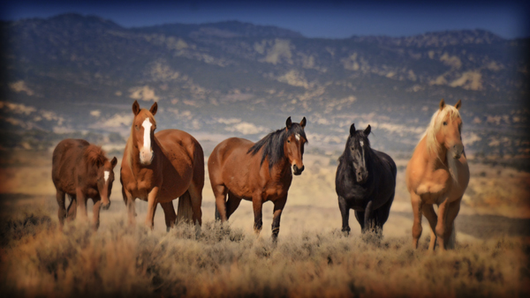
Columbian Exchange
Animals

Slide 10
Environmental Impacts
Timber for boats
Single cash crop
Erosion and flooding

Slide 11
Video clip
https://www.youtube.com/watch?v=PUl7ZbRX0SU

Slide 12
The spread of religion in this era led to rich syncretic blends of religious symbolism and beliefs
Virgin of Guadalupe

Slide 13
Pesos de Ocho

Slide 14
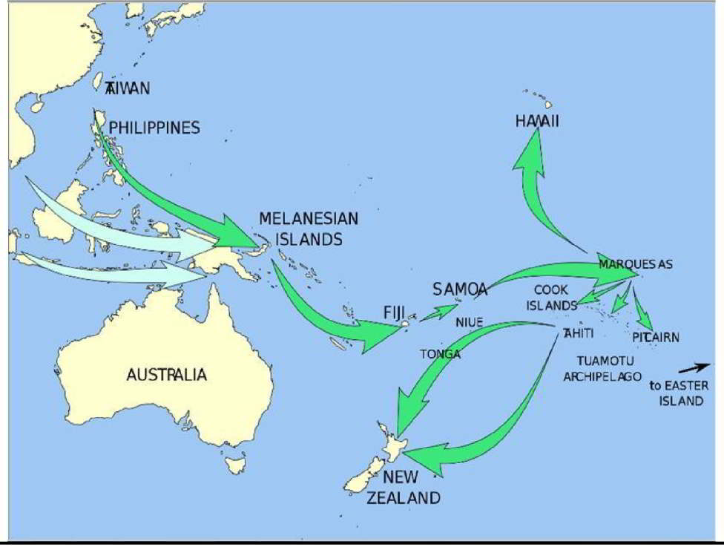
Continuity- Oceania and Polynesia as a community of trade and communication

