Slide 1
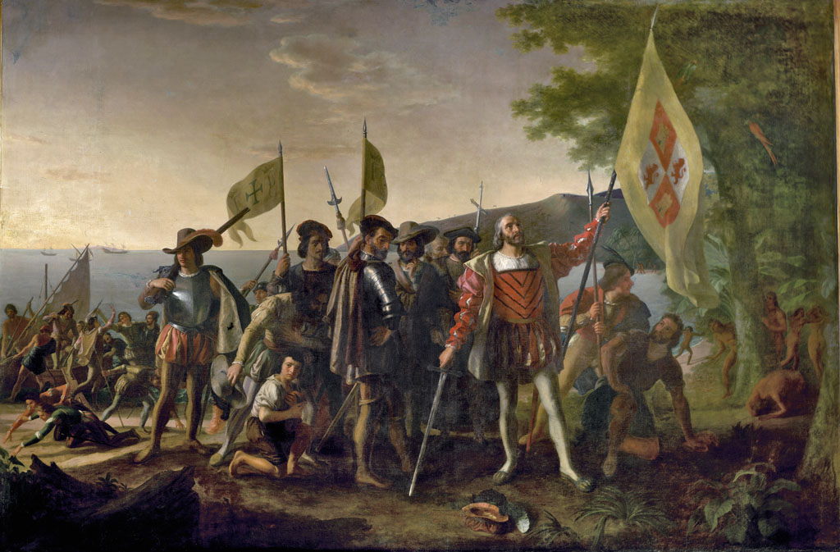
LEQ: What is the Columbian Exchange and how will it change Earth?

Slide 2
Columbian Exchange
The widespread exchange of plants, animals and diseases between the Americas and Africa, Europe, and Asia.

Slide 3
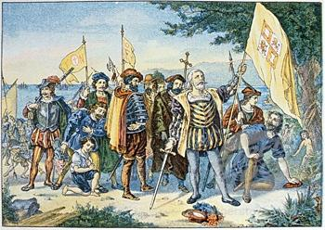
Food and Goods

Slide 4
From the Americas
Cashews
Vanilla
Strawberries
Chocolate
Sweet potatoes
Tobacco

Slide 5
From Afroeurasia
Garlic
Lettuce
Black pepper
Sugar
Wheat

Slide 6
Animals

Slide 7
From the Americas
Llamas
Guinea Pigs
Turkeys

Slide 8
From Afroeurasia
Cattle
Chickens
Horses
Mice and rats
Sheep

Slide 9
Diseases

Slide 10
From Afroeurasia
Cholera
Malaria
Measles
Smallpox
Influenza

Slide 11
Video
https://www.youtube.com/watch?v=PUl7ZbRX0SU

Slide 12
Menu Activity
Find a partner
Decide if you two are from the New World (Americas) or the Old World (Africa, Europe, or Asia)
Your first 3 courses and beverage must use ingredients from your home world BEFORE the Columbian Exchange.
Your second meal (also including 3 courses and a beverage) will be AFTER the Columbian Exchange so it can include a diverse variety of ingredients.

Slide 13
Results of the Columbian Exchange

Slide 14
East India Company

Slide 15
Mercantilism

Slide 16
Triangular Trade

Slide 17
Interactive Triangular Trade
http://www.eduplace.com/kids/socsci/books/applications/imaps/maps/g5s_u3/

Slide 18
The Middle Passage

