Slide 1
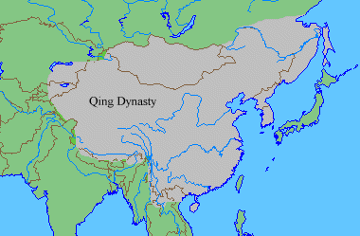
The Manchus

Slide 2
New transoceanic maritime reconnaissance: Zheng He (during Ming) (4.1.III.A.)
What purpose did these voyages serve?
to restore former Chinese preeminence in the world.
Why did the voyages stop?
resources to purifying their empire and protecting them from further nomadic invasions.

Slide 3
Land Empires expand with gunpowder: Manchus (4.3.II.B.)
In 1644 the Manchus entered China and easily drove all the way to Beijing where they defeated the weakened Ming and established their own rule over China, the Qing Dynasty.

Slide 4
New elites, Manchus in China (4.2.II.A.)

Slide 5
Rulers used religion to justify rule: emperor’s performance of Confucian rituals (4.3.I.B.)
Civil Service Exam
Adopted the Chinese title Son of Heaven
Performing Confucian rituals

Slide 6
Treatment of different ethnic and religious groups
Buddhists
Mongols
Respected cultures of minorities
Treatment of Chinese

Slide 7
Bureaucratic elites: civil service bureaucrats
Manchus preserved the highest positions in the government for themselves

Slide 8
Silk Production in China (4.2.I.A.)
The city of Canton

Slide 9
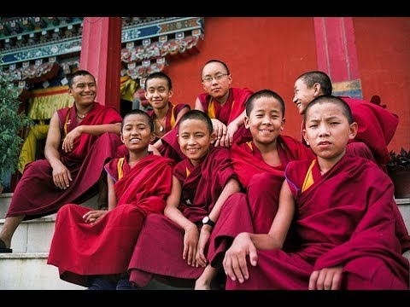
Buddhism spreads in Asia (4.1.VI.B.)
Tibetan Buddhism

Slide 10
Map Activity
Part I of Discussion- Gun Empires

Slide 11
The Mughals

Slide 12
Land Empires expand with gunpowder: Mughals (4.3.II.B.)
Like the Ottomans, they relied on a military elite armed with firearms and created a strong centralized empire organized with a bureaucracy.

Slide 13
Cotton textile production in India, increased peasant labor (4.2.I.A.)
Cotton, which was softer than many fabrics and could be dyed and printed with elaborate patterns, became an extremely popular fad in Europe

Slide 14
Spice trade with Europeans benefits Mughal leaders: Shan Jahan (4.3.I.A.)
The most important beautification of the imperial courts was by emperor Shah Jahan. Jahan ruled during the commercial boom of the Mughal Empire and was flush with silver from the New World used to purchase tons of Indian pepper.

Slide 15
Power of existing elites fluctuated, zamindars (4.2.II.B.)
Acting as local aristocratic landlords, they collected taxes from peasants and sent a set quota to the state.

Slide 16
Rulers used art to display power, Taj Mahal (4.3.I.A.)

Slide 17
Religion in the Mughal Empire: Islam and Sikhism (4.1.VI.A. and D.)
Sikhism, combined Islam’s notion of the oneness of God with the Hindu concept of inclusiveness

Slide 18
Rulers used religion of justify rule, Akbar (4.3.I.B.)
Religious toleration through debates
Akbar married Hindu princesses but did not require them to convert
Hindus given gov’t jobs
Created syncretic religion called “the divine faith”

