Slide 1
Bell Ringer
Analyze one unique characteristic of the Greek city-state Sparta.

Slide 2
LEQ: How does Rome become an empire?

Slide 3
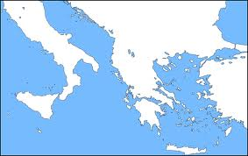
Geography
The Mediterranean Sea and the Alps mountains are two important geographic features.

Slide 4
Government
Rome got rid of their king and created a new type of government: a republic
A republic is a political system in which the citizens of a region elect representatives to run the government.

Slide 5
Problems
Patricians (aristocrats) and the Plebeians (common people) struggled for power within Rome.
The patricians maintained power through a patronage system.
Notes:
Patronage system is a system in which wealthy people provide financial, social or legal support for lower ranking families in return for political backing and loyalty.

Slide 6
Solution: Law of the Twelve Tables
Displayed laws on 12 bronze tablets.
Organized by patricians at the insistence of the plebeians
Dealt with trials, a key issue among the two classes.
Notes:
Forum- central square.

Slide 7
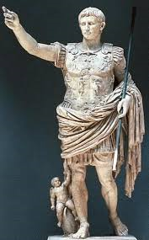
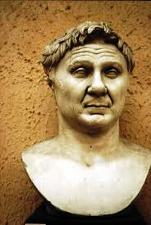
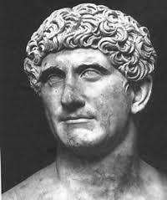
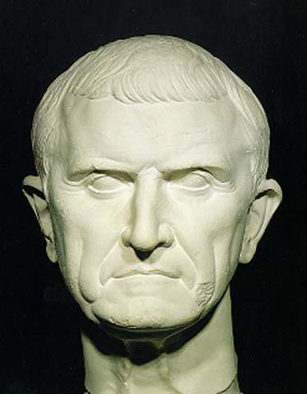
First Triumvirate: Julius Caesar,
Pompey and
Crassus
Second Triumvirate:
Marc Antony and Octavian (to be known later as Augustus.
Rome is now an empire.

Slide 8
Pax Romana- during the reign of Augustus- Stable gov’t and law, trade, and peace!

Slide 9
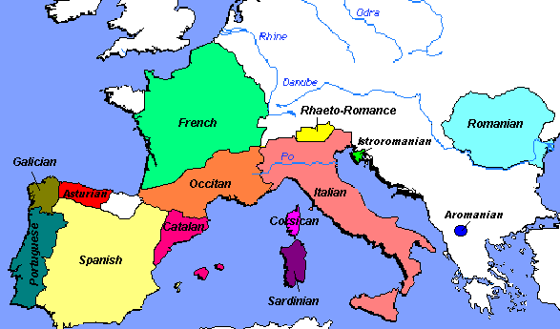
Roman Achievements
Romantic Languages
Aqueducts
Civil Law: a form of law based on a written code of laws.
Notes:
Roman languages develop from latin. Aqueducts help to bring water to cities.

Slide 10
Rome: the birthplace of Christianity

Slide 11
Fall of the Roman Empire
Notes:
20 emperors ruled between 235 and 284

Slide 12
Let’s Review
Achievements:
Religion:
Empire:

Slide 13
Video: Story of Us
Start at 7:28 – Stop at 14:00
On a separate sheet of paper, record three interesting facts about Rome

