Slide 1
LEQ: What are the characteristics of the world’s major religions?

Slide 2
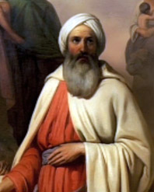
Judaism- Founder/prophet
Abraham

Slide 3
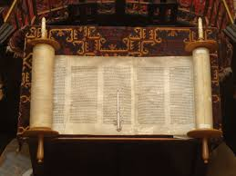
Judaism- Book
Torah

Slide 4
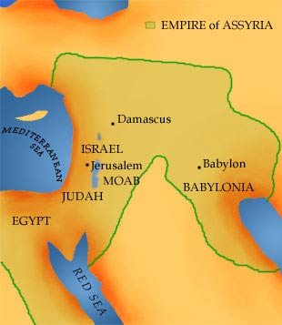
Judaism- Location
Modern day Israel, Jordan and Syria

Slide 5
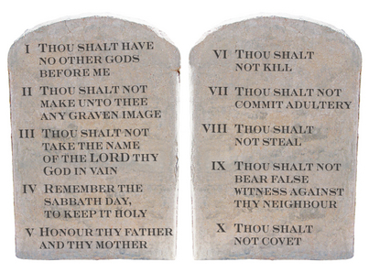
Judaism- Founding Principle
Follow the 10 Commandments
Kosher

Slide 6
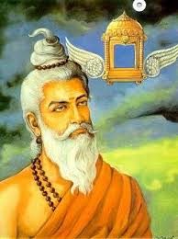
Hinduism- Founder/Prophet
Brahmin Priests

Slide 7
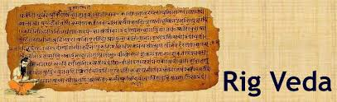
Hinduism- Book
Rig Vedas

Slide 8
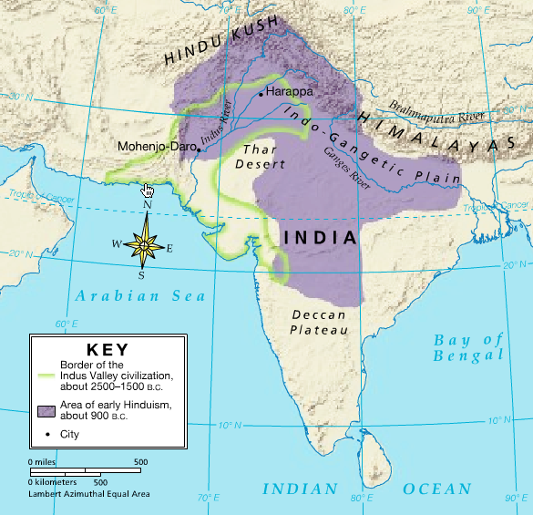
Hinduism- Location of Origin
India

Slide 9
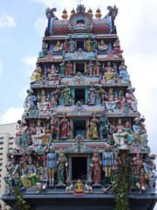
Hinduism- Founding Principle
Dharma- must follow spiritual obligations
Karma- actions shape future
Moksha- liberation
Samsara- Reincarnation

Slide 10
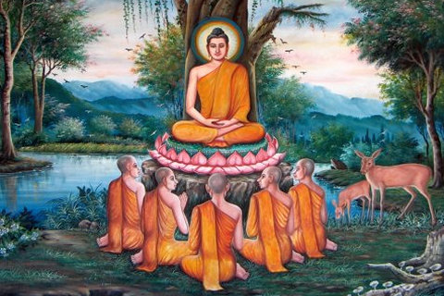
Buddhism- Founder
Siddhartha Gautama or Buddha

Slide 11
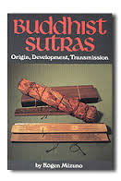
Buddhism- Book
Sutras

Slide 12
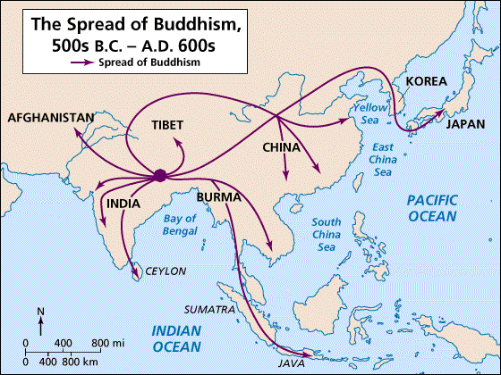
Buddhism- Location of Origin
India

Slide 13
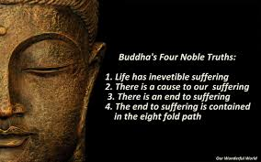
Buddhism-Founding Principle
The Four Noble Truths – guidelines of Buddha’s teachings
Eight Fold Path – the Middle War and part of the 4 Noble Truths.
Nirvana – release from the world; achieve enlightenment.

Slide 14
Now it’s your turn!
You will complete the organizers for Christianity, Islam and Confucianism.
Look at the white board for topic page numbers.
After you have finished your graphic organizer, raise your hand and you can start on part 1 of your study guide.
Remember your Vocabulary Quiz will cover Egypt, Mesopotamia, Ancient Greece and Ancient Rome.

