Slide 1
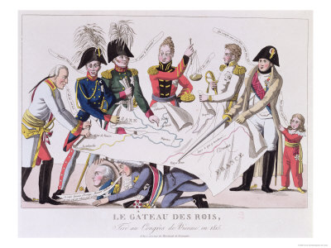
Bell Ringer

Slide 2
Bell Ringer
Take up the White Man’s burden—
Send forth the best ye breed
Go bind your sons to exile
To serve your captives’ need;
To wait, in heavy harness,
On fluttered folk and wild—
Your new-caught, sullen peoples,
Half-devil and half-child.
--Rudyard Kipling, “The White Man’s Burden”
Analyze the phrase “White Man’s Burden.” What is the phrase referring to?

Slide 3
Nationalism
Italy, Germany and Russia

Slide 4
Bell Ringer
List three characteristics of ancient Rome.
Government?
Geography?
Laws?
Economy?
Social Structure

Slide 5
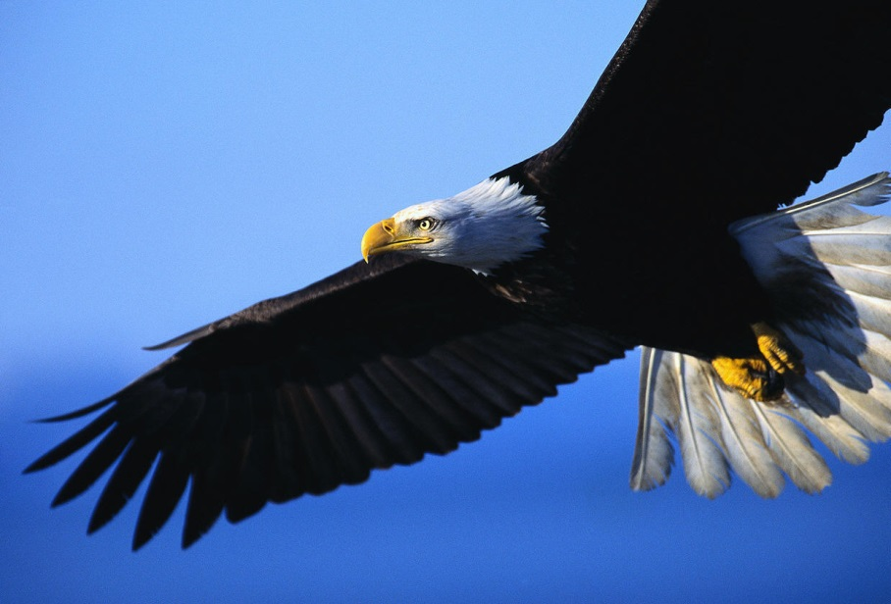
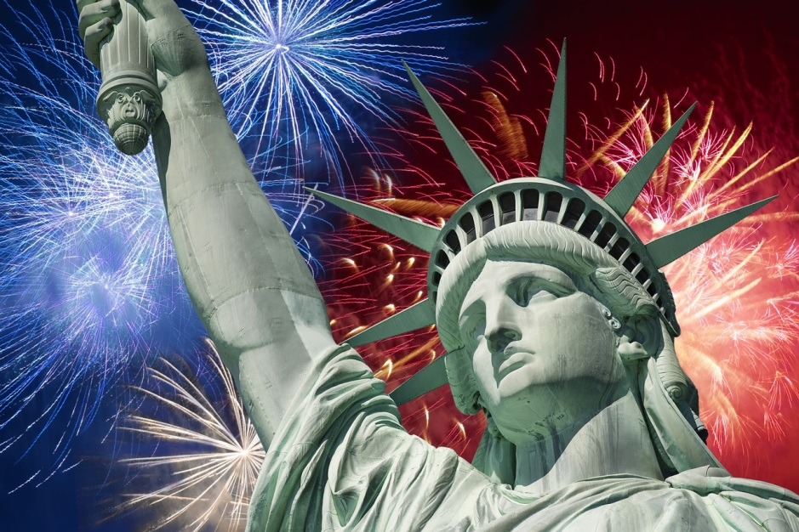
Nationalism for America

Slide 6
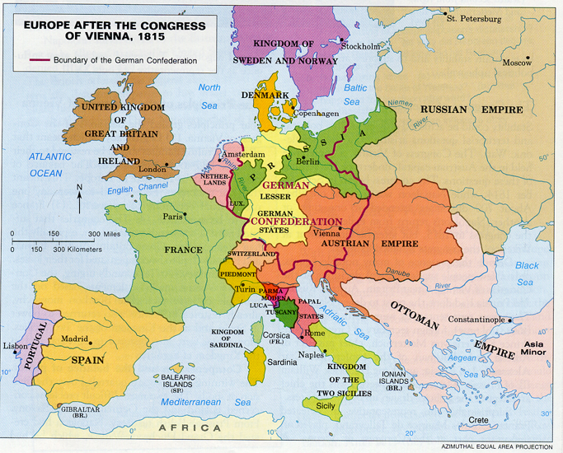

Slide 7
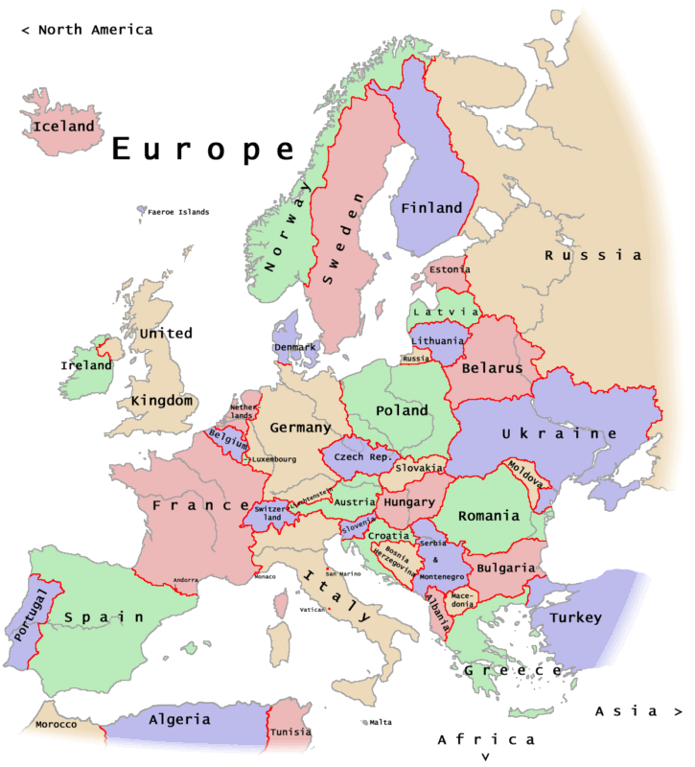

Slide 8
Giuseppe Mazzini
Created group called Young Italy to fight for the cause

Slide 9
Camillio di Cavour
Founded the nationalists newspaper
Prime Minister

Slide 10
Guiseppe Garibaldis
His followers - Red Shirts
Using guerrilla warfare he gained back territory in Italy

Slide 11
Italy
Main figures of Italian unification:
Giuseppe Mazzini- the heart of Italian nationalism.
Camillio di Cavour- the brain of Italian nationalism.
Giuseppe Garibaldi-the sword of Italian nationalism.
How did these three men represent the unification of Italy?

Slide 12
Changes in Italy after unification:
1. Italy was politically united

Slide 13
Changes in Italy after Unification:
2. Widespread poverty, unemployment and high Taxes

Slide 14
Changes in Italy after unification:
3. Large numbers of Italians left Italy for the Americas

Slide 15
Reforms
1. Most males could vote, not just the wealthy elite

Slide 16
Reforms
2. Laws were put into place that limited working hours

Slide 17
Reforms
3. Improved infrastructure
Improved transportation and water system

Slide 18
Reforms
4. The Triple Alliance- Italy, Austria-Hungary and Germany

Slide 19
Reforms
Italy tried to build and empire and gain control over Africa

Slide 20
Video Clip:
Nationalism Powerpoint.pptx
https://www.youtube.com/watch?v=ZiaDnA2Rwok

Slide 21
German Unification
A. Congress of Vienna created 39 separate states that divided Germany. These states had common culture and language- they started a movement to unite.

Slide 22
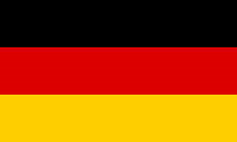
Germany
Steps to unification:
1. Germans revolt against Frederick Wilhelm IV- king of Prussia
2. Otto von Bismarck- Prussia’s Prime Minister. His political philosophy :realpolitik. He defends the unification of Germany through “blood and iron.”
Notes:
who agreed to bring about democratic reforms but later breaks his promises. After the unification of Germany, he is known as the first Kaiser of Germany.

Slide 23
Germany
Steps to unification:
3. Zollverein- a customs union that dismantled tariff barriers between German states.

Slide 24
The Zollverein Leather, salmon, eels and matches, Cows and madder, paper, shears, Ham and cheese and boots and vetches, Wool and soap and yarns and beers; Gingerbread and rags and fennels, Nuts, tobacco, glasses, flax, Leather, salt, lard, dolls and funnels, Radish, whisky, wax; Articles of home consumption, All our thanks are due to you! You have wrought without presumption What no intellect could do; You have made the German Nation Stand united, hand in hand, More than the Confederation Ever did for Fatherland.
~Hoffmann von Fallersleben

Slide 25
Changes in Germany after unification:
1. Germany becomes a federal nation with 25 separate states

Slide 26
Changes in Germany after unification:
2. Otto von Biskmark limits influences of the Catholic Church

Slide 27
Changes in Germany after unification:
3. Germany becomes industrialized

Slide 28
Changes in Germany after unification:
Social reforms for health, old age and disability

Slide 29
Changes in Germany after unification:
4. Germany enters into the Triple Alliance

Slide 30
Video Clip:
https://www.knowmia.com/watch/lesson/5283
https://www.youtube.com/watch?v=3DfnbtRhjS8

Slide 31
Bell Ringer
Analyze one result of German unification.

Slide 32
Events leading to the revolution:
Russians wanted freedom and democracy

Slide 33
Events leading to the revolution:
Czars resisted reform

Slide 34
Decembrists Revolt
Secret society that fought the Czars rule
Gathered at the Winter Palace to refuse alliance to new Czar Nicholas.
Many were killed or many fled to Siberia

Slide 35
Reforms of Alexander II
Freed serfs and gave them land

Slide 36
Reforms of Alexander II
Set up a new judicial system

Slide 37
Reforms of Alexander II
Allowed local governments

Slide 38
Reforms of Alexander II
Reorganized the military

Slide 39
Unrest under Czar Alexander III
He ended the reforms of his father
Due to social unrest, widespread attacks of Jews began to take place
These attacks are called Pogram

Slide 40
Reforms under Nicholas II
Trans-Siberian Railroad- link western Russia with Siberia
Russo-Japanese War- Japan won…

Slide 41
Russia
Military Defeats:
Russia lost the Crimean War in 1855, against Great Britain, France, the Ottoman Empire, and Sardinia.
Russia lost the Russo-Japanese War against Japan, in 1904.
How did these military defeats influence Russian nationalism?

Slide 42
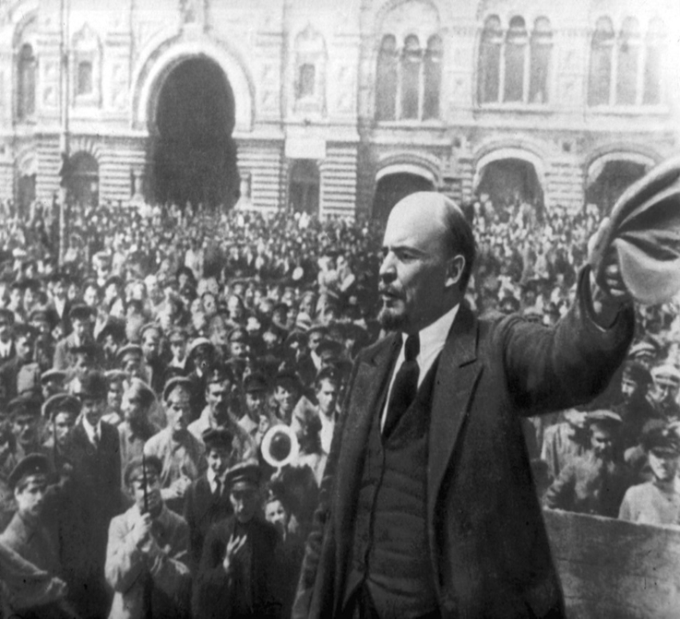
Russia and WWI (complete these notes on back)
Groups called the Bolsheviks, led by Vladimir Lenin, followed the ideas of Communists leader Karl Marx

Slide 43
https://www.youtube.com/watch?v=VxHUeHhdYz0

Slide 44
Created a Socialists Republic
A society with no private property, the state would collectively own and distribute all goods

Slide 45
“All private ownership of land is abolished immediately without compensation. All landowners’ estates and all land belonging to the Crown, to monasteries, church lands with all their livestock and property are transferred to the disposition of the township of Land Committees.”
-Vladimir Lenin, 1917

Slide 46
The Soviet Union- Union of Soviet Socialist Republics

Slide 47
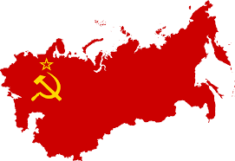
“Peace, Land and Bread!”

Slide 48
Mini Activity- Open book to page 793
Look for green box: Primary Sources, Lenin’s Call to Power
In your notes, answer question 1 and 2

Slide 49
“Having reached the strait, it became necessary to cross it. To have reinstated Sicily in the great Italian family was certainly a glorious achievement. But what then were we, in compliance with diplomacy, to leave our country incomplete and maimed? What of the two Calabria, and Naples, awaiting us with open arms? And the rest of Italy still enslaved by the foreigner and the priest? We were clearly bound to pass the strait, despite the utmost vigilance of the Bourbons and their adherents.” ~Giuseppe Garibaldi

Slide 50
“Oh Sire, we working men and inhabitants of St. Petersburg, our wives, our children and our parents, helpless and aged women and men have come to you our ruler, in search of justice and protection. We are beggars, we are oppressed and overburdened with work, we are insulted, as slaves. The moment has come for us when death would be better than the prolongation of our intolerable suffering. We are seeking here our last salvation. Do not refuse to help your people. Destroy the wall between yourself and your people.”
~Father Gapon, Russia, 1906

Slide 51
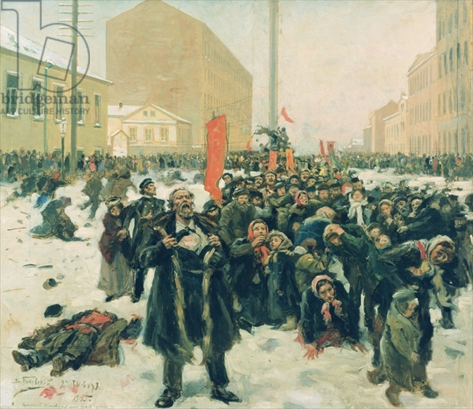
“Death in Snow”
By:
Vladmir
Makovsky

Slide 52
Explain the three most important factors that helped with the unification of Italy and Germany.

Slide 53
Start Up
Take out your Standard 7 Vocabulary List (you received it on Friday)
We are going to review vocabulary terms.

Slide 54
Imperialism

Slide 55
Reasons for Imperialism
European advances in technology

Slide 56
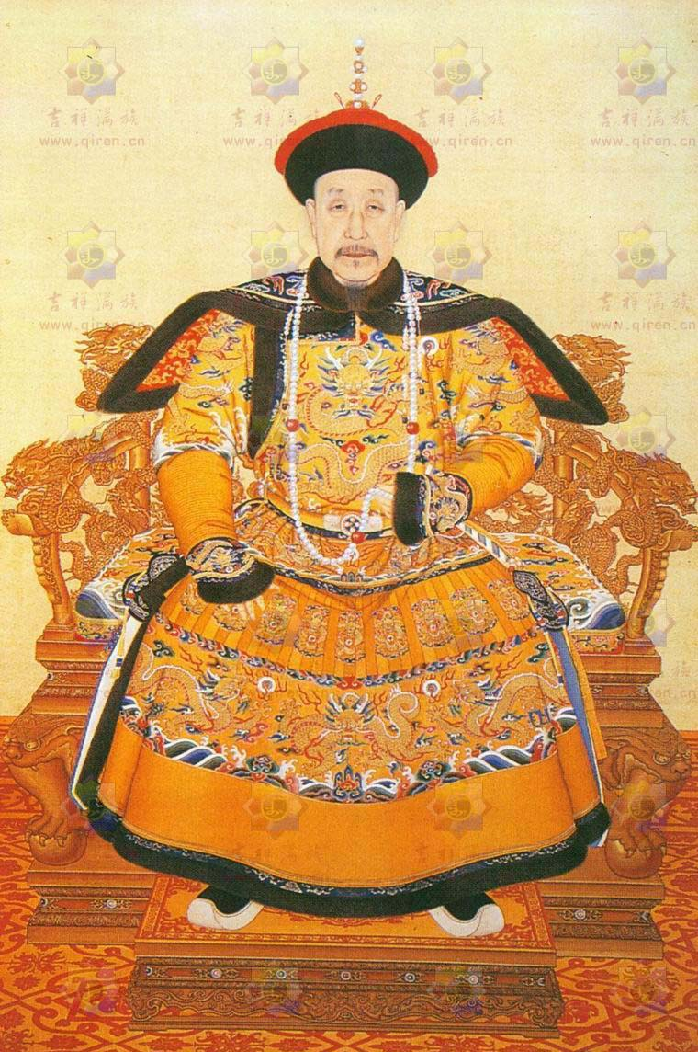
Reasons for Imperialism
Weak empires in Asia and Africa

Slide 57
Reasons for Imperialism
British East India Company swept in with armies and took over control

Slide 58
Reasons for Imperialism

Slide 59
Reasons for Imperialism
Social Darwinism

Slide 60
Rudyard Kipling, The White Man's Burden, 1899
Take up the White Man's burden-- Send forth the best ye breed-- Go bind your sons to exile To serve your captives' need; To wait in heavy harness, On fluttered folk and wild-- Your new-caught, sullen peoples, Half-devil and half-child.

Slide 61
Changes in India:
Language: taught English
Laws: implemented western laws and banned traditional Hindu laws

Slide 62
Sepoy Mutiny
Indian soldiers were forced to bite off the end of ammunition cartridges that were greased with meat fat.

Slide 63
Raj
The era of British rule in India.
Indians had no say in their government.

Slide 64
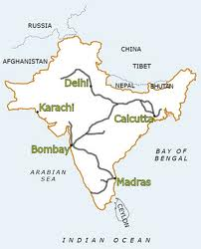
Events that happened during the British rule:

Slide 65
Events that happened during the British Rule:

Slide 66
Events that happened during the British rule:

Slide 67
Indian Nationalism
Indian nationalism boycott British made goods- Swadishi boycotts
Burned British cloth

Slide 68
Out of India and into Africa

Slide 69
Scramble for Africa
Initially Europeans interest in Africa was for the slave trade.

Slide 70
Economic Interests
As a result of the Industrial Revolution, entrepreneurs needed raw materials.

Slide 71
Political Interest
European nations believed that controlling the colonies gave them power and respect.

Slide 72
Cultural Motives
Spread Christianity

Slide 73
European Advancement
Telegraph
Railroads

Slide 74
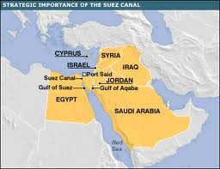
European Advancement
Suez Canal:
Linked the Mediterranean with the Red Sea to shorten the trip to Europe

Slide 75
European Advancement
Berlin Conference:
When European nations claimed territory in Africa they had to notify the other nations, to prevent conflict between nations.

Slide 76
African Resistance: Boer War
British conflict with Dutch settlers, called Boers.
War broke out and the British won by destroying the Boer farms and imprisoning women and children.

Slide 77
https://www.youtube.com/watch?v=E9wO-NoP7h4

Slide 78
Map Activity- Please tape map in notes

